Slide 1
SWEETS AND DRINKS

Slide 2
Sweets Vocabulary
Pie
cookies
Cake
candy
chocolate
pancakes
pudding
cupcakes
ice-cream.

Slide 5
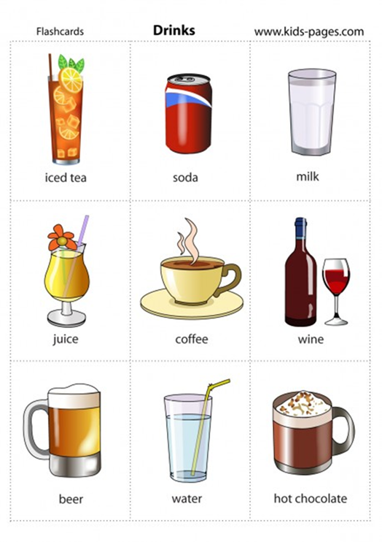
Drink Vocabulary

Slide 6
Listen this song and sing
I Love Sweets":
Sweets, sweets,
I love sweets.
Donuts, ice cream.
Chocolate, candy, pudding, cake.
What’s your favorite sweet.
Sweets, sweets,
I love sweets.
Donuts, ice cream.
Chocolate, candy, pudding, cake.
What’s your favorite sweet.
https://www.youtube.com/watch?v=S2EIktLSb8k

Slide 7
Look, listen and repeat Learn drink Vocabulary: talking flashcards. https://www.youtube.com/watch?v=7abWAvbEE8A Learn sweets Vocabulary. Talking flashcards. https://www.youtube.com/watch?v=oLu0mG8KOPo On your workbooks: Draw, colour and copy the words. Than write your favourite food ( I like/I don’t like)

