Slide 1
Ins. Anna Rullo

Slide 2
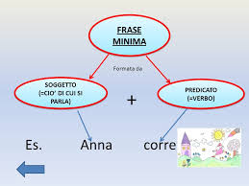

Slide 3
