Slide 1
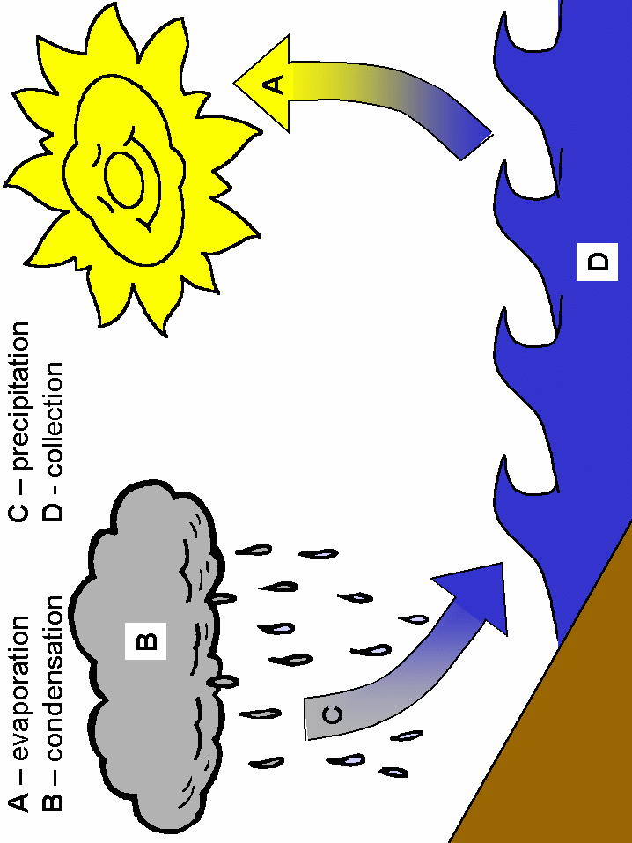

THE WATER CYCLE
IV A RODARI
INGLESE- SCIENZE- ED. CIVICA
INS. PERNA FORTUNATA

Slide 2
KEY WORDS
WATER
RAIN
HAIL
SUN
DROP
FOG
WATER VAPOR
EARTH
SNOW
FOGGY
FROST
EVAPORATION
PRECIPITATION
TRANSPIRATION
CONDENSATION

Slide 3
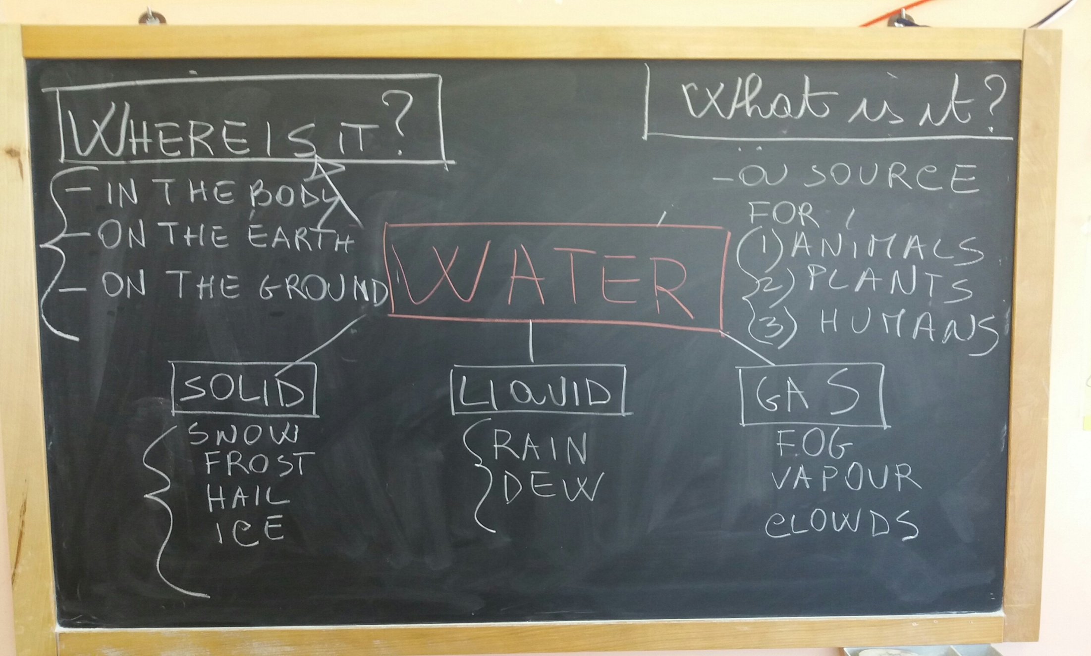
LOOK AND LISTEN
70% of our body is made of water
There are three forms of water:
-solid
-liquid
-gas

Slide 4
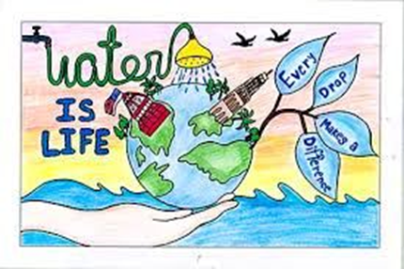
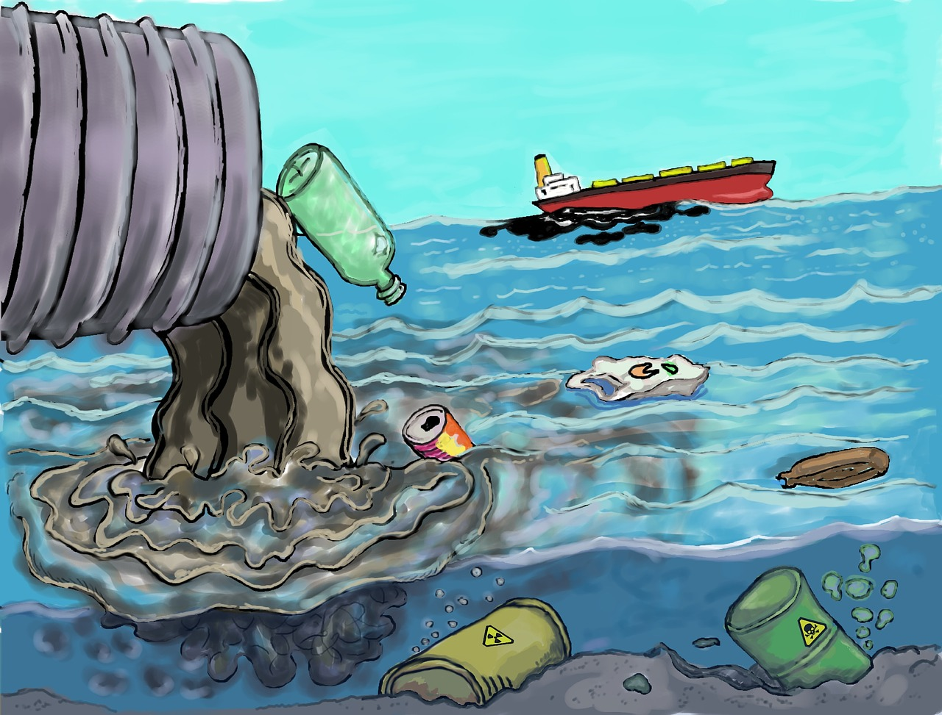
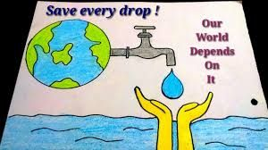
Do not waste water
Do not pollute

Slide 5

Listen and read.Then draw and colour “The story of the raindrop.”
Hi I’m Gocciolina, the rain drop, and this is a story of how I spend my time.

Slide 6
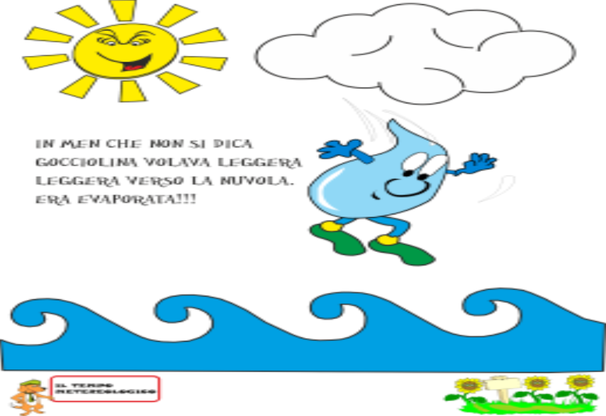
While relaxing in the ocean the sun heats me up and I turn into water vapor during the process of Evaporation. When this happens I go back into the air

Slide 7


Slide 8
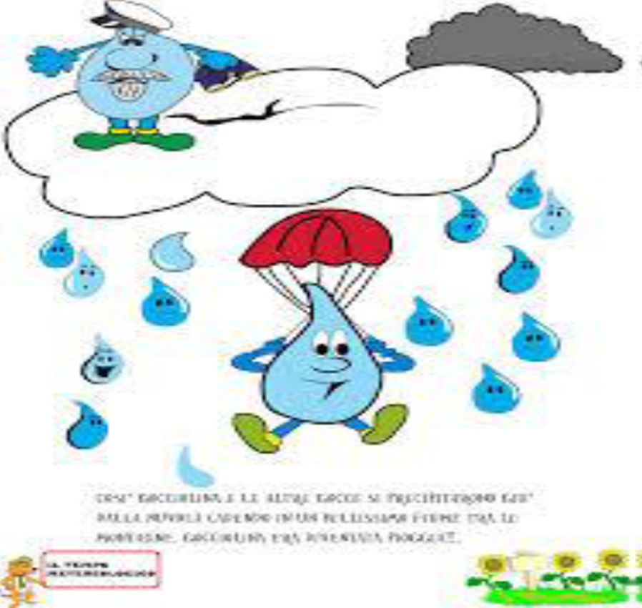
While in the air I get really cold and I turn back into liquid forming clouds. This process is called condensation.

Slide 9
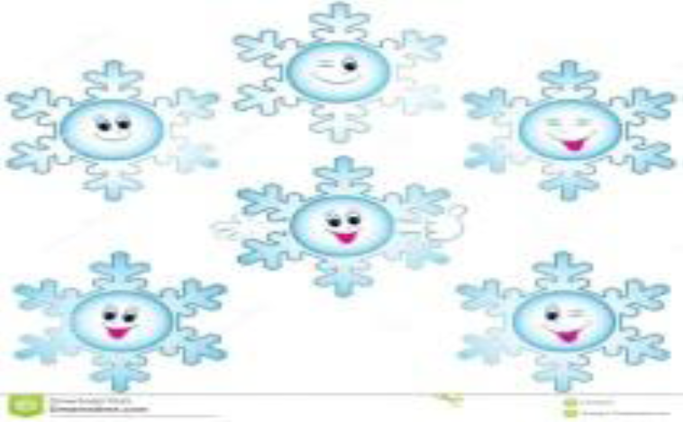
Soon all my friends join me and the cloud gets so full that it can no longer hold us all in. When this happens we head back to Earth. This is the process of precipitation.
Precipitation can fall towards the Earth also as snow, rain, hail, or fog .

Slide 10
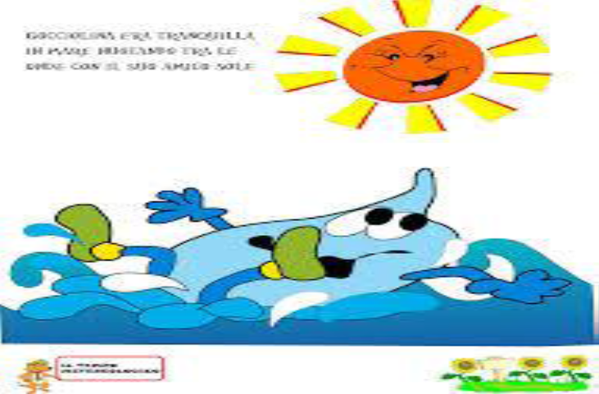
Drops of rain, snowflakes or little drops of fog come back to Earth and the fun starts all over again.

Slide 11
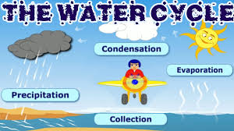
Watch the video

Slide 12
A song “The water cycle” https://www.youtube.com/watch?v=TWb4KlM2vts
Takes the water and moves it
Up and down and all around the Earth Evaporation comes
When the heat from the Sun
Warms up all the groundwater
Then it turns to water vapor
Condensation takes over
It goes up to the clouds
Water vapor cools down
And it changes to a liquid, now
Precipitation happens
When the drops get big
It falls like rain, snow, sleet, and hail upon my head
I know it's the water cycle happening again
Evaporation, condensation, precipitation
The water cycle
Takes the water and moves it
Up and down and all around the Earth

Slide 13
Make a rain cloud
You need: a tray, a jar, water, ice-cubes.
1 Put some water in a jar
2 Cover the jar with a tray of ice-cubes
3 The vapour goes up from the water
4 The vapour meets the cold air from the air and condenses.
You can see a rain cloud

Slide 14
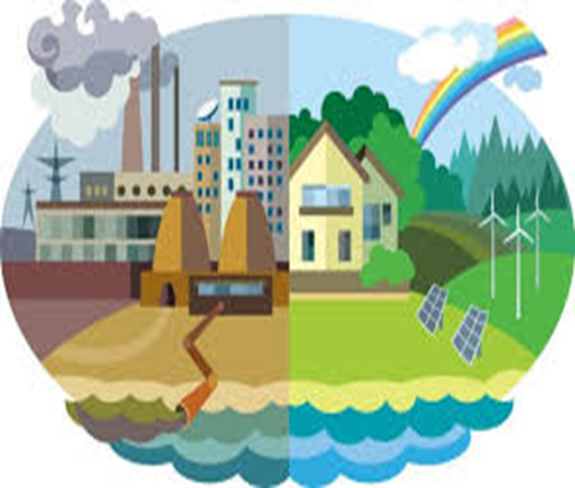
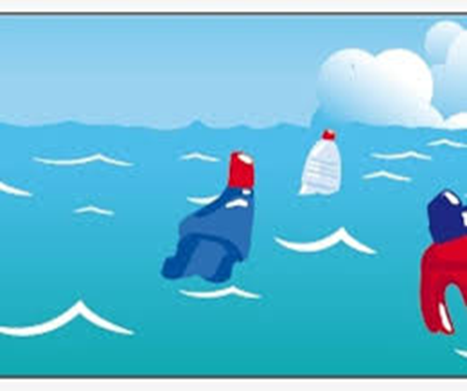
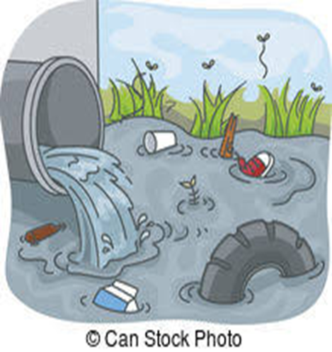
Don’t pollute the rivers, lakes, sea

Slide 15
