Slide 1
La «poesia» del Natale Classe IV F Plesso Fra’ Siciliano Attività trasversale di italiano/arte/musica/ed.fisica/L2
Doc. Pascale Maria Rosaria

Slide 3
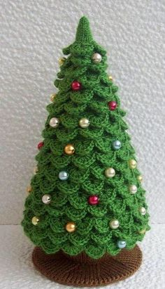
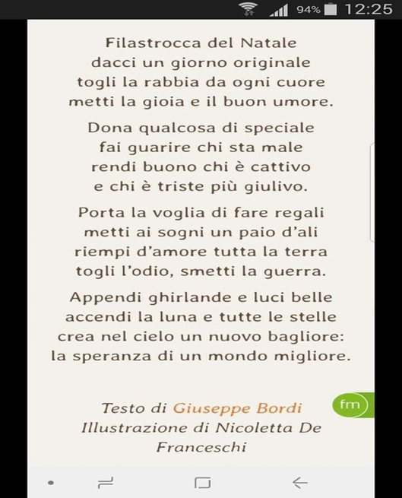

Slide 4
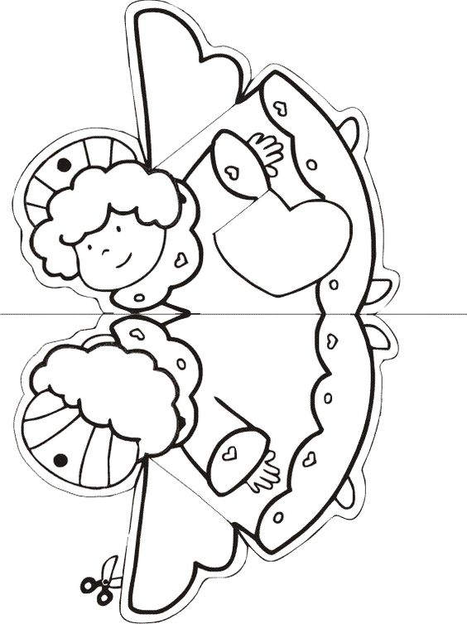

Slide 6
Jingle bells
Dashing through the snow in a one-horse open sleigh, over the fields we go, laughing all the way. Bells on bobtail ring, making spirits bright What fun it is to ride and sing a sleighing song tonight. Jingle bells, jingle bells, jingle all the way. O, what fun it is to ride in a one-horse open sleigh. Jingle bells, jingle bells, jingle all the way. O, what fun it is to ride in a one-horse open sleigh. A day or two ago I thought I’d take a ride, and soon Miss Fannie Bright was seated by my side. The horse was lean and lank, misfortune seemed his lot, he got into a drifted bank and we, we got upsot. Jingle bells, jingle bells, jingle all the way. O, what fun it is to ride in a one-horse open sleigh. Jingle bells, jingle bells, jingle all the way. O, what fun it is to ride in a one-horse open sleigh. Now the ground is white, go it while you’re young, Take the girls tonight and sing this sleighing song. Just get a bobtailed bay, two-forty for his speed, Then hitch him to an open sleigh, and crack! You’ll take the lead. Jingle bells, jingle bells, jingle all the way. O, what fun it is to ride in a one-horse open sleigh. Jingle bells, jingle bells, jingle all the way. O, what fun it is to ride in a one-horse open sleigh

