Slide 1
CLASSE : VE SICILIANO
MATERIA :INGLESE
INS. IACCARINO TIZIANA

Slide 2
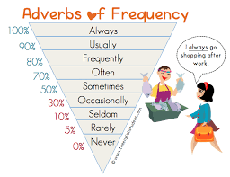
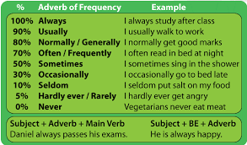
EXAMPLE: I ALWAYS GO SHOPPING AFTER WORK

Slide 3
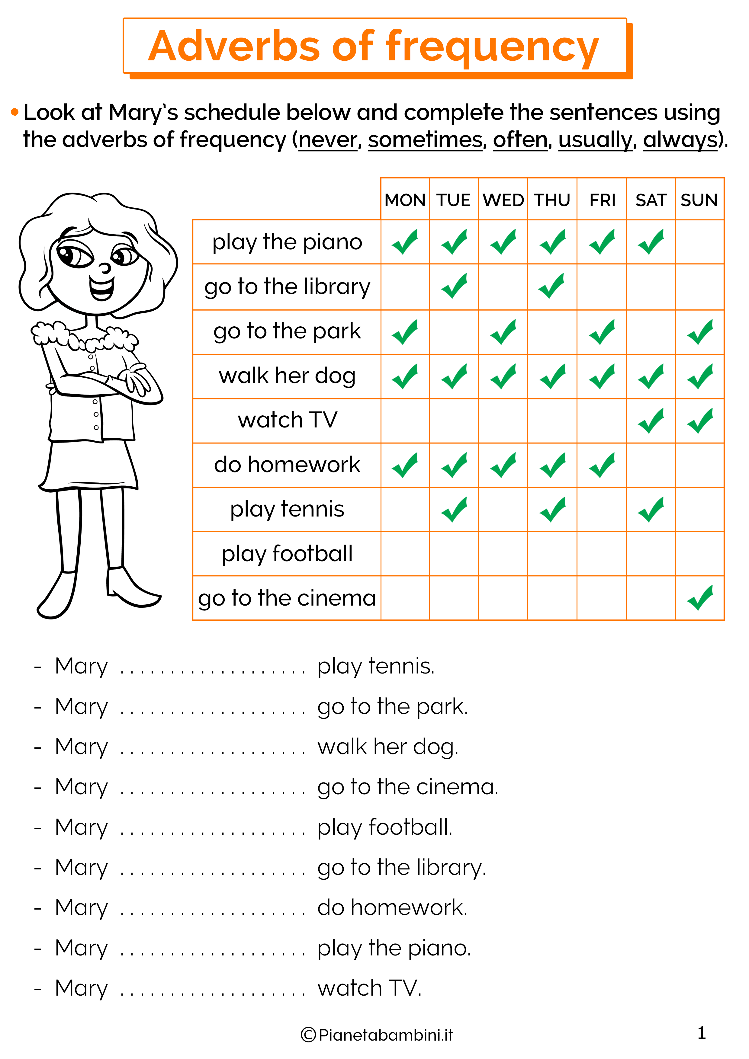
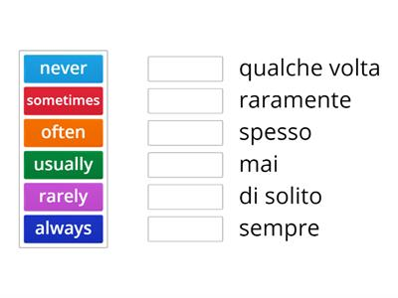

Slide 4
