Slide 1
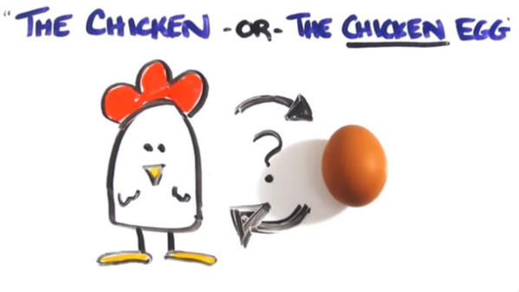
SCIENZE e INGLESE
CLASSI VB VC e VD

Slide 2
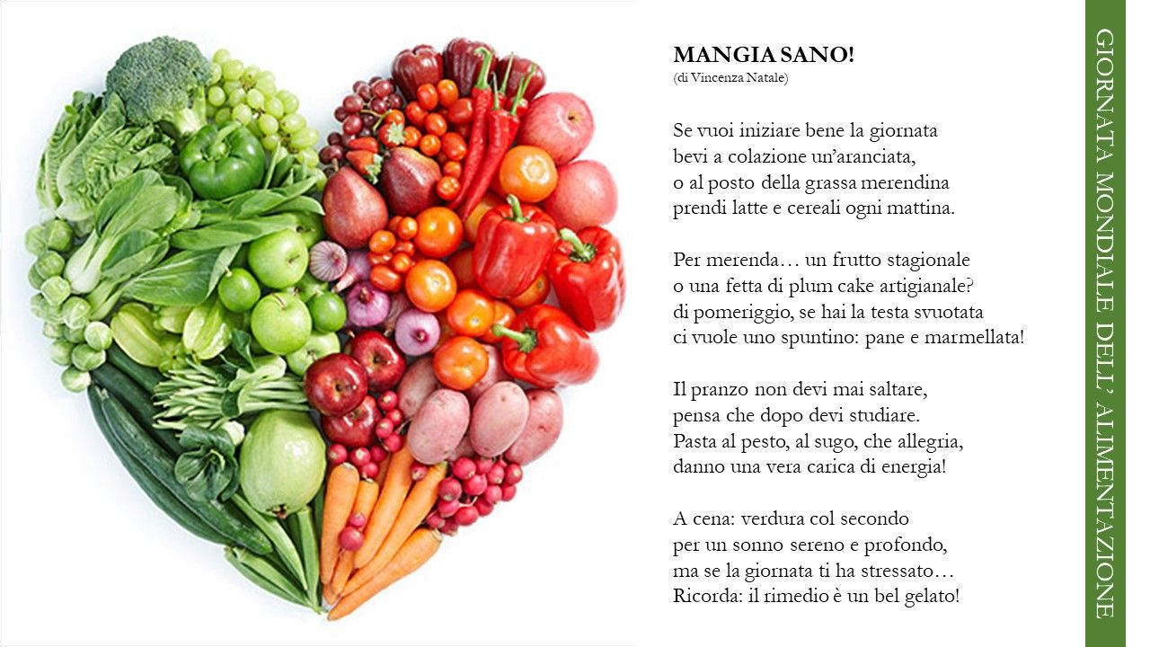
La dieta mediterranea rappresenta una parte fondamentale di tutti noi: sia quella legata alla nostra cultura, al piacere di stare a tavola in compagnia e di cucinare per chi amiamo, sia quella legata al benessere, al modo semplice e intuitivo che abbiamo per usare il cibo come nutrimento efficace per mantenere sano il nostro corpo. I protagonisti della tradizione alimentare mediterranea sono una vasta gamma di ortaggi e di frutti, la pasta, il pane e altri carboidrati complessi derivati da cereali preferibilmente integrali, l’olio extravergine d’oliva, i legumi, le uova e i derivati del latte, oltre a moderate quantità di prodotti animali come il pesce e la carne (in particolare bianca).
Quando invece partecipi ad una festa ??

Slide 3
BIRTHDAYS AROUND THE WORLD
Leanne: Hi! I’m Leanne, from Ireland. When I have a birthday party
we eat a homemade birthday cake decorated with sprinkles.
My mum usually makes it and it’s really good! She puts a coin in the cake and the boy or girl who finds it is the first to play the party games.
At parties we receive colourful crackers. Inside the crackers there is always a small prize.
Aarav: Hello! My name’s Aarav and I’m from India. At birthday parties in India we wear new clothes. We get up very early and get dressed
in new clothes. In the afternoon we eat with our family: we have curry and we eat a dessert called dudh pakh, made with rice, almonds
and pistachios. At school we wear colourful clothes and we give chocolates to all the children in the class.

Slide 4
Birthday Song
Ch. It’s my birthday tomorrow
and what about you?
I was born on the fifth of November
and what about you?
There are twelve months in the calendar
birthday comes just once a year
and now my birthday is here.
Friends are making decorations,
mum is baking a chocolate cake.
Ice cream, sandwiches and sausage rolls,
the birthday party is almost ready
please, don’t miss it at all.
Ch.

Slide 5
SU GINGER
Complete pag. 44 and 45
SU TERRAMARE (scienze)
Studia e completa pag.28

