Slide 1
THE MATERIALS
III E- D CAPOLUOGO
ENGLISH- TECNOLOGY- CIVICS
INS. PERNA FORTUNATA

Slide 2
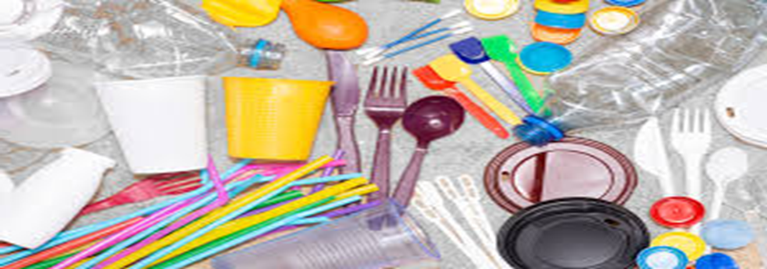
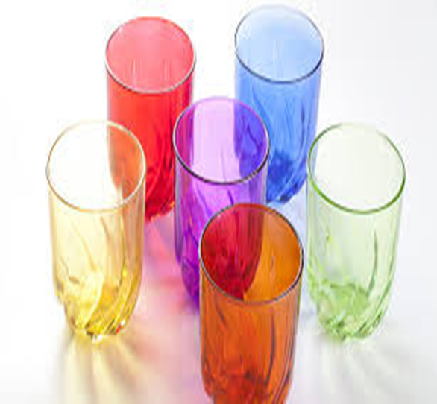
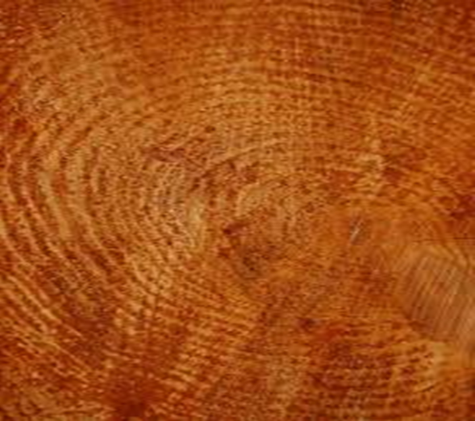
WOOD GLASS

Slide 3
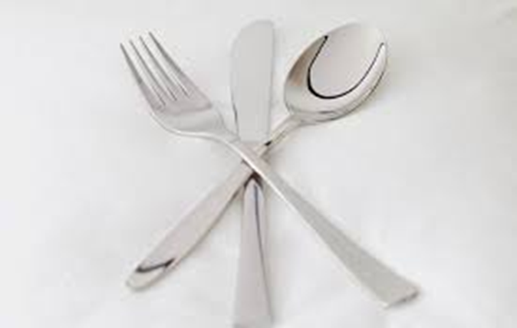
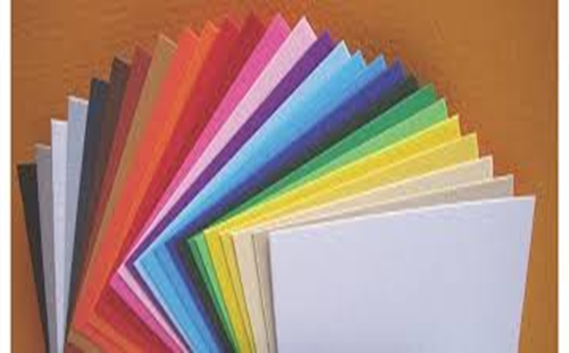
METAL PAPER
FABRIC

Slide 4
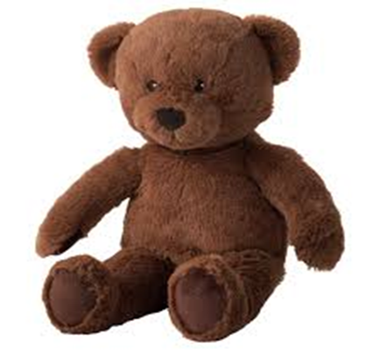
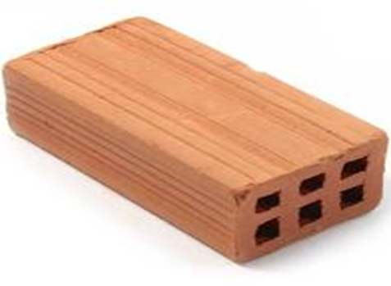
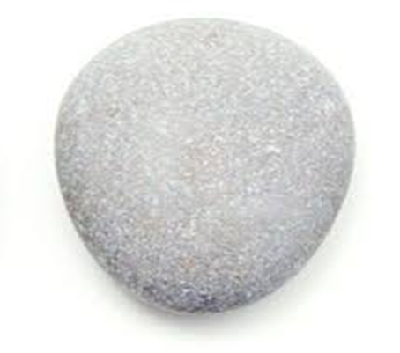
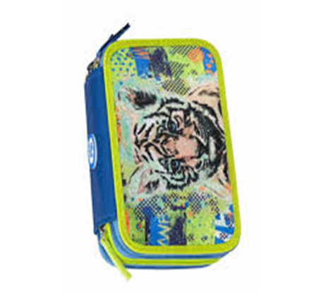
HARD SOFT
SMOOTH ROUGH

Slide 5
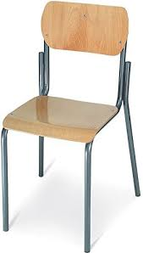
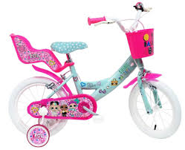
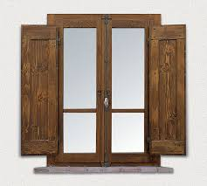
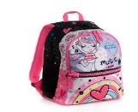
COPY ON THE WORKBOOK. THEN COMPLETE AND READ
The chair is made of …..and ……
The book is made of….. and……
The pencil-case is made of……and……
The bike is made of…….and …….
The window is made of …….and……
The schoolbag is made of………and…….

Slide 7
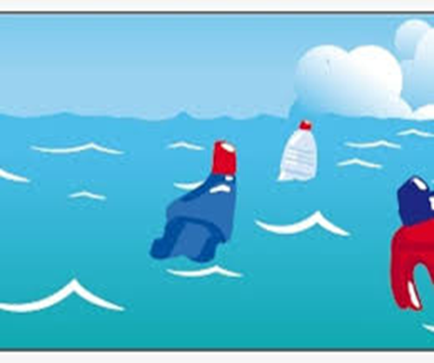
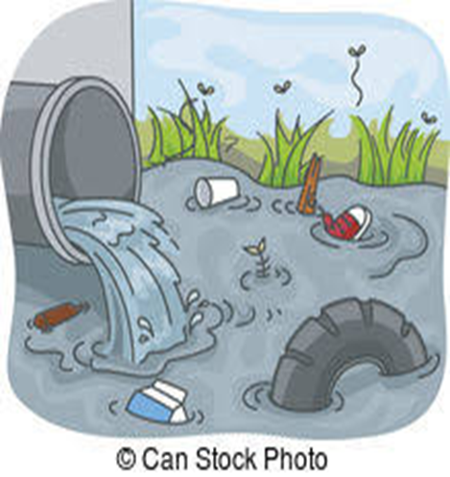
RESPOND AND RESPECT Don’t pollute the rivers, lakes, sea

Slide 8
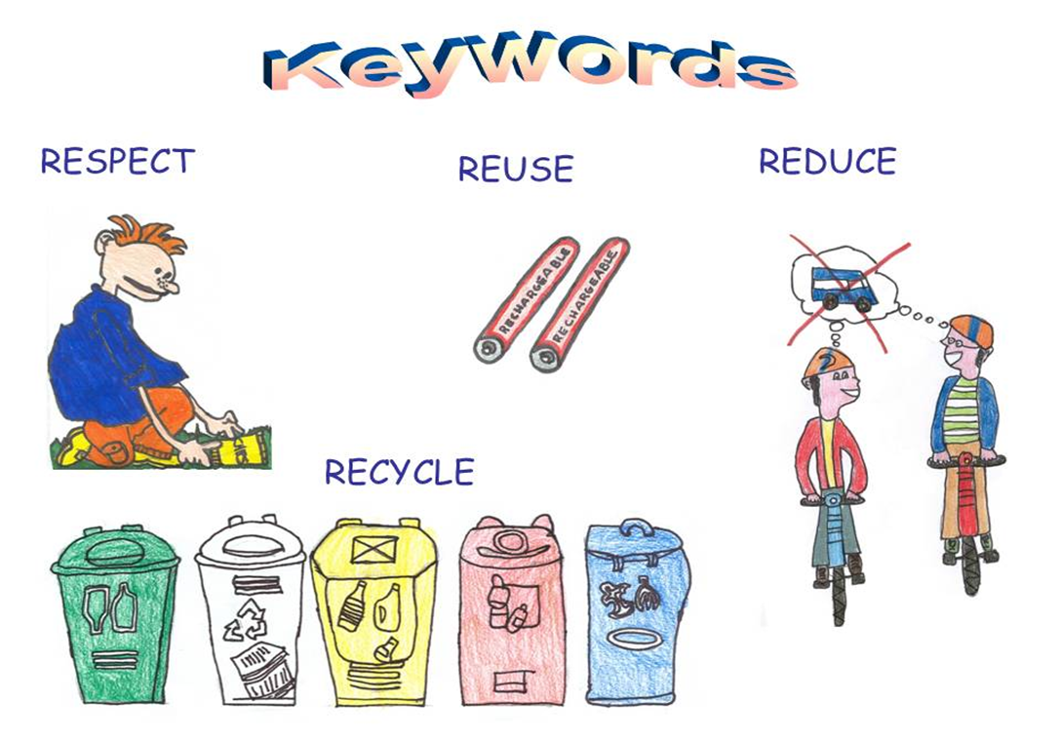
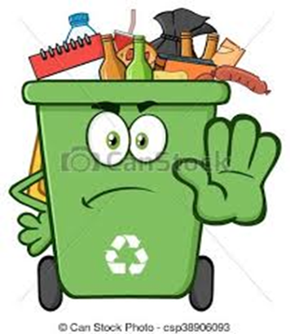
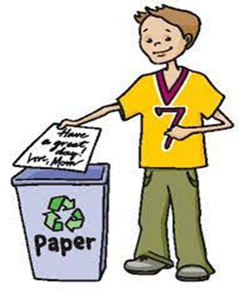
RESPOND Take care of our town
Recycle plastic, paper and glass Collect bottles, newspaper and tins
Put litter in the bin

