Slide 1
Merry Christmas

Slide 2
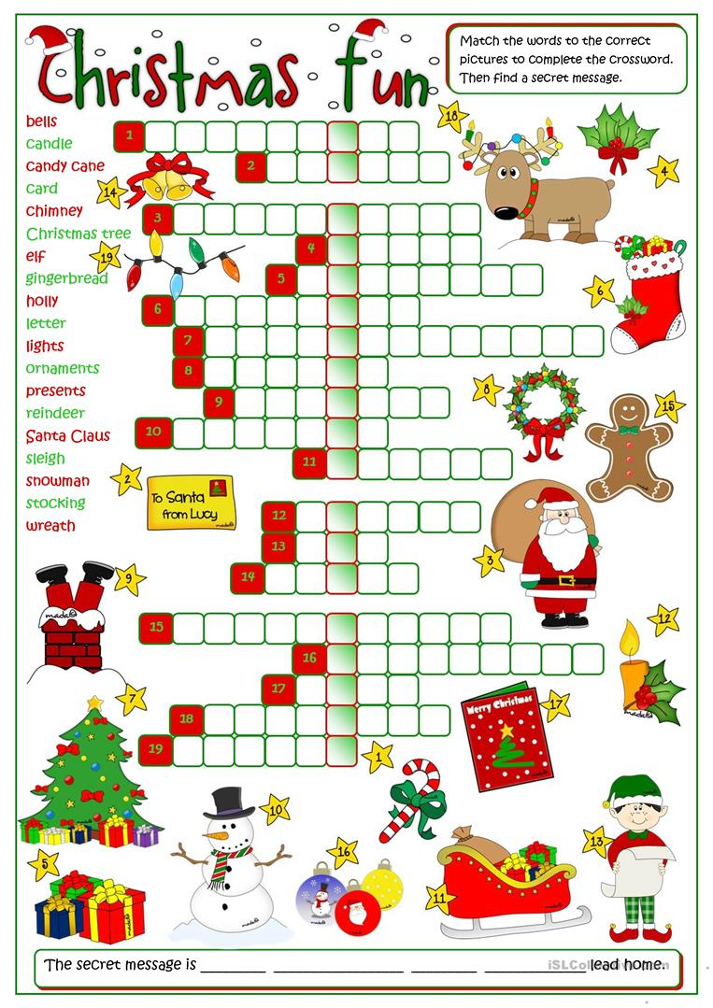
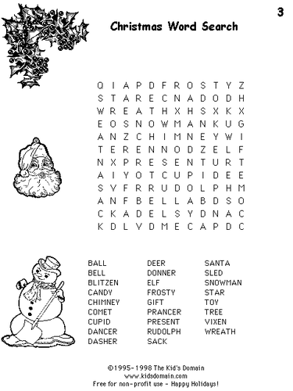
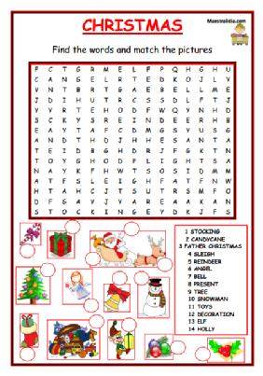
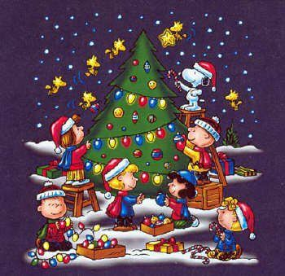

Slide 3
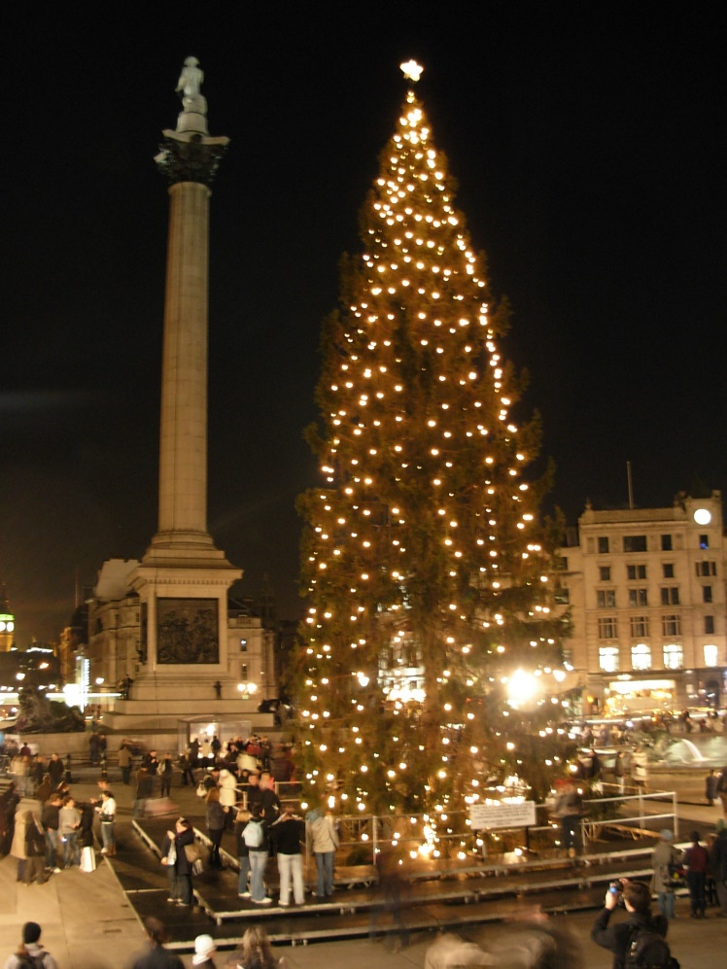
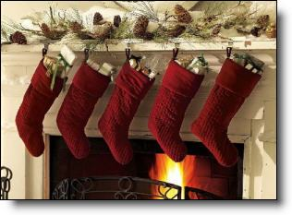
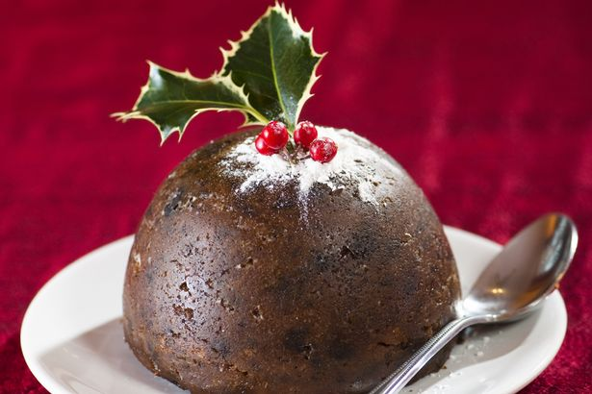
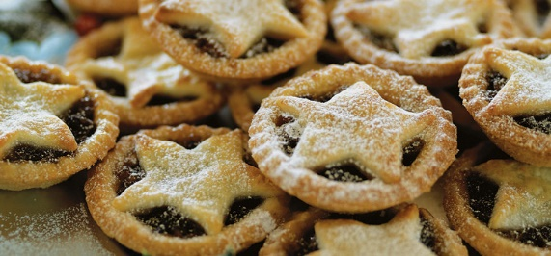
Le tradizioni natalizie nel regno unito

Slide 4
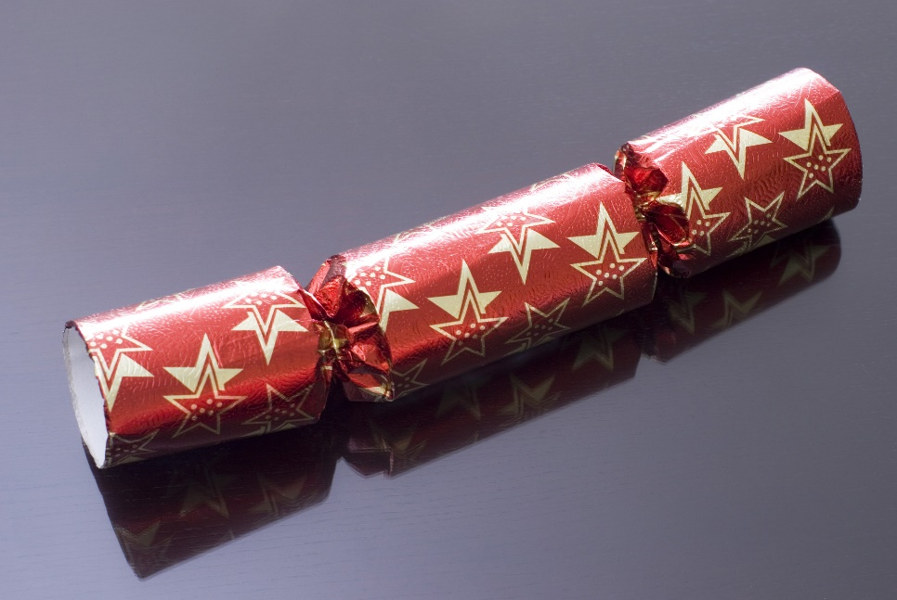
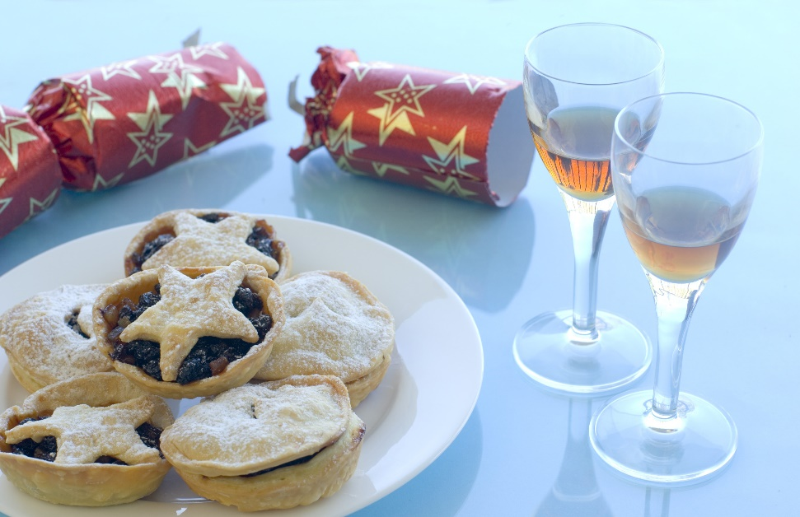

Slide 5
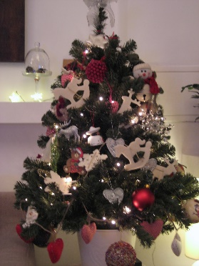
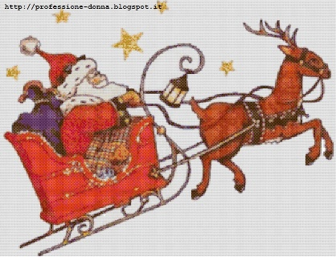
Christmas poem
Christmas is coming
Christmas is coming,
The tree is in the house,
Presents for everyone
Even for the mouse.
Santa is coming,
He’s riding on his sleight.
Giddy up! Giddy up!
He’s already on his way.

Slide 6
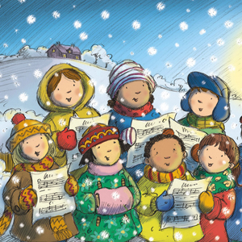
Christmas carols
Jingle bells
We wish you a merry Christmas
Santa Claus is coming to town

Slide 7
Merry Christmas and best wishes for a happy new year.
May your holidays be filled with laughter, love and joy.

