Slide 1
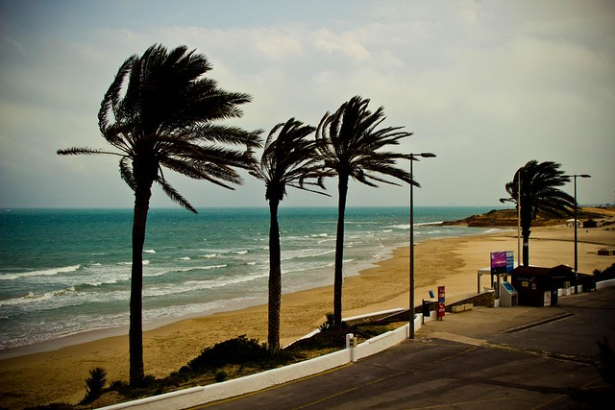
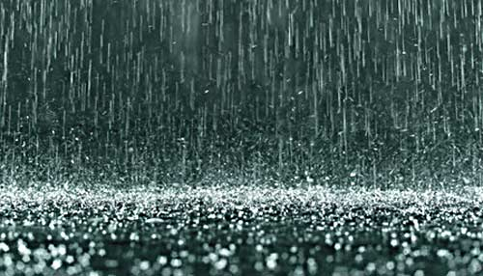
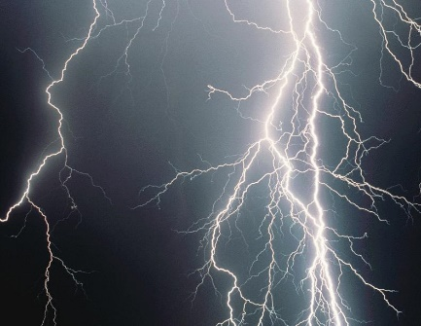
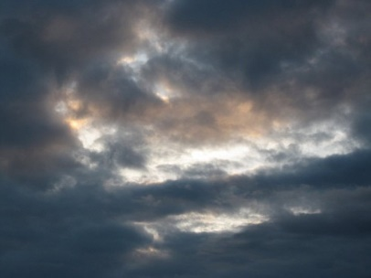
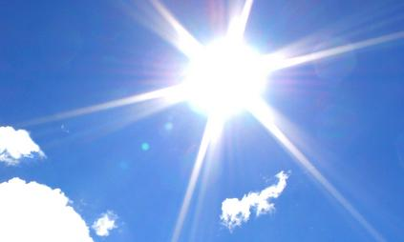
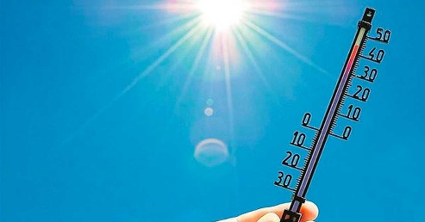
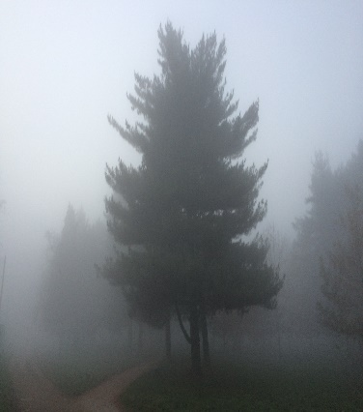
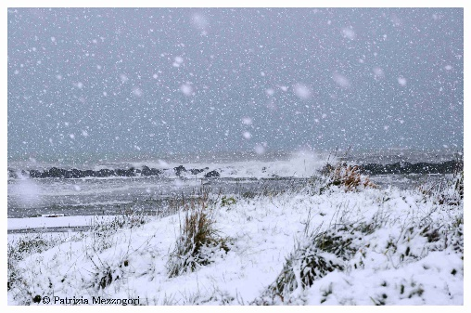

What’s the weather like?

Slide 2

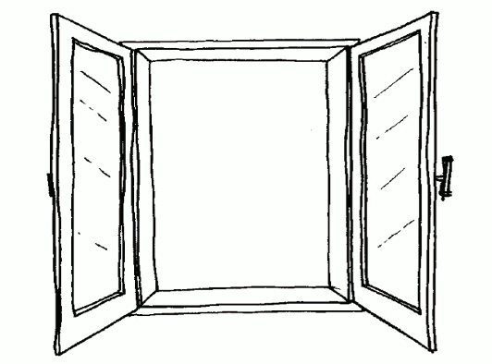
Draw the weather in the windows
It’s windy
It’s snowing
It’s raining
It’s foggy
It’s hot

Slide 3
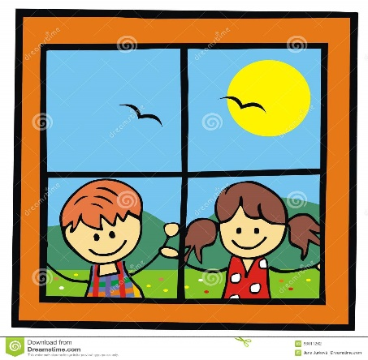
It’ sunny
It’s cold
It’s stormy
It’s cloudy

Slide 4
COMPLETE
Days of the week | What’s the weather like today?
Sunday, 6 th December | It’s______________and____________
Monday, 7 th December
------------------,8 th December
------------------,9 th December
-----------------, 10 th December
-----------------,11 th December
------------------,12 th December

Slide 5

To be review
Write is or are
They ______ sad.
The balloon ______ big.
The girls _________ happy.
4. Mary _______ eight.
5. You _______ boys.
6. She _______pretty.
Make these sentences interrogative
You are happy.
They are cats.
She is big.
I am a girl.
Make these sentences negative
The boys are at school.
The book is on the desk.
She is my teacher.
They are rules.

