Slide 1

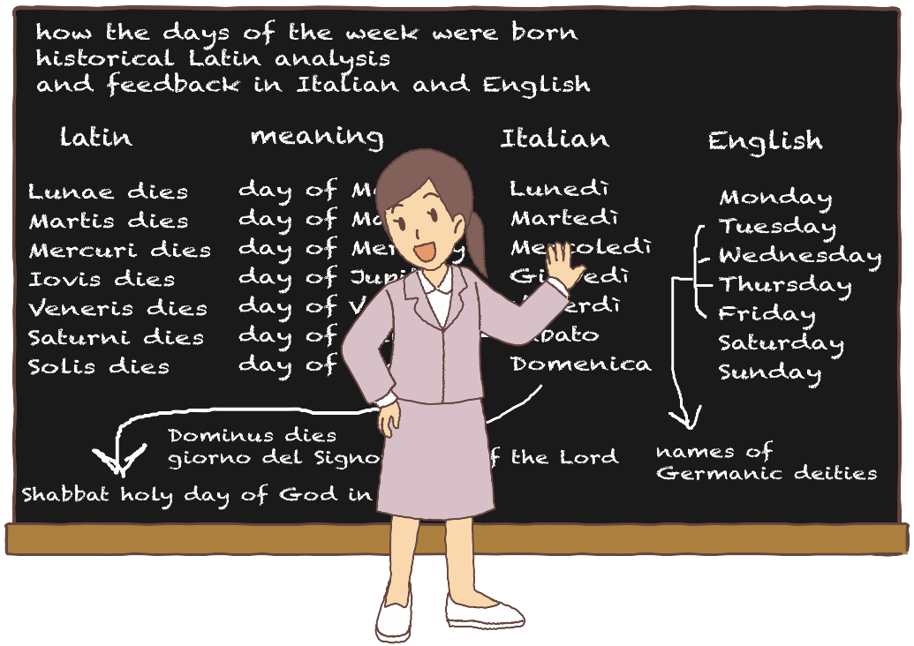



Slide 2
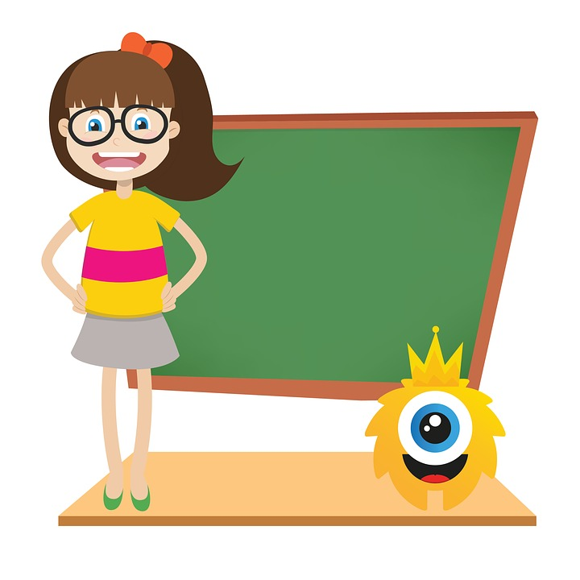
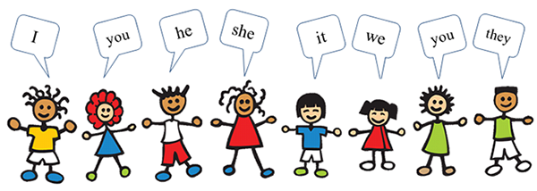

Personal pronouns

Slide 3
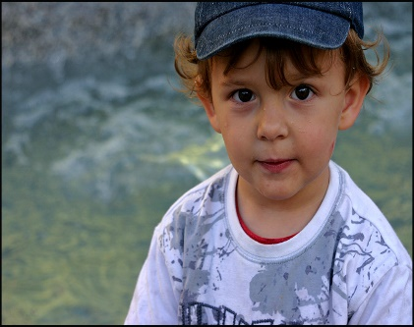
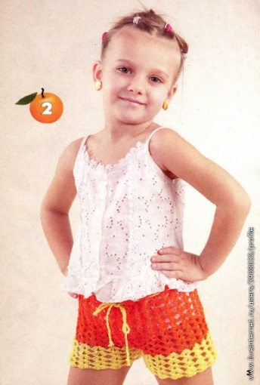
Remember
Who’s this?
This is Paul.
How old is he?
He’s three.
Who’s this?
This is Lola.
She’s six.
How old is she?

Slide 4




How are you today?
I’m tired
I’m bored
I’m happy
I’m sad

Slide 5




I’m sleepy
I’m great
I’m angry
I’m scared
And you….how are you today?
……………………………………………..

Slide 6
