Slide 1
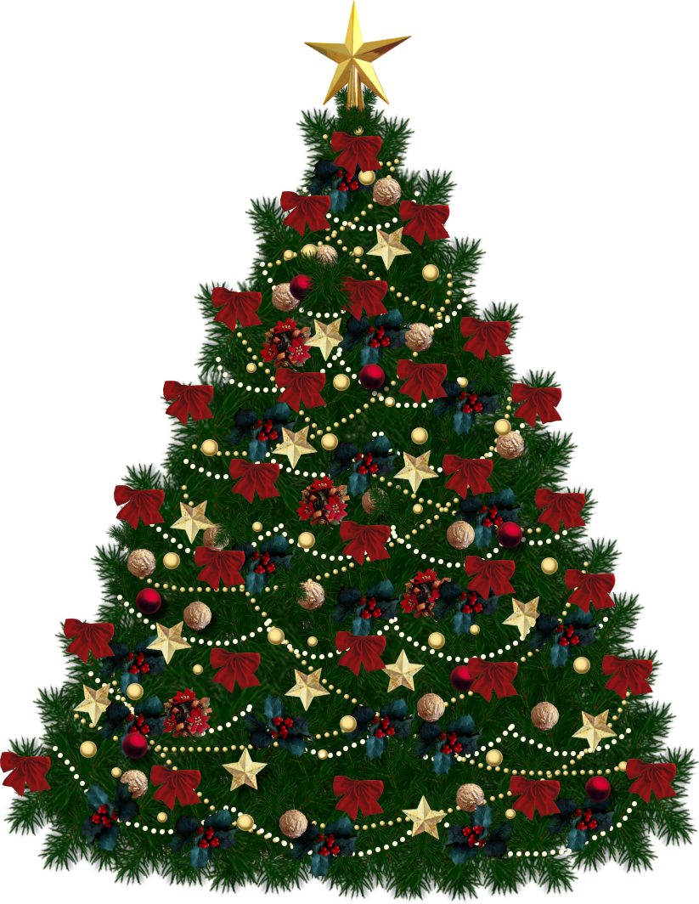
Merry Christmas

Slide 2
The pretty tree
Read and decorate Sally’s Christmas tree as written in the text
Sally has a pretty Christmas tree.
The tree is green with many ornaments.
There are five red baubles, four blue baubles, three orange baubles, six yellow stars, three light blue angels and on top
of the tree there is a bright gold angel.
Under the Christmas tree there are two big red presents
And three small yellow presents.
Sally is very happy.
She likes Christmas very much!

Slide 3
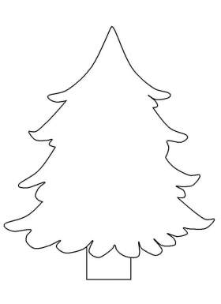

Slide 4
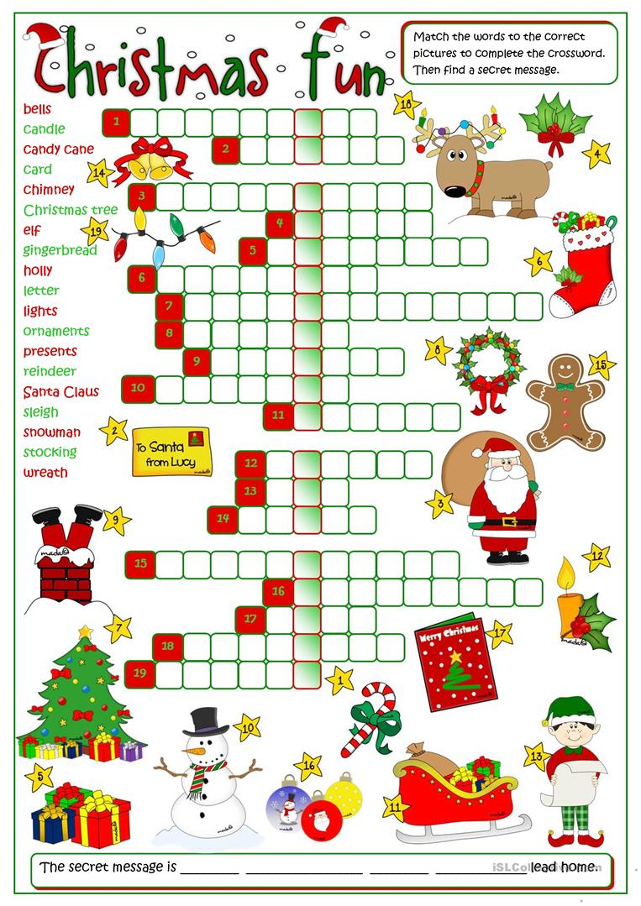
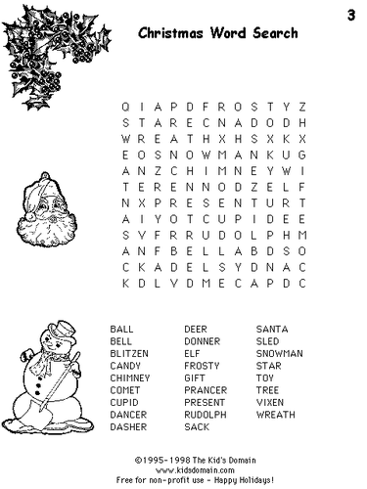
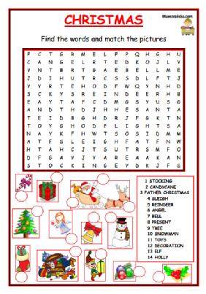
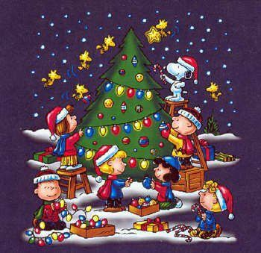
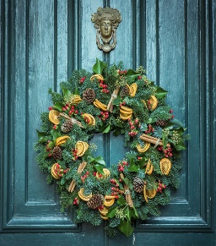
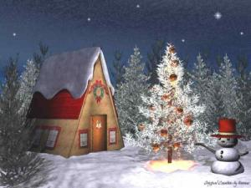

Slide 5
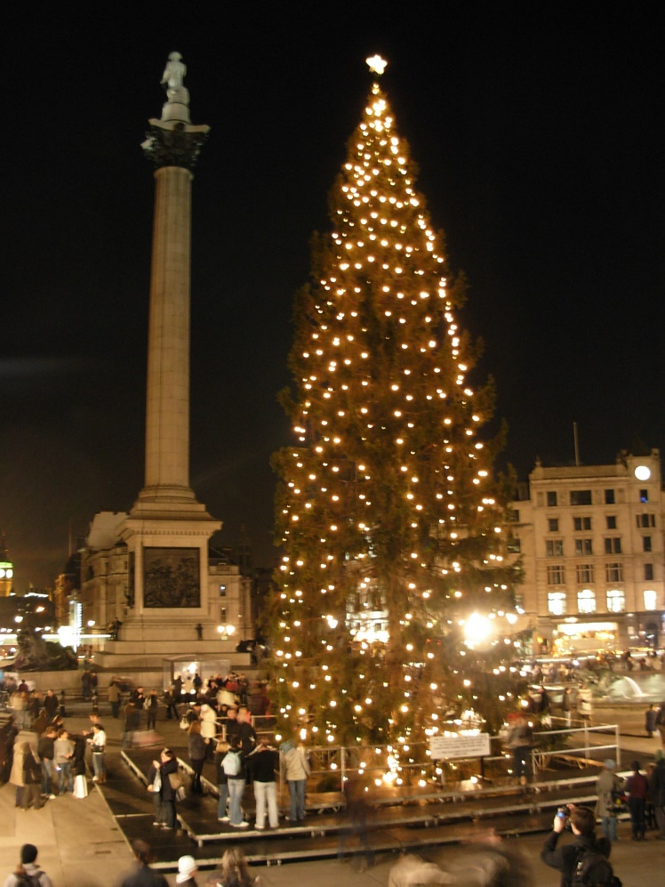
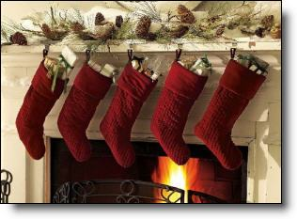
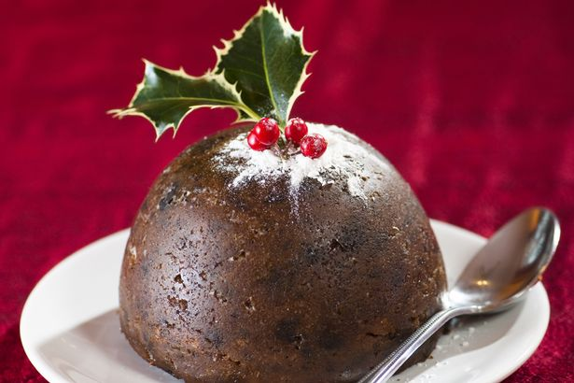
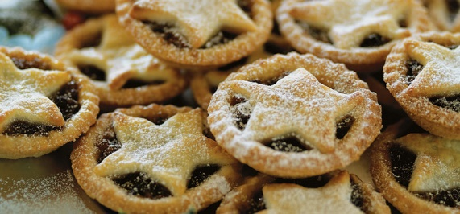
Le tradizioni natalizie nel regno unito

Slide 6
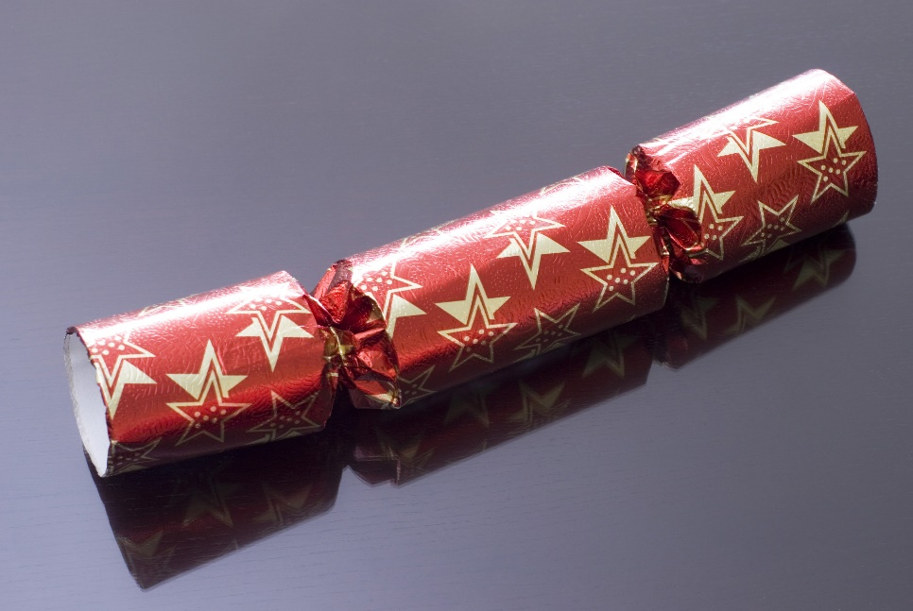
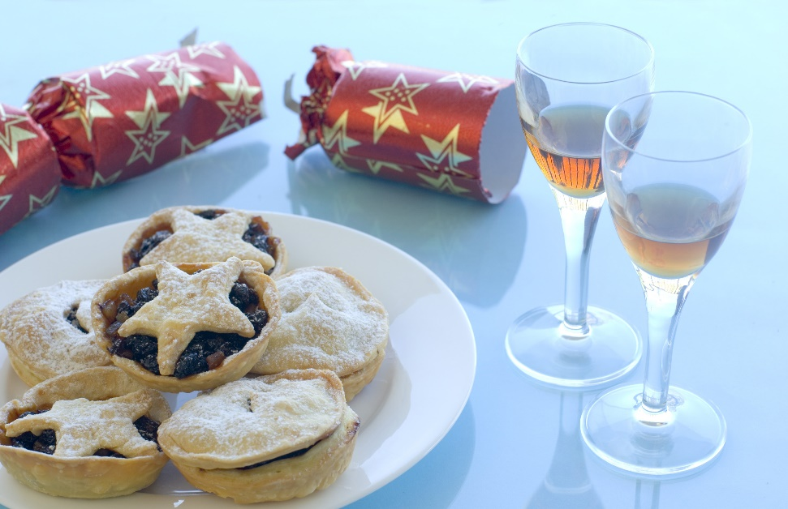

Slide 7
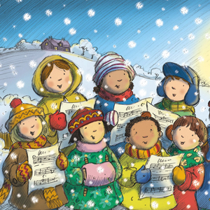
Christmas carols
Jingle bells
We wish you a merry Christmas
Santa Claus is coming to town

Slide 8
Merry Christmas and best wishes for a happy new year.
May your holidays be filled with laughter, love and joy.

