Slide 1
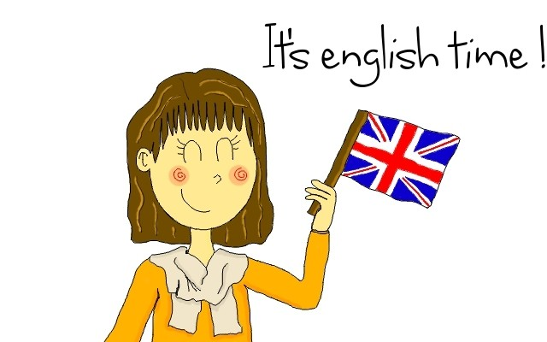
REVISION TIME!
Teacher Teresa Calabria 3°C

Slide 2
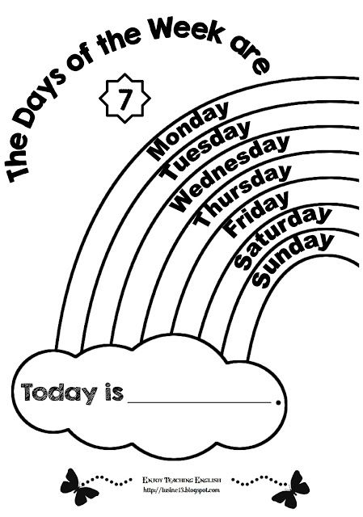

Slide 6
What’s the
weather like?

