Slide 1
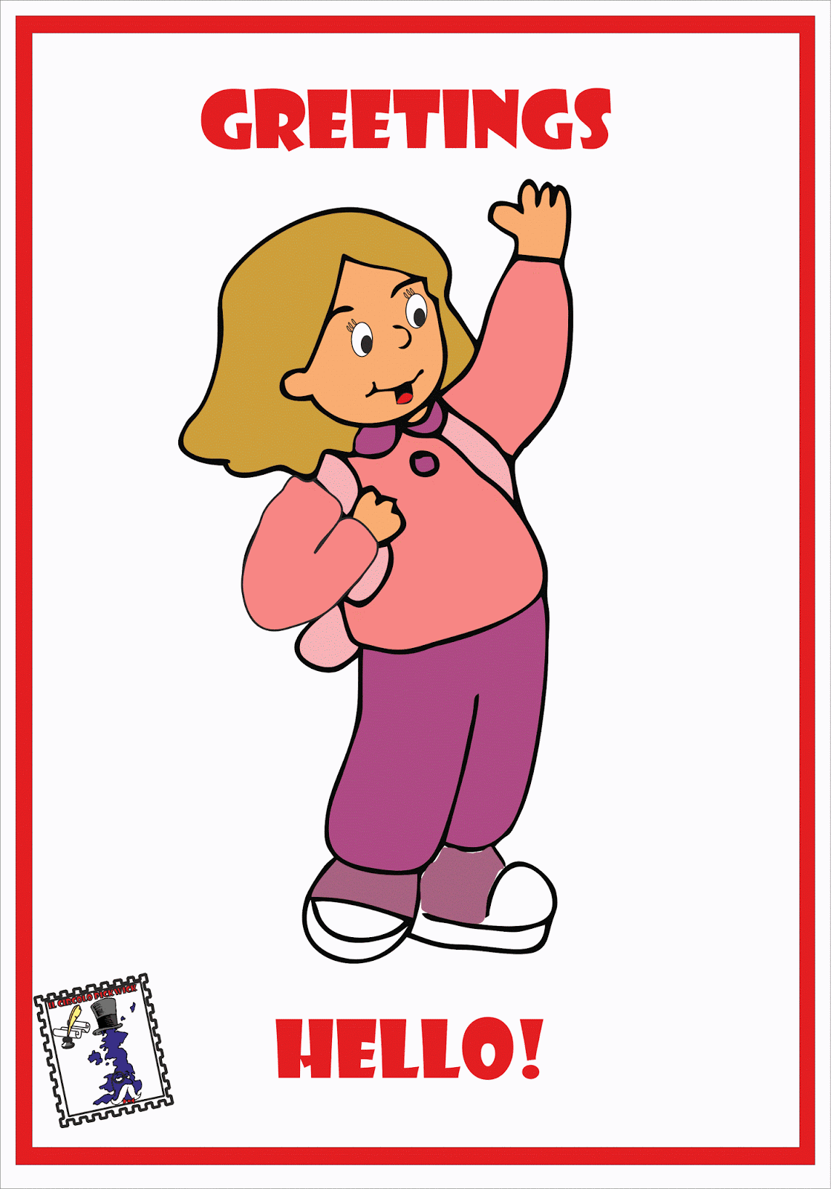
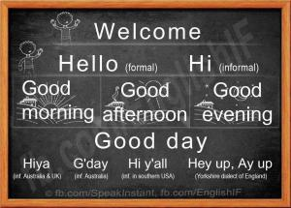
REVISION TIME:
greetings, little conversation and how questions begin
Teacher Calabria Teresa 3C

Slide 2
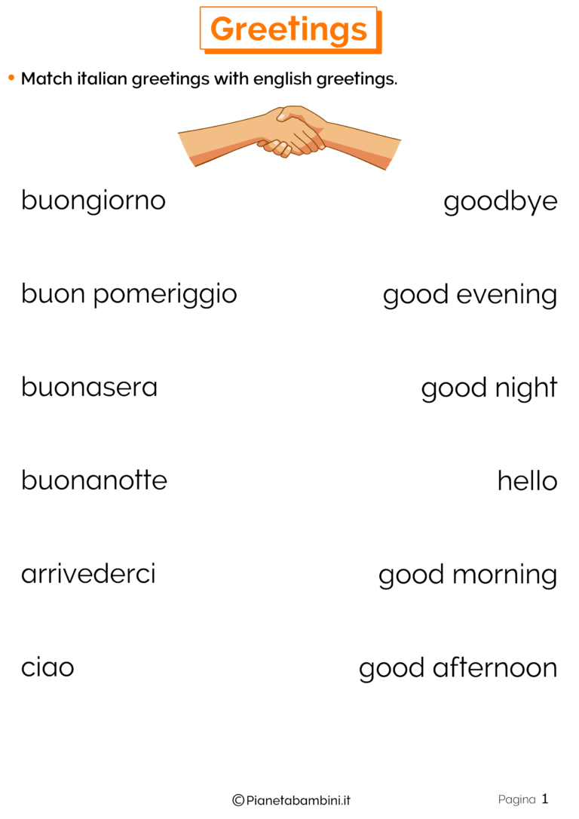
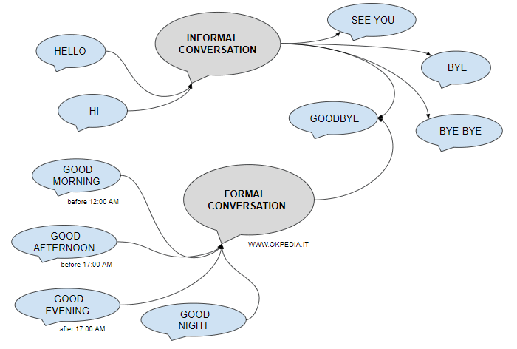

Slide 3
Homework: repeat and write the colors on your excercise book

Slide 4
