Slide 1
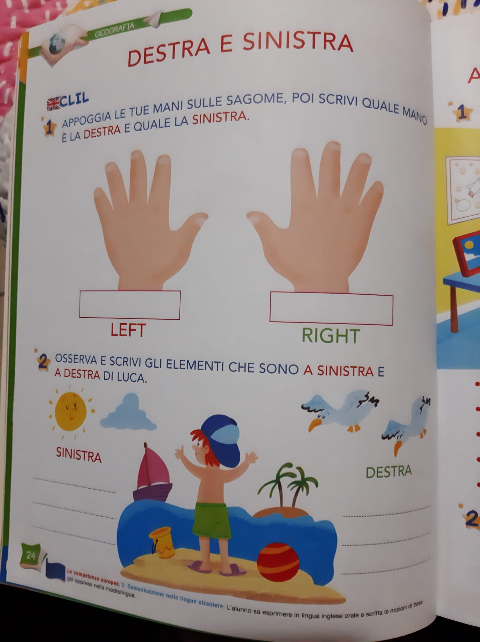
THE ELEMENTES THAT ARE TO THE RIGHT AND LEFT OF LUCA

Slide 2
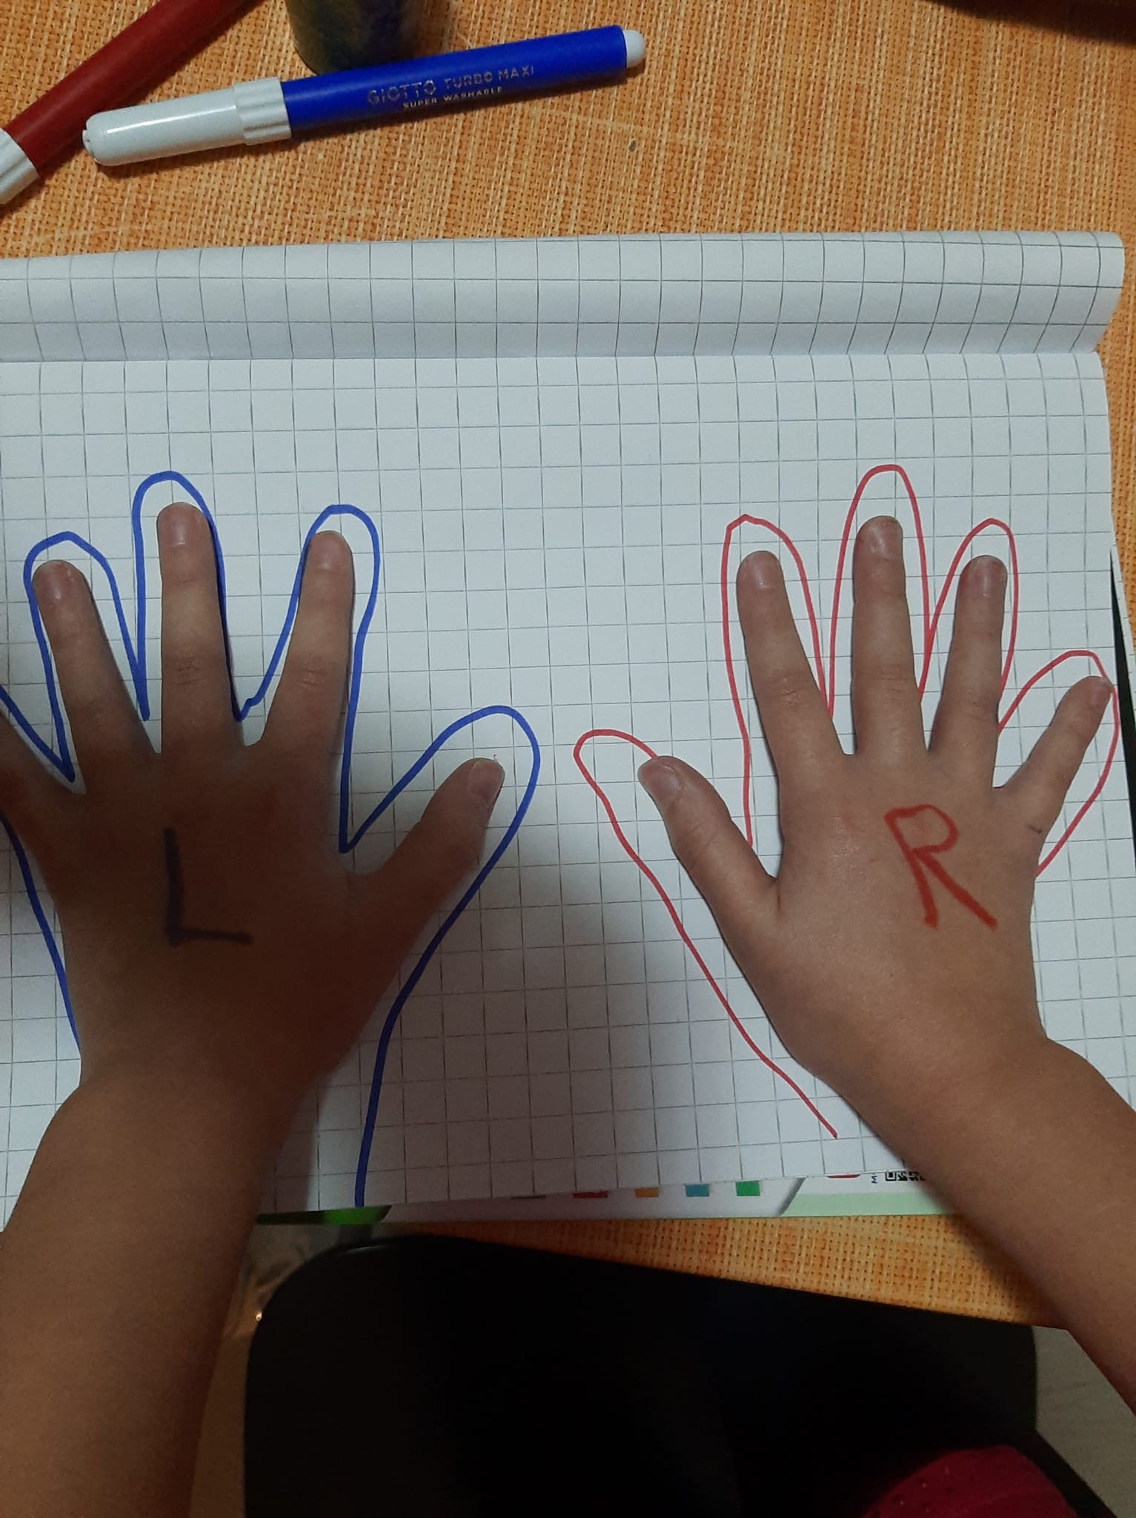
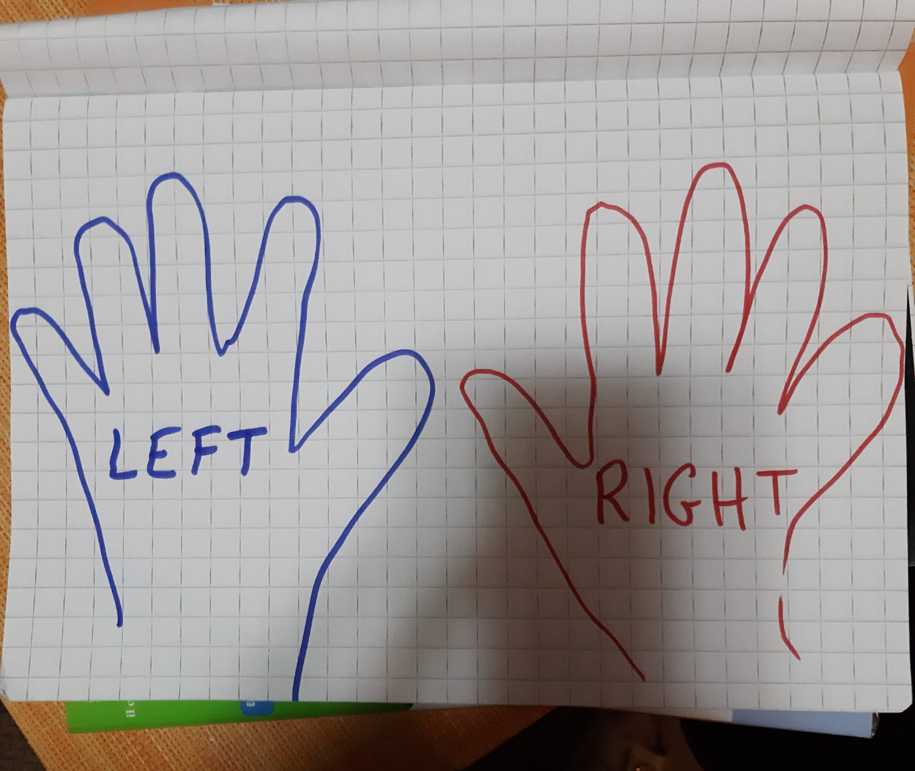
PUT YOUR HANDS ON THE NOTEBOOK AND MAKE THE OUTLINE WITH THE FELT-TIP PEN
LEFT HAND IS BLUE
RIGHT HAND IS RED

Slide 3
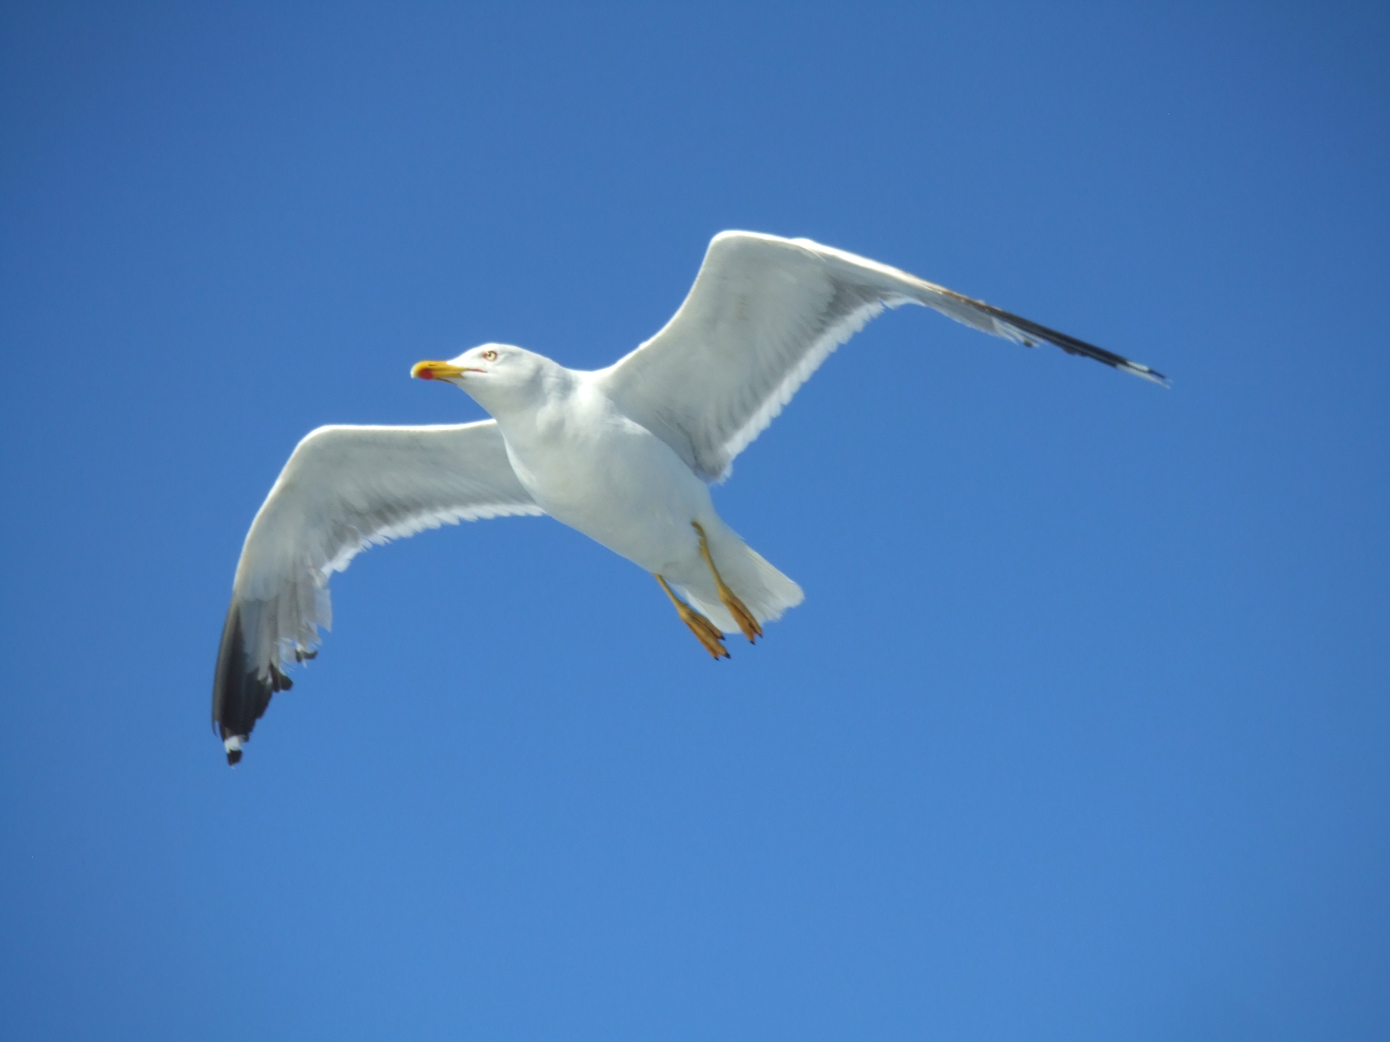
LEFT
RIGHT
SEAGULL
ISLAND
BUCKET

