Slide 1
TELLING THE TIME IN ENGLISH

Slide 2
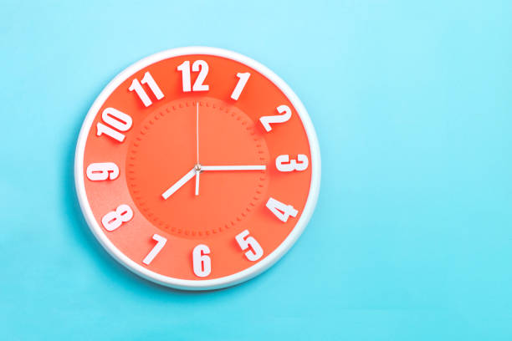
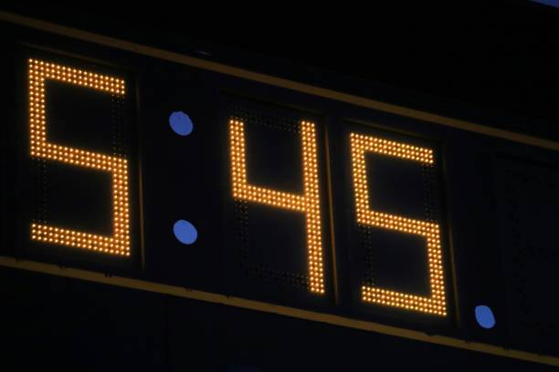
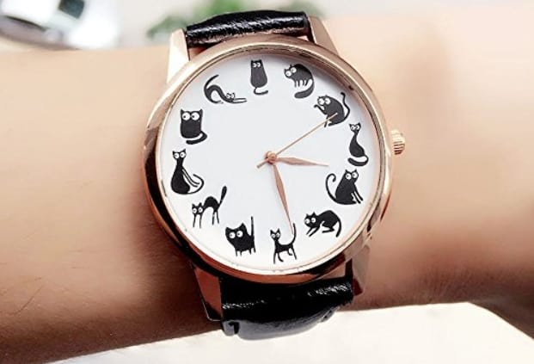
WHERE DO WE READ THE TIME?
WATCH
CLOCK
ALLARM CLOCK

Slide 3
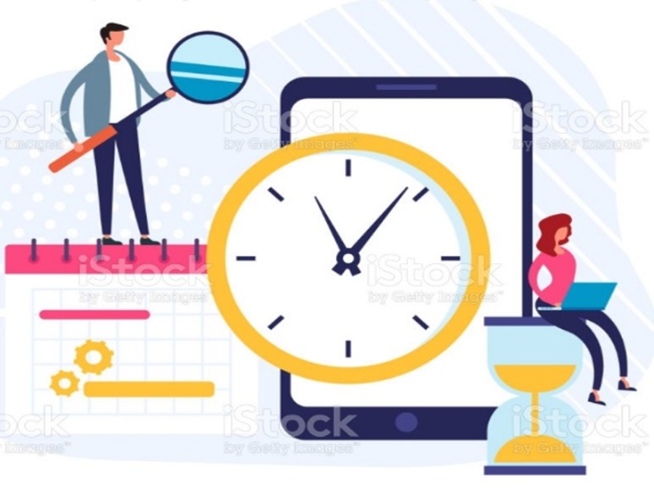
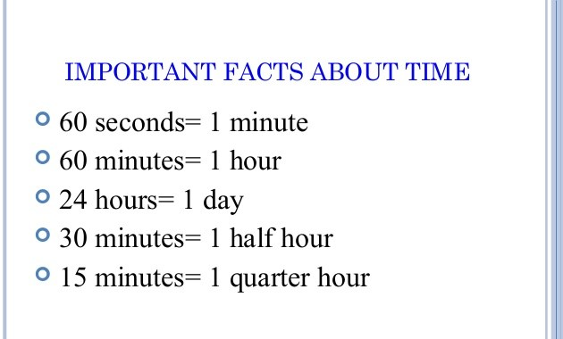
About the clock

Slide 4
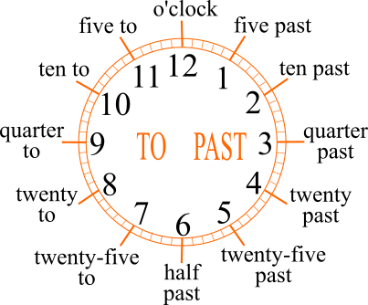
How to tell the time in English
Listening games
https://padlet.com/mrcantone63/cky6ue2jjrszxsyp

Slide 5
Asking the time
We can use some questions for asking the time
Answering the questions
It’s exactly… It’s about… It’s almost…
What time is it?
What’s the time?
Could you tell me the time, please?
Do you know what time is it?
It’s three o’clock a.m./p.m.
It’s ten past ten a.m./p.m.
Sure, it’s a quarter to five a.m./ p.m.
Yes, it’s twenty to eight a. m./p.m.

Slide 6
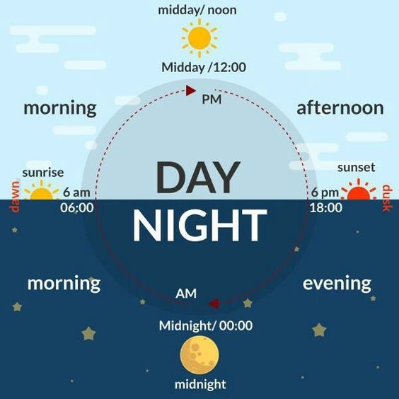
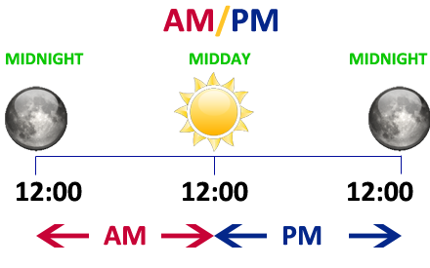
THE DAY in the clock
We use A.M. to show that is between midnight and noon.
We use P.M. to show that is between noon and midnight.

Slide 7
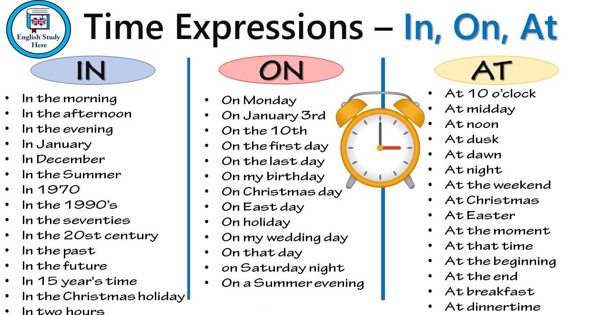
We use the Time Expressions

Slide 8
We use the Time Expressions

Slide 9
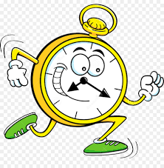
Now answer the questions….
Work in pair
Work in pair
What time do you get up?
What time do you have breakfast?
What time do you do your homework?
What time do you have lunch and dinner?
What time do you watch TV?
What time do you go to bed?
I get up at seven o’clock a.m.
I have breakfast at a quarter past seven a.m.
I do my homework at a quarter to three p.m.
I have lunch at half past midday. and dinner at half past eight p.m.
I watch Tv at twenty-five to seven.
I go to bed at midnight.

Slide 10
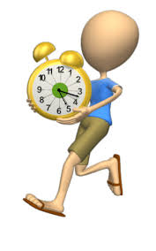
Practice-Homework- Reading and writing a short text about your daily routine
Send me your works
Read, complete and drow the time in the clock

