Slide 2
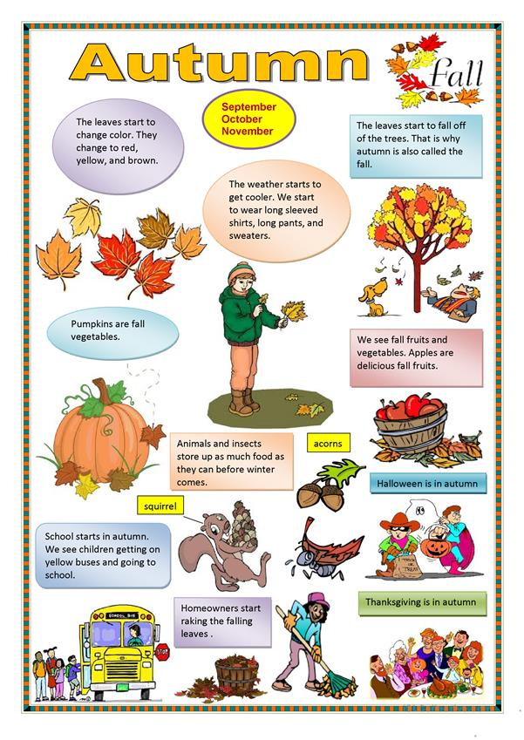

Slide 3
Read, translate and answer the questions

Slide 4
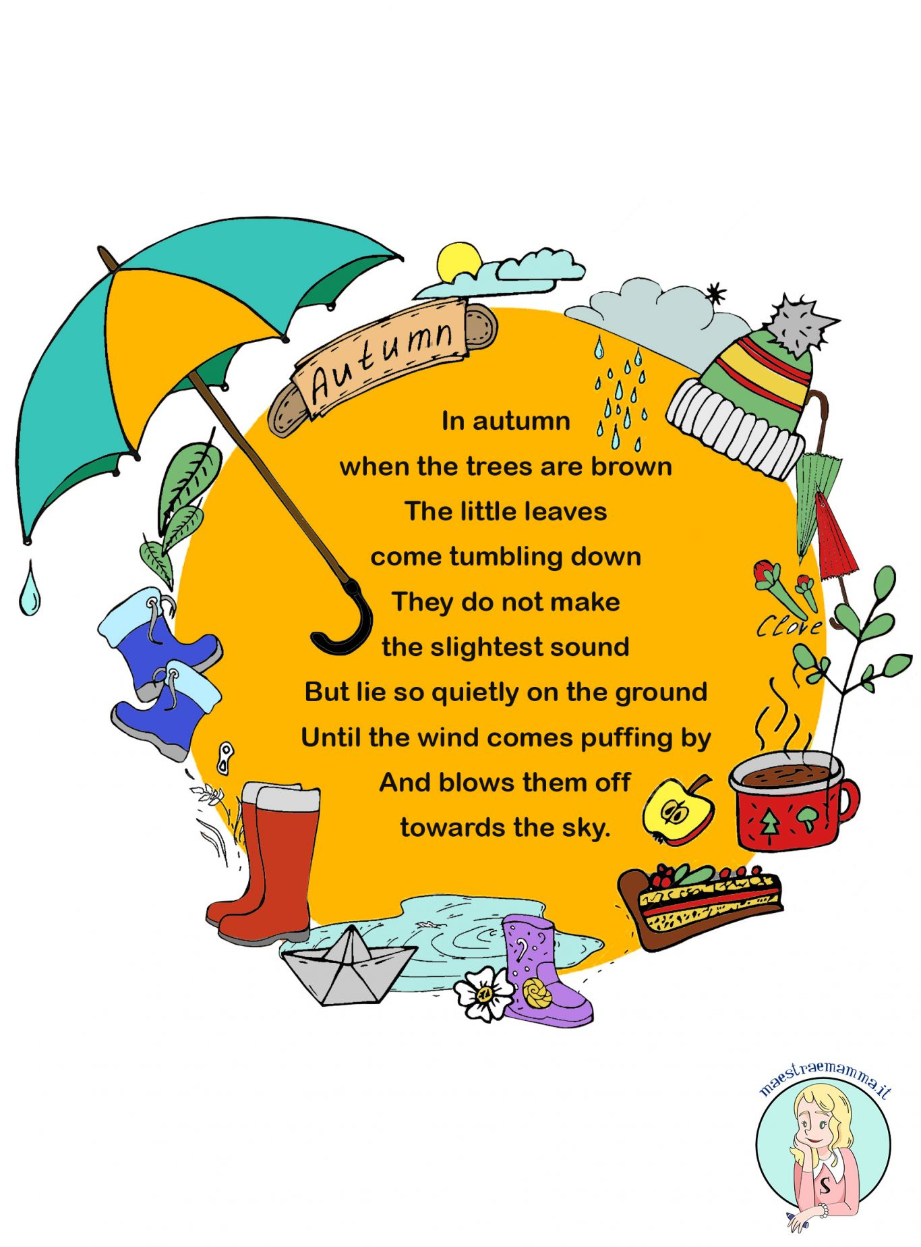
Learn the poem

