Slide 1
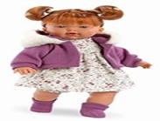
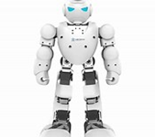
THE - TOYS
Inglese classe 2° E Siciliano
Ins. Vincenza Mele

Slide 4
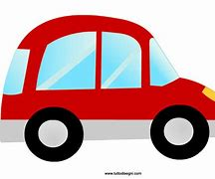
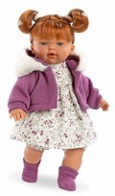
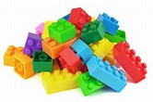
Wednesday 18 November 2020 Scrivi, disegna e leggi Write, draw and read
The toys I giocattoli
Car – macchina
Robot – robot
Doll - bambola
Lego bricks - costruzioni
Puzzle – puzzle

Slide 5
Wednesday 25 november 2020
Write and read Scrivi e leggi
I have got a green ball
I have got a yellow car
I have got a small doll
I have got yellow, blue and red lego bricks
I have got a big robot
I have got a brown teddy bear
I have got a red and green bike
I have got green, blue and red puzzle

Slide 6
I play the trombone
I play the flute WIND INSTRUMENTS
I play the trumbet
I play the clarinet
Ora leggi ,disegna ,colora e traduci le frasi
BUON - LAVORO - BYE - BYE

