Slide 1
Focus on
About my school
Class 4 D Teacher Anna Toscano

Slide 2
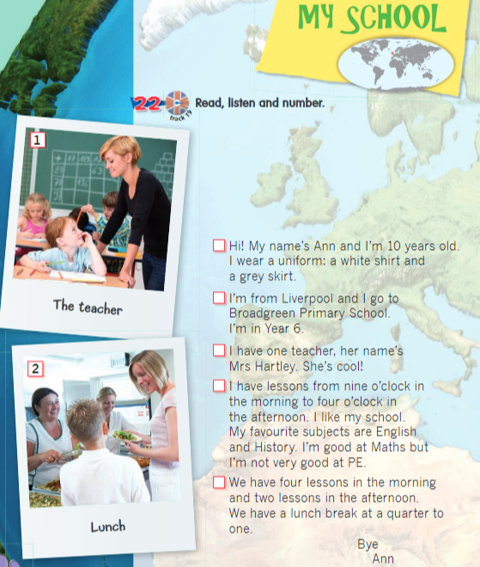
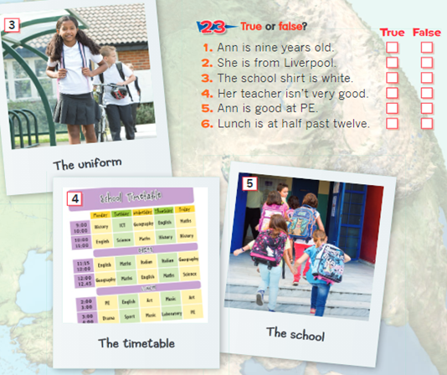
TTRACCIA 19

Slide 3
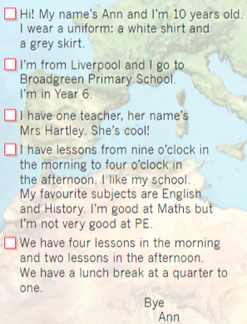
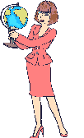
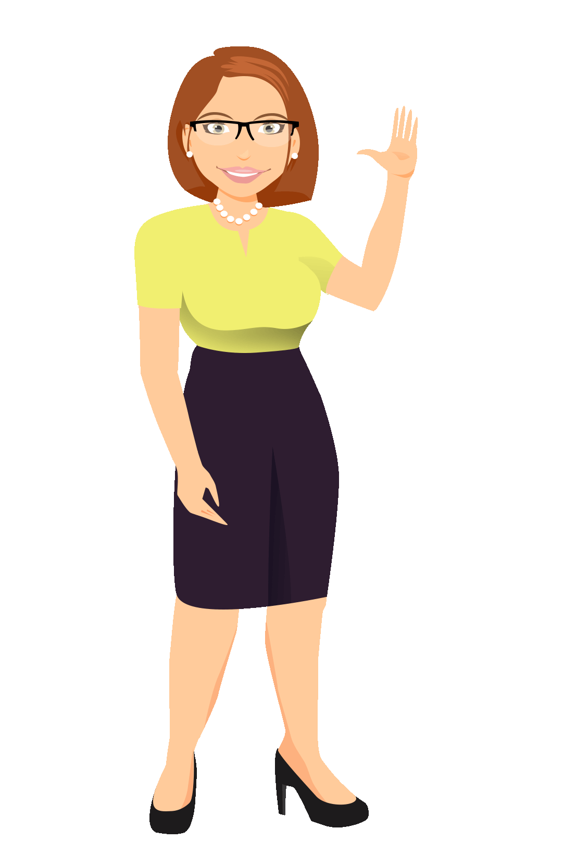
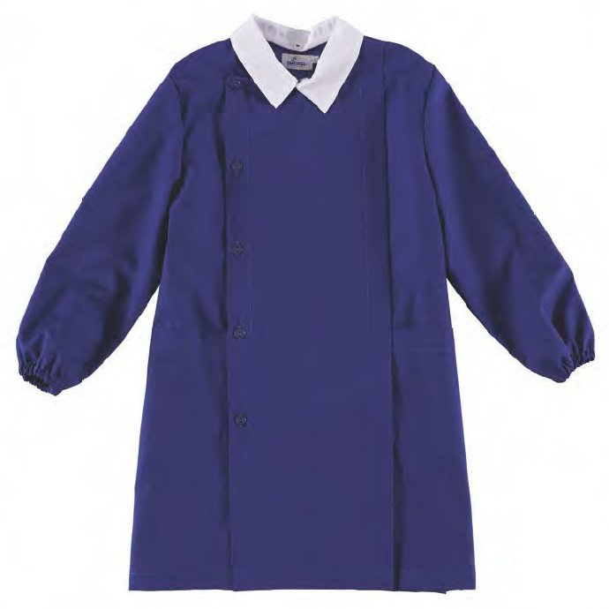
WRITE ABOUT YOUR SCHOOL
Teacher
Her name is…
Teachers
Their names are…
SINGULAR
PLURAL
School Smock:
blue for the boys, white for the girls.
REMEMBER
ESSERE AVERE
I’m I’m not I have I haven’t
You’ re you aren’t you have you haven’t
He’s he isn’t he has he hasn’t
She’s she isn’t she has she hasn’t
It’s it isn’t it has it hasn’t
We’re we aren’t we have we haven’t
You’re you aren’t you have you haven’t
They’re they aren’t they have they haven’t
ACTIVITY

Slide 4
NOUNS

Slide 5
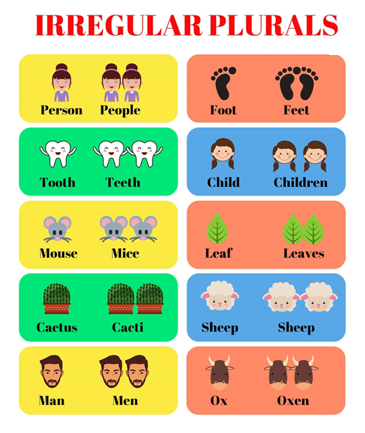

Slide 6
https://youtu.be/UJNsuNMTvgE

