Slide 1
A busy life
Class 4 D
Teacher Anna Toscano

Slide 2
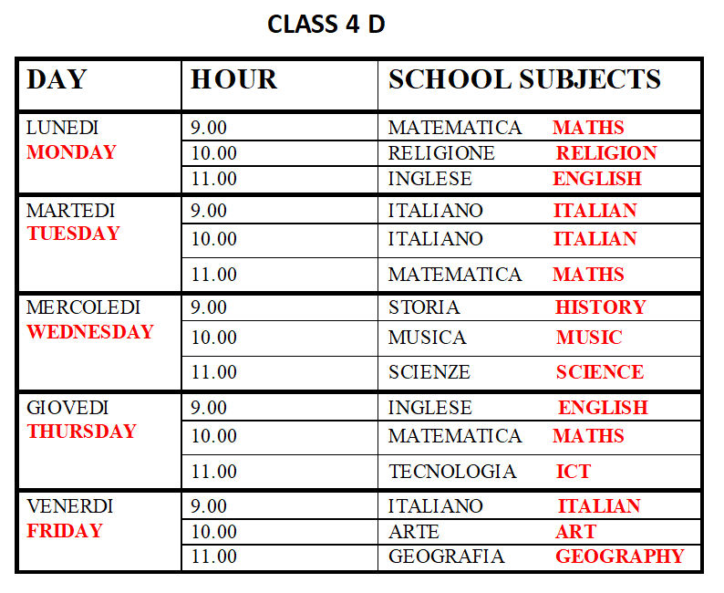
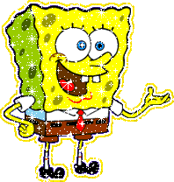
OUR TIMETABLE
Let’s look our timetable!
What time have we got English?
We have got English on Monday at eleven o’clock
and on Thursday at nine o’clock.

Slide 3
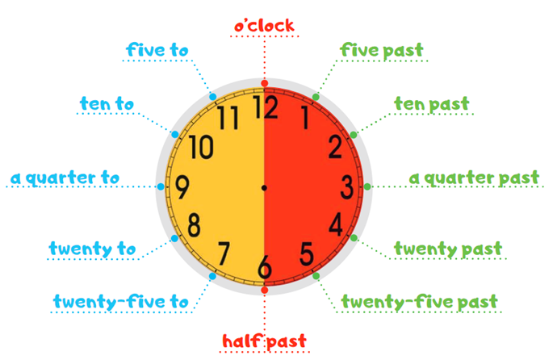
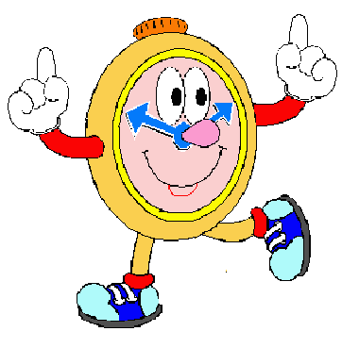
What time is it?
What's the time?

Slide 4
https://www.youtube.com/watch?v=pdoGXFIOtB4

