Slide 1
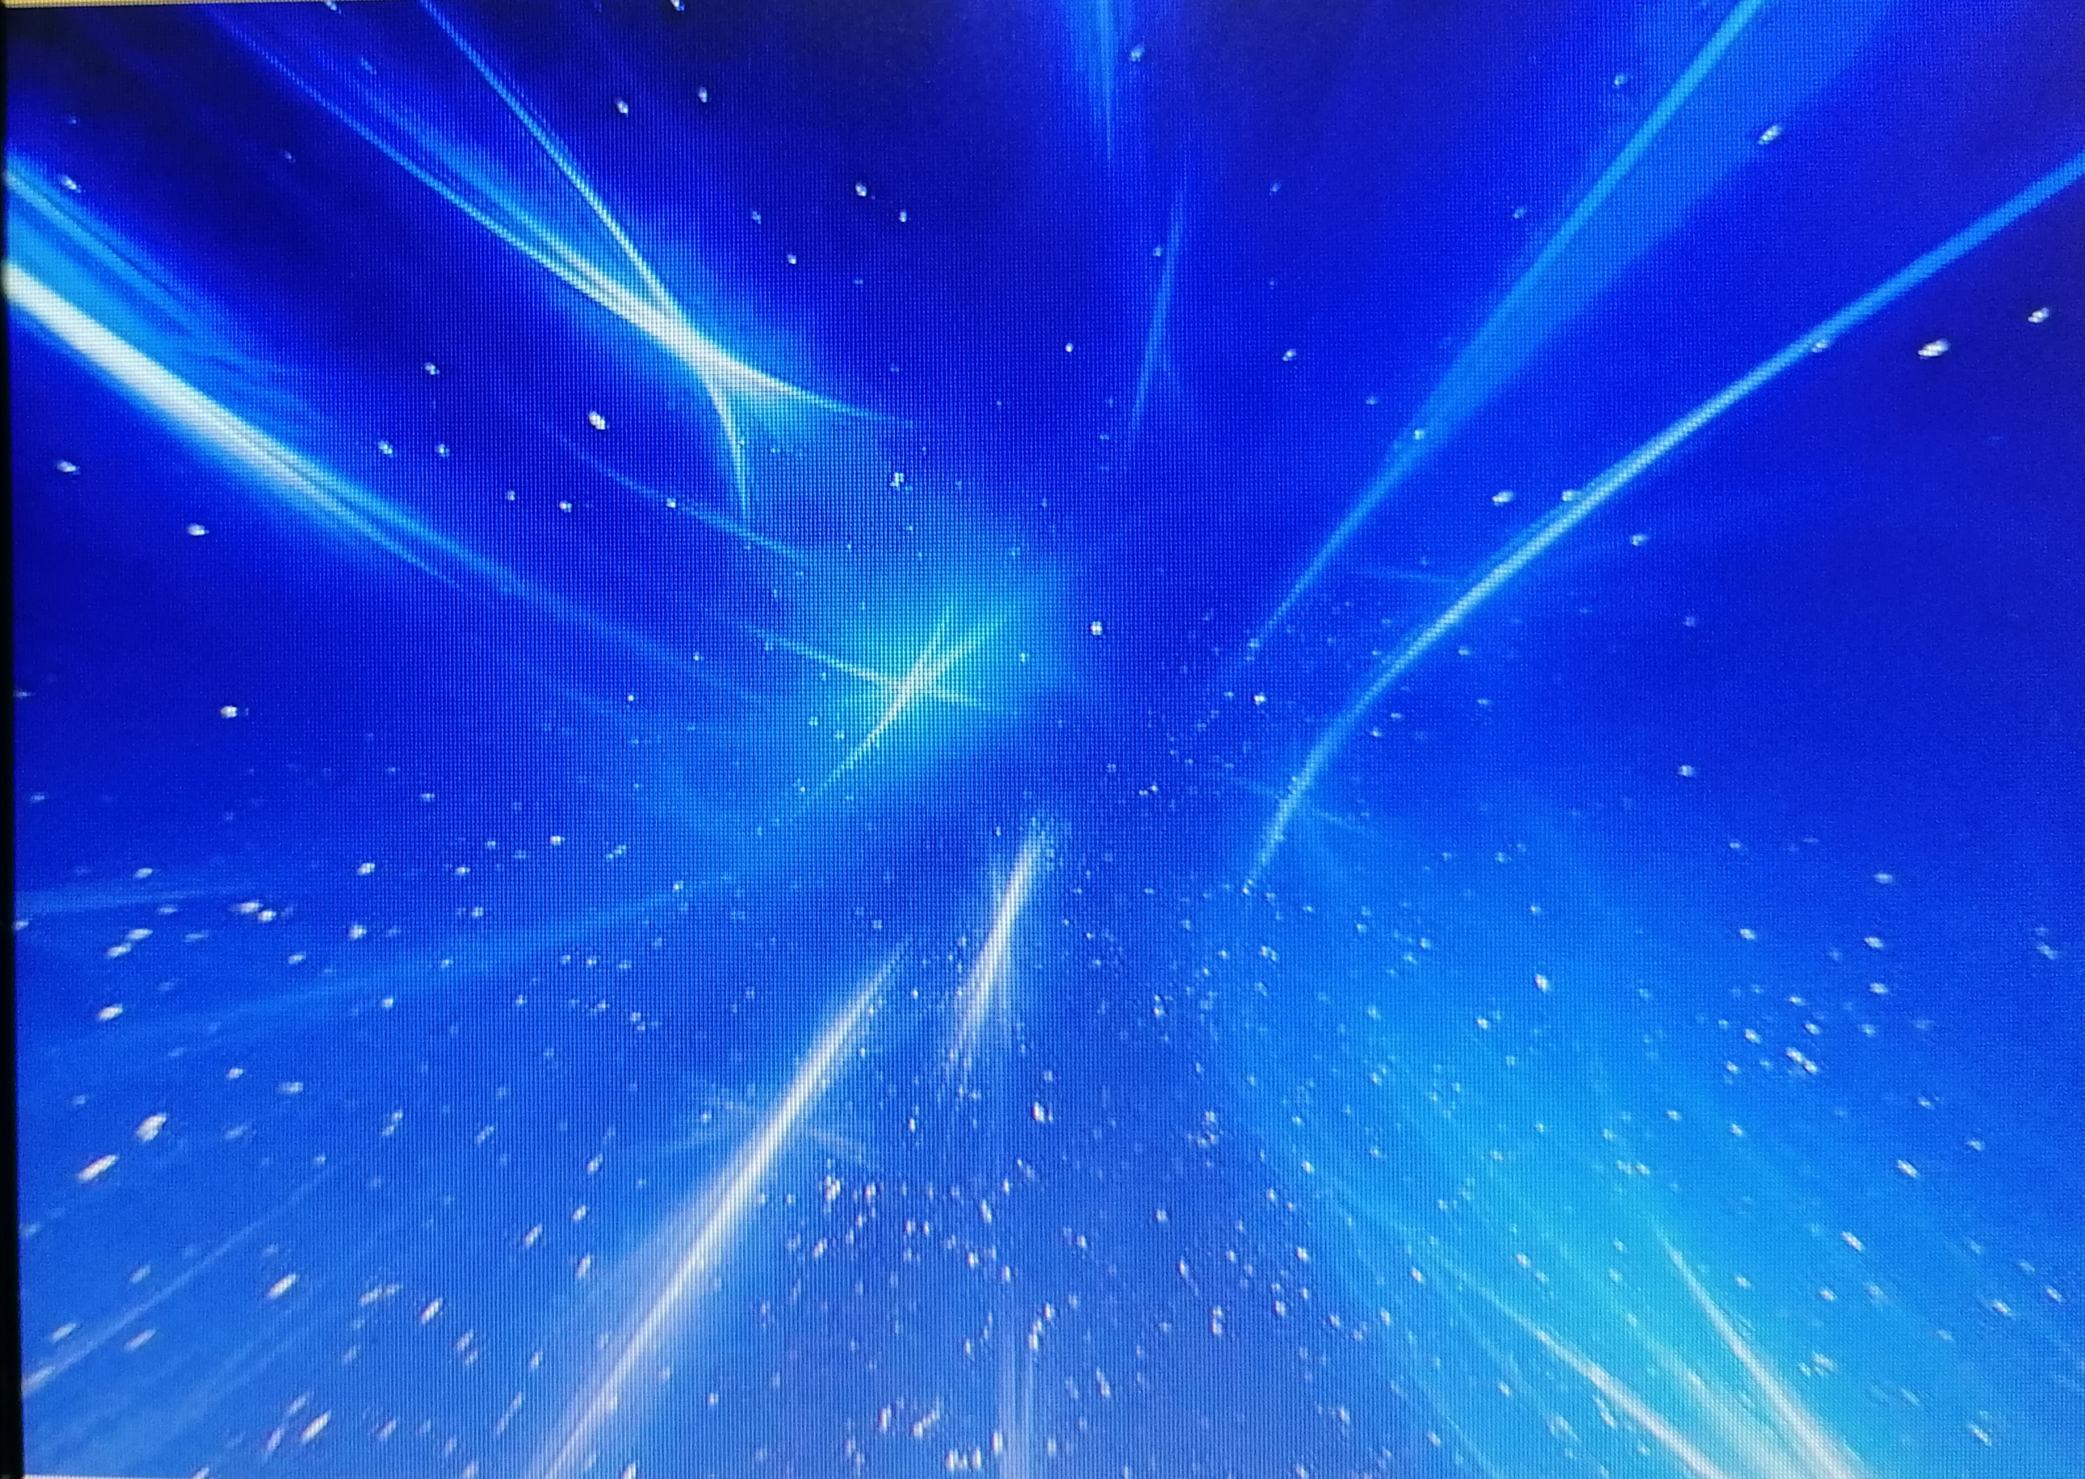
CLIL
THE SOLAR SYSTEM
i
( ENGLISH - SCIENCES - ITALIAN – MATHS - TECHNOLOGY – ART )
I light up IMMENSE!
G. Ungaretti

Slide 2
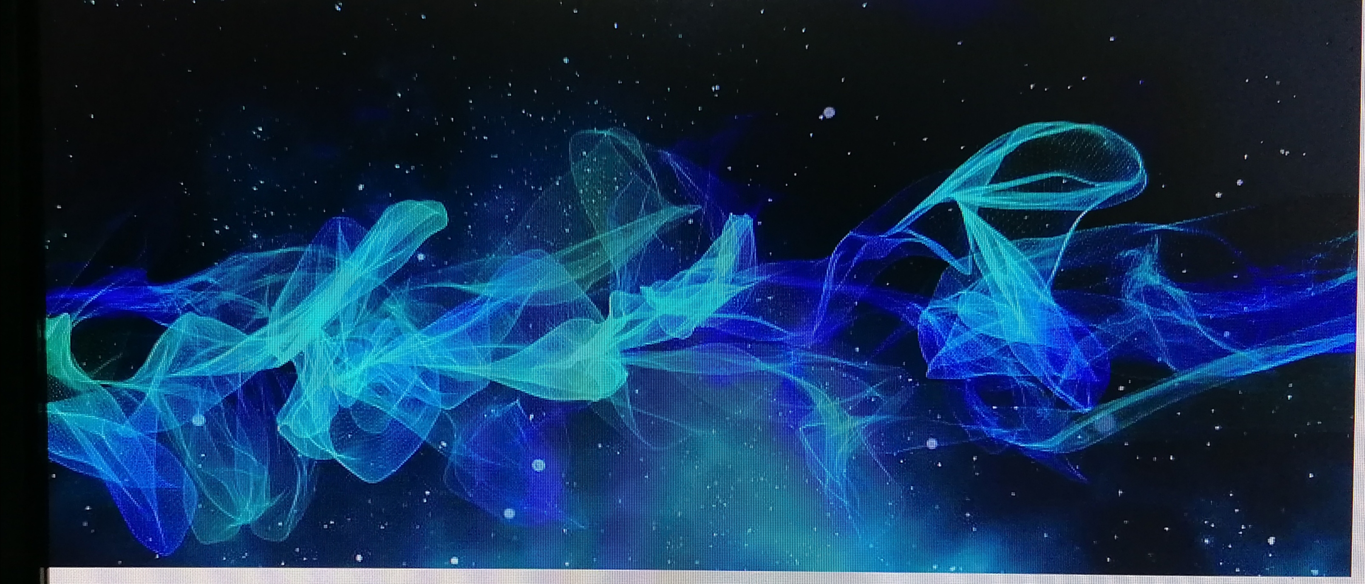
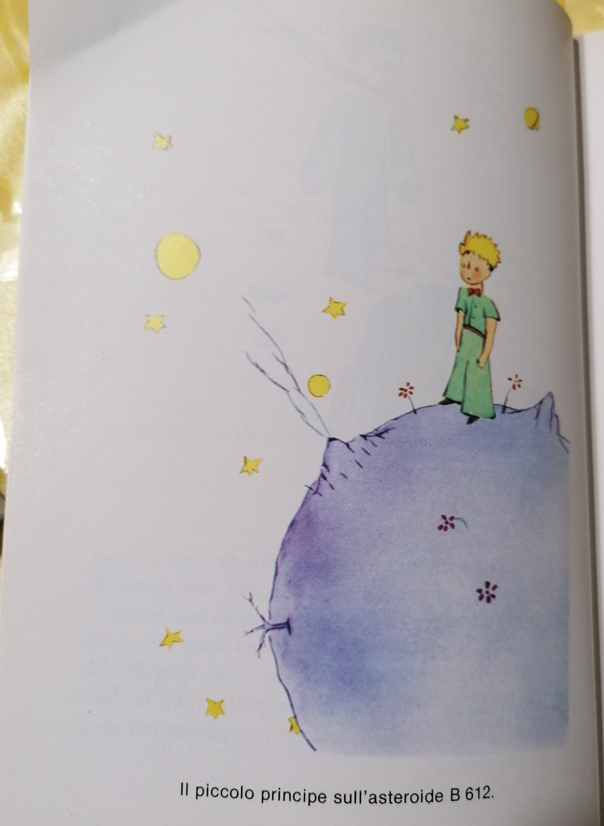
WE ARE ALONE IN THE IMMENSE SPACE THAT EXISTS !

Slide 3
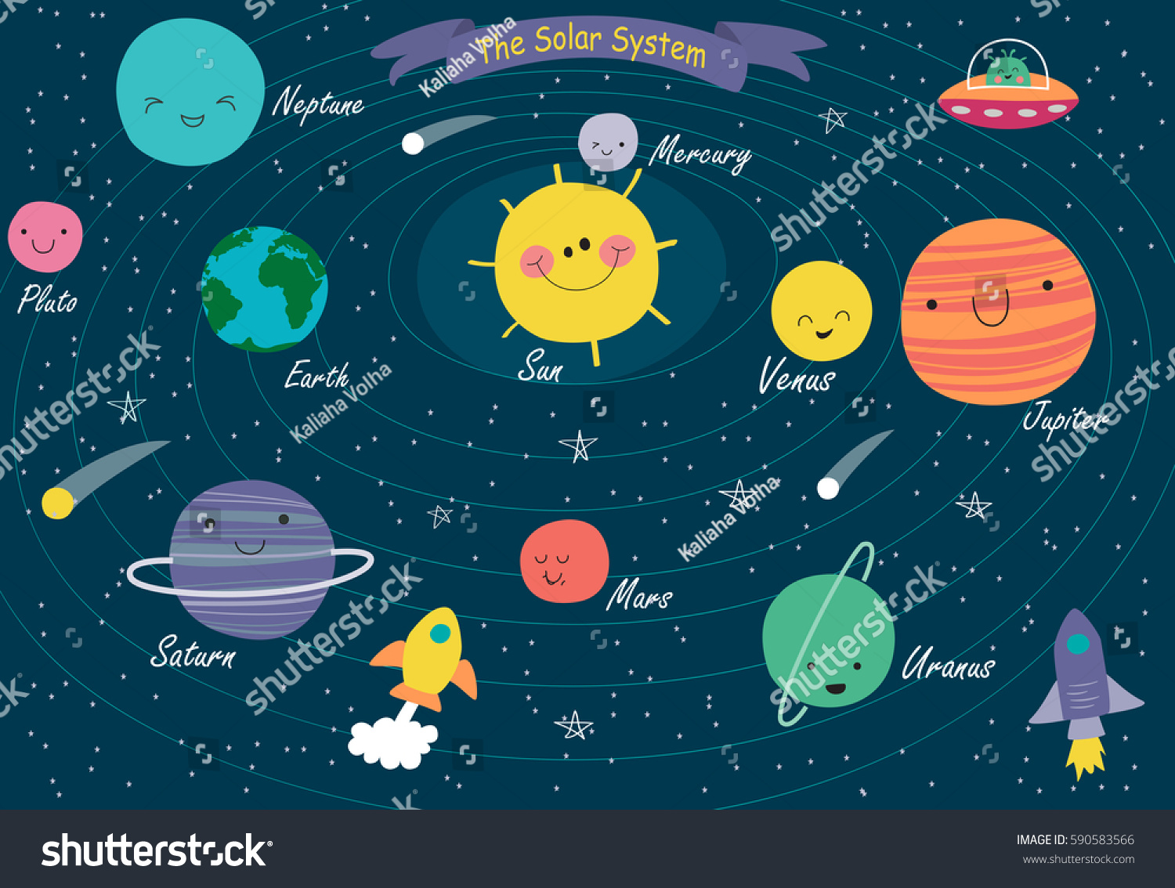
HERE WE ARE!

Slide 4
LOOK and MEMORIZE!

Slide 5
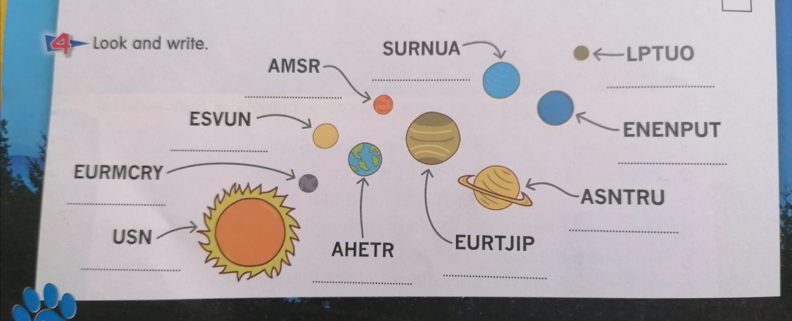
HOW FUNNY IT IS!

Slide 6
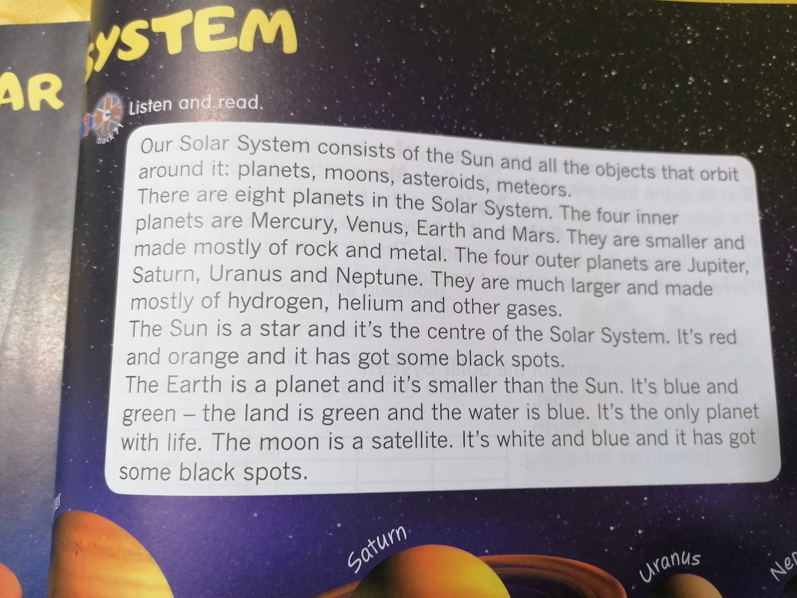
REPEAT . . . REPEAT. . . REPEAT . . .

Slide 7
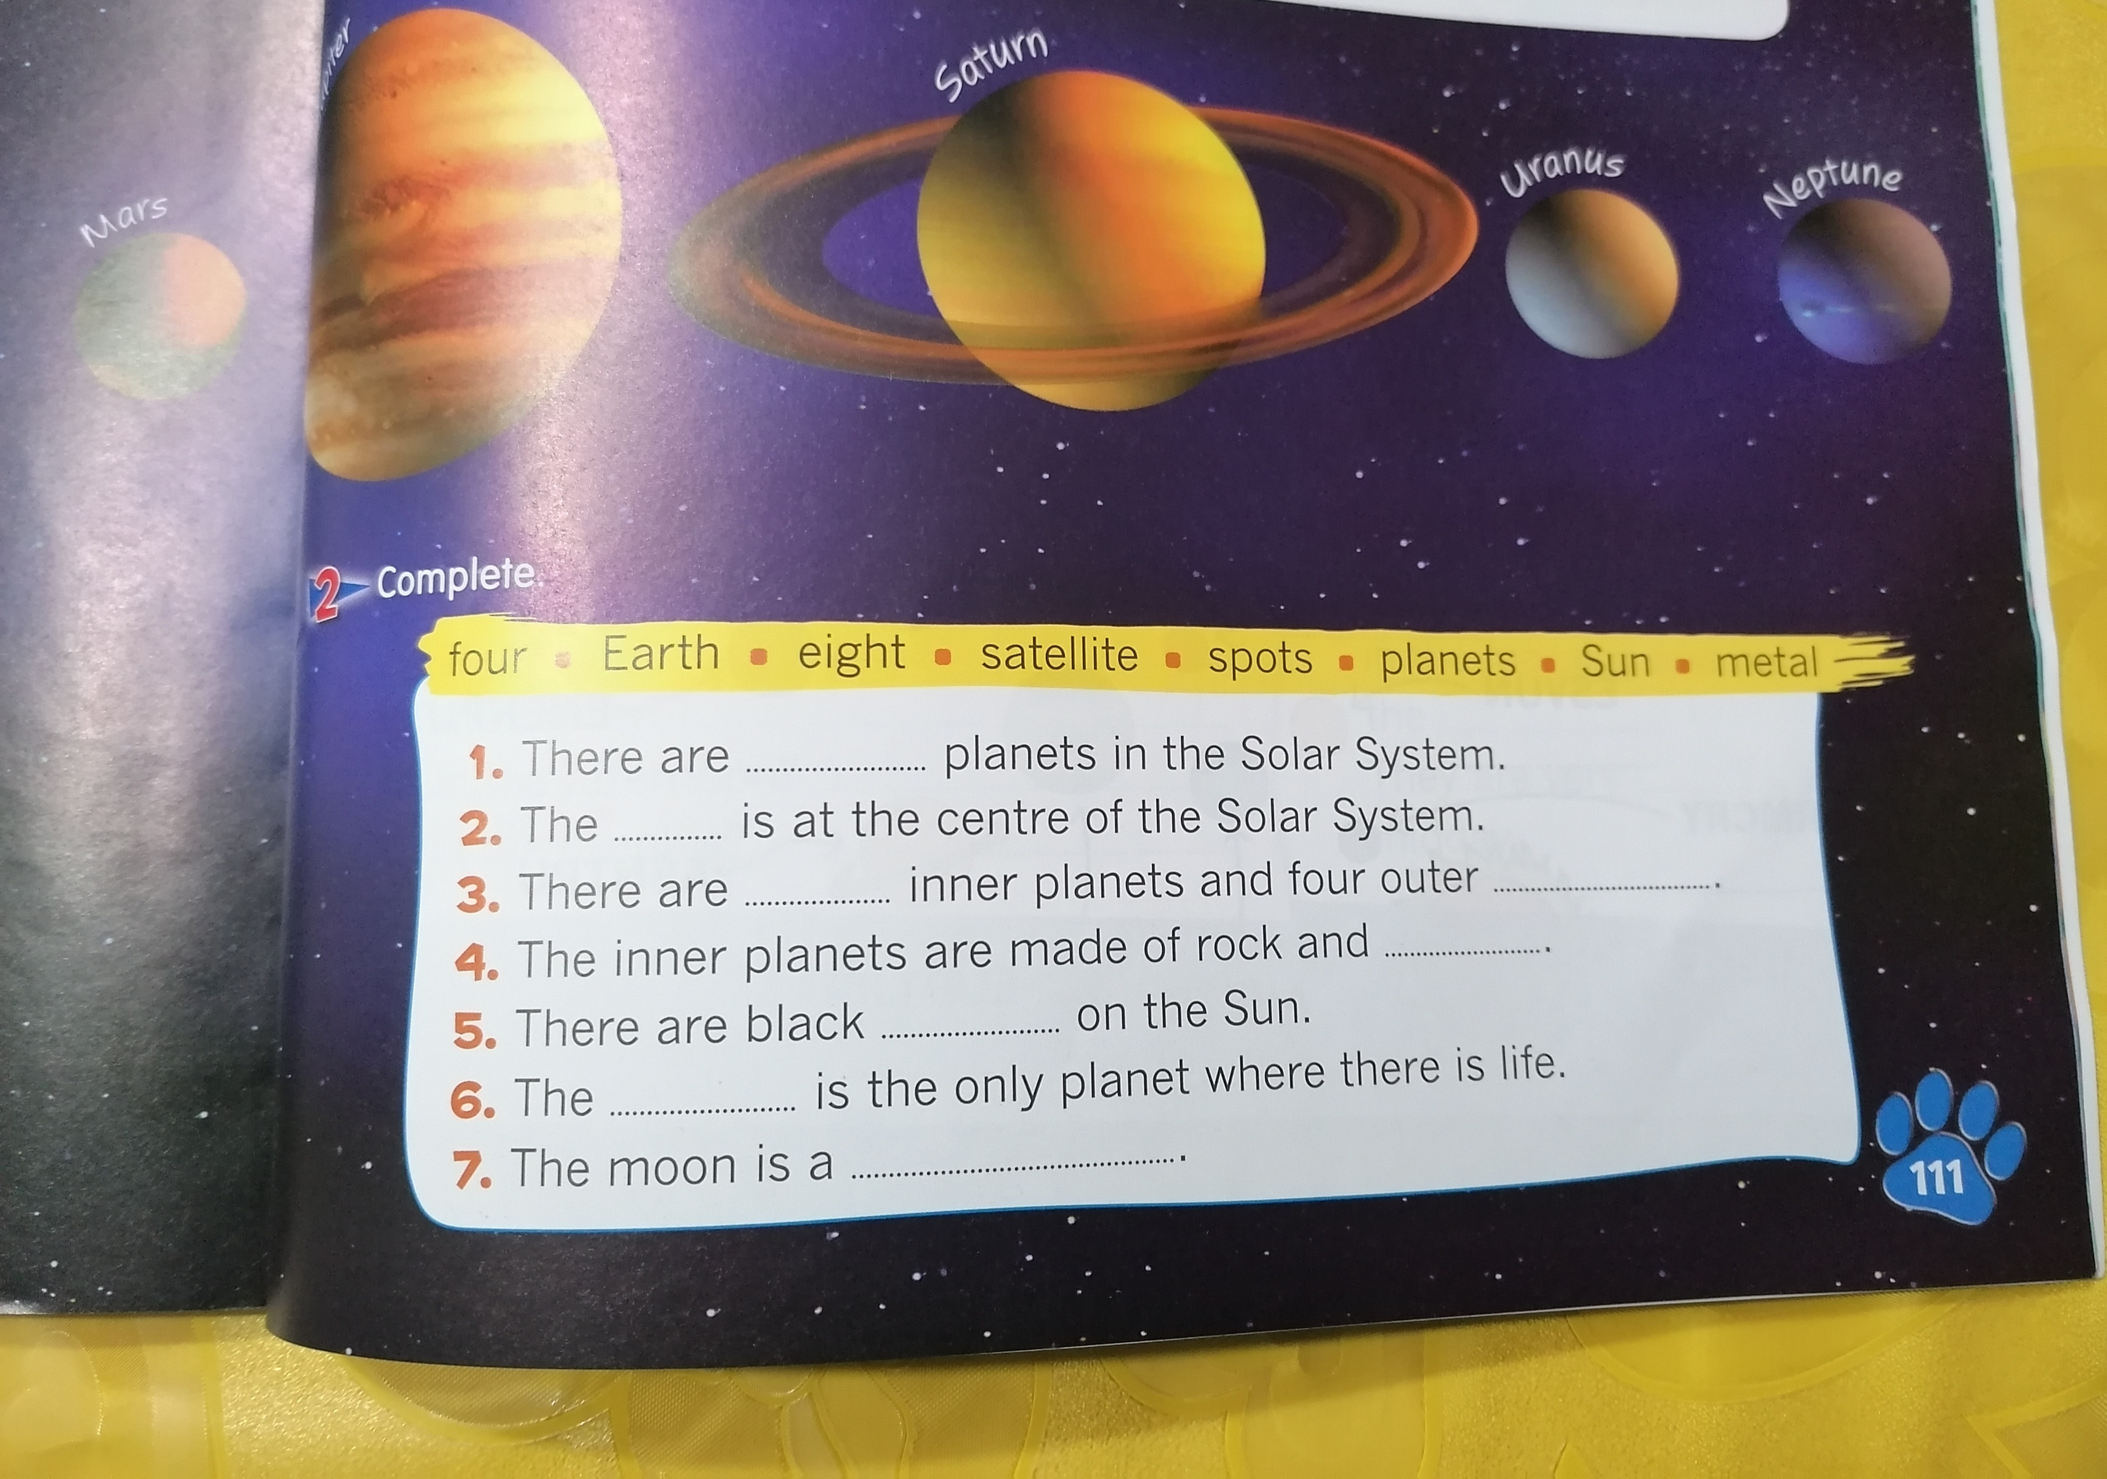
IT’S YOUR TURN, NOW!

Slide 8
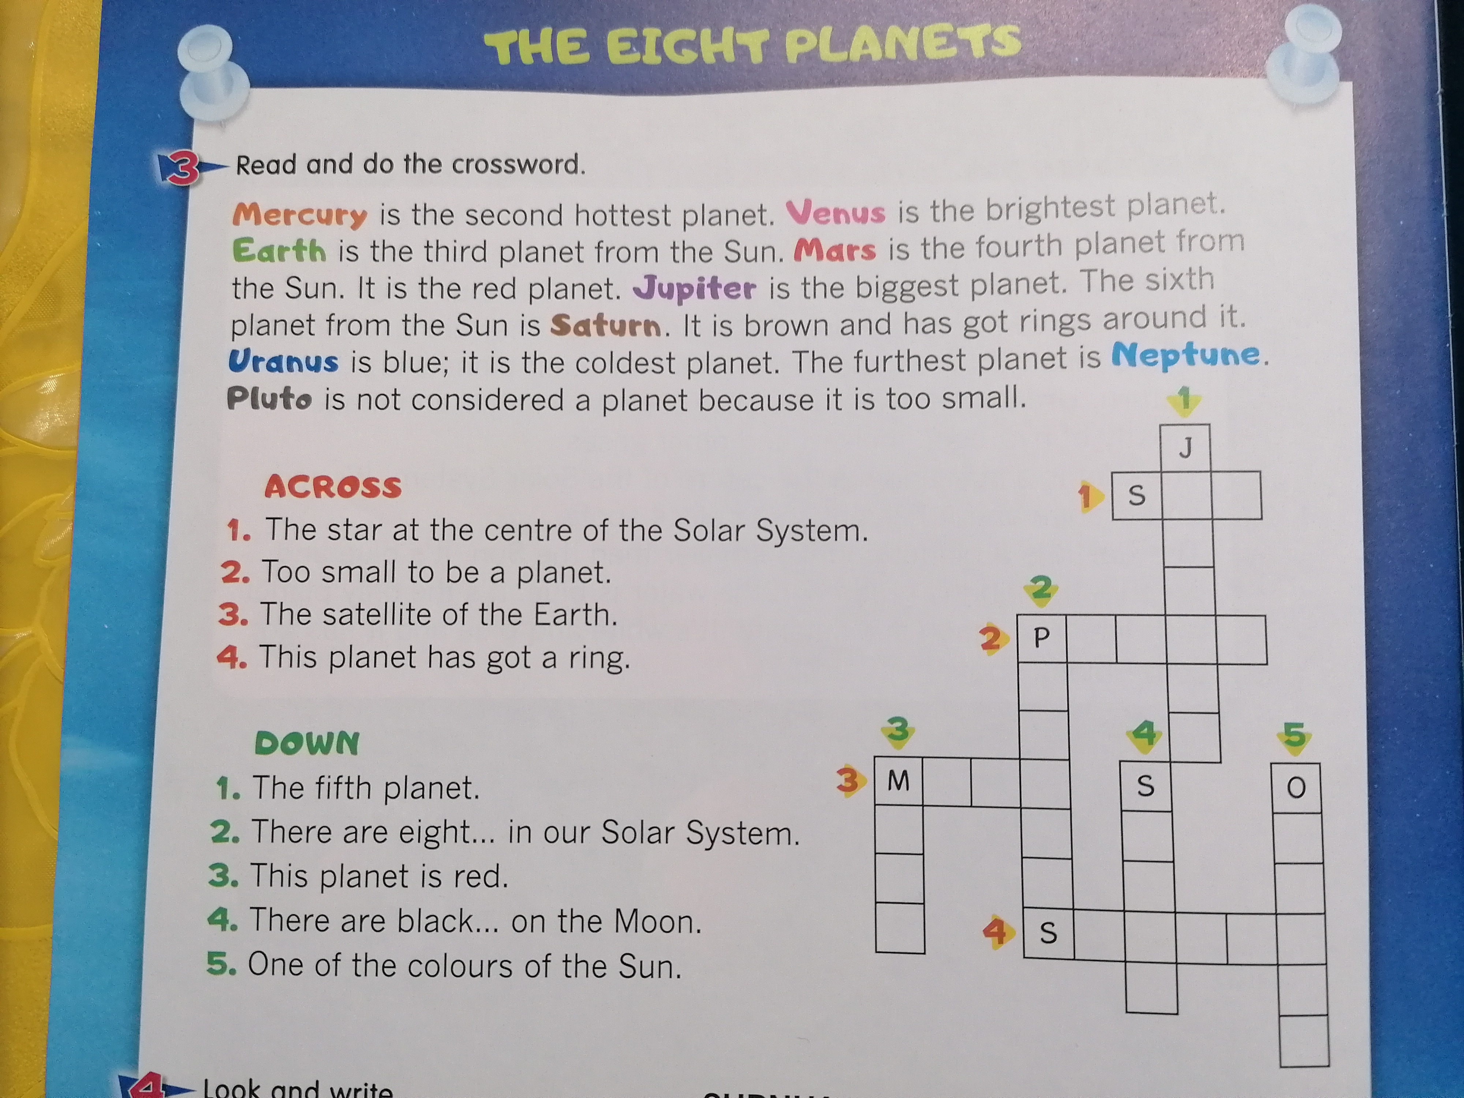
M
O R E O N !

Slide 11
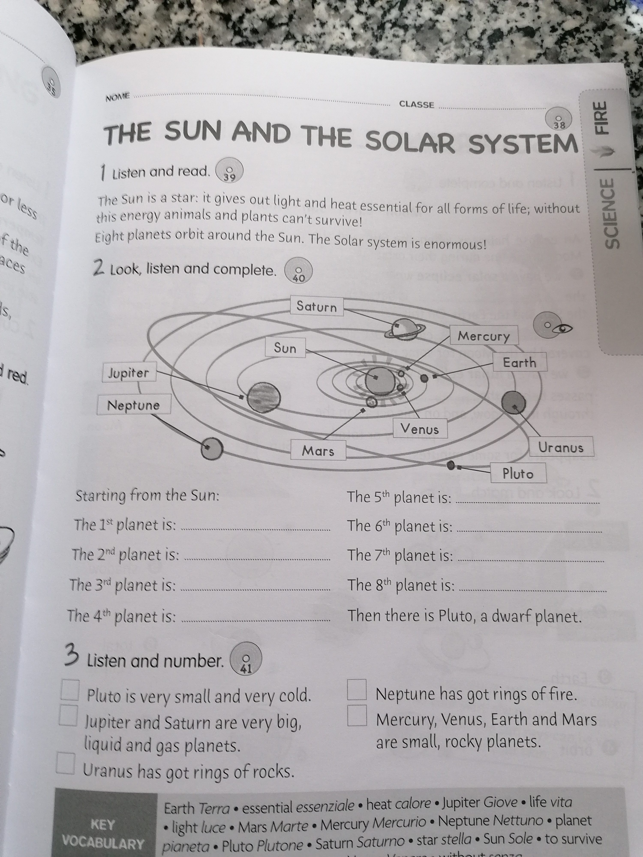
V E R I F I C A T I O N !

Slide 12
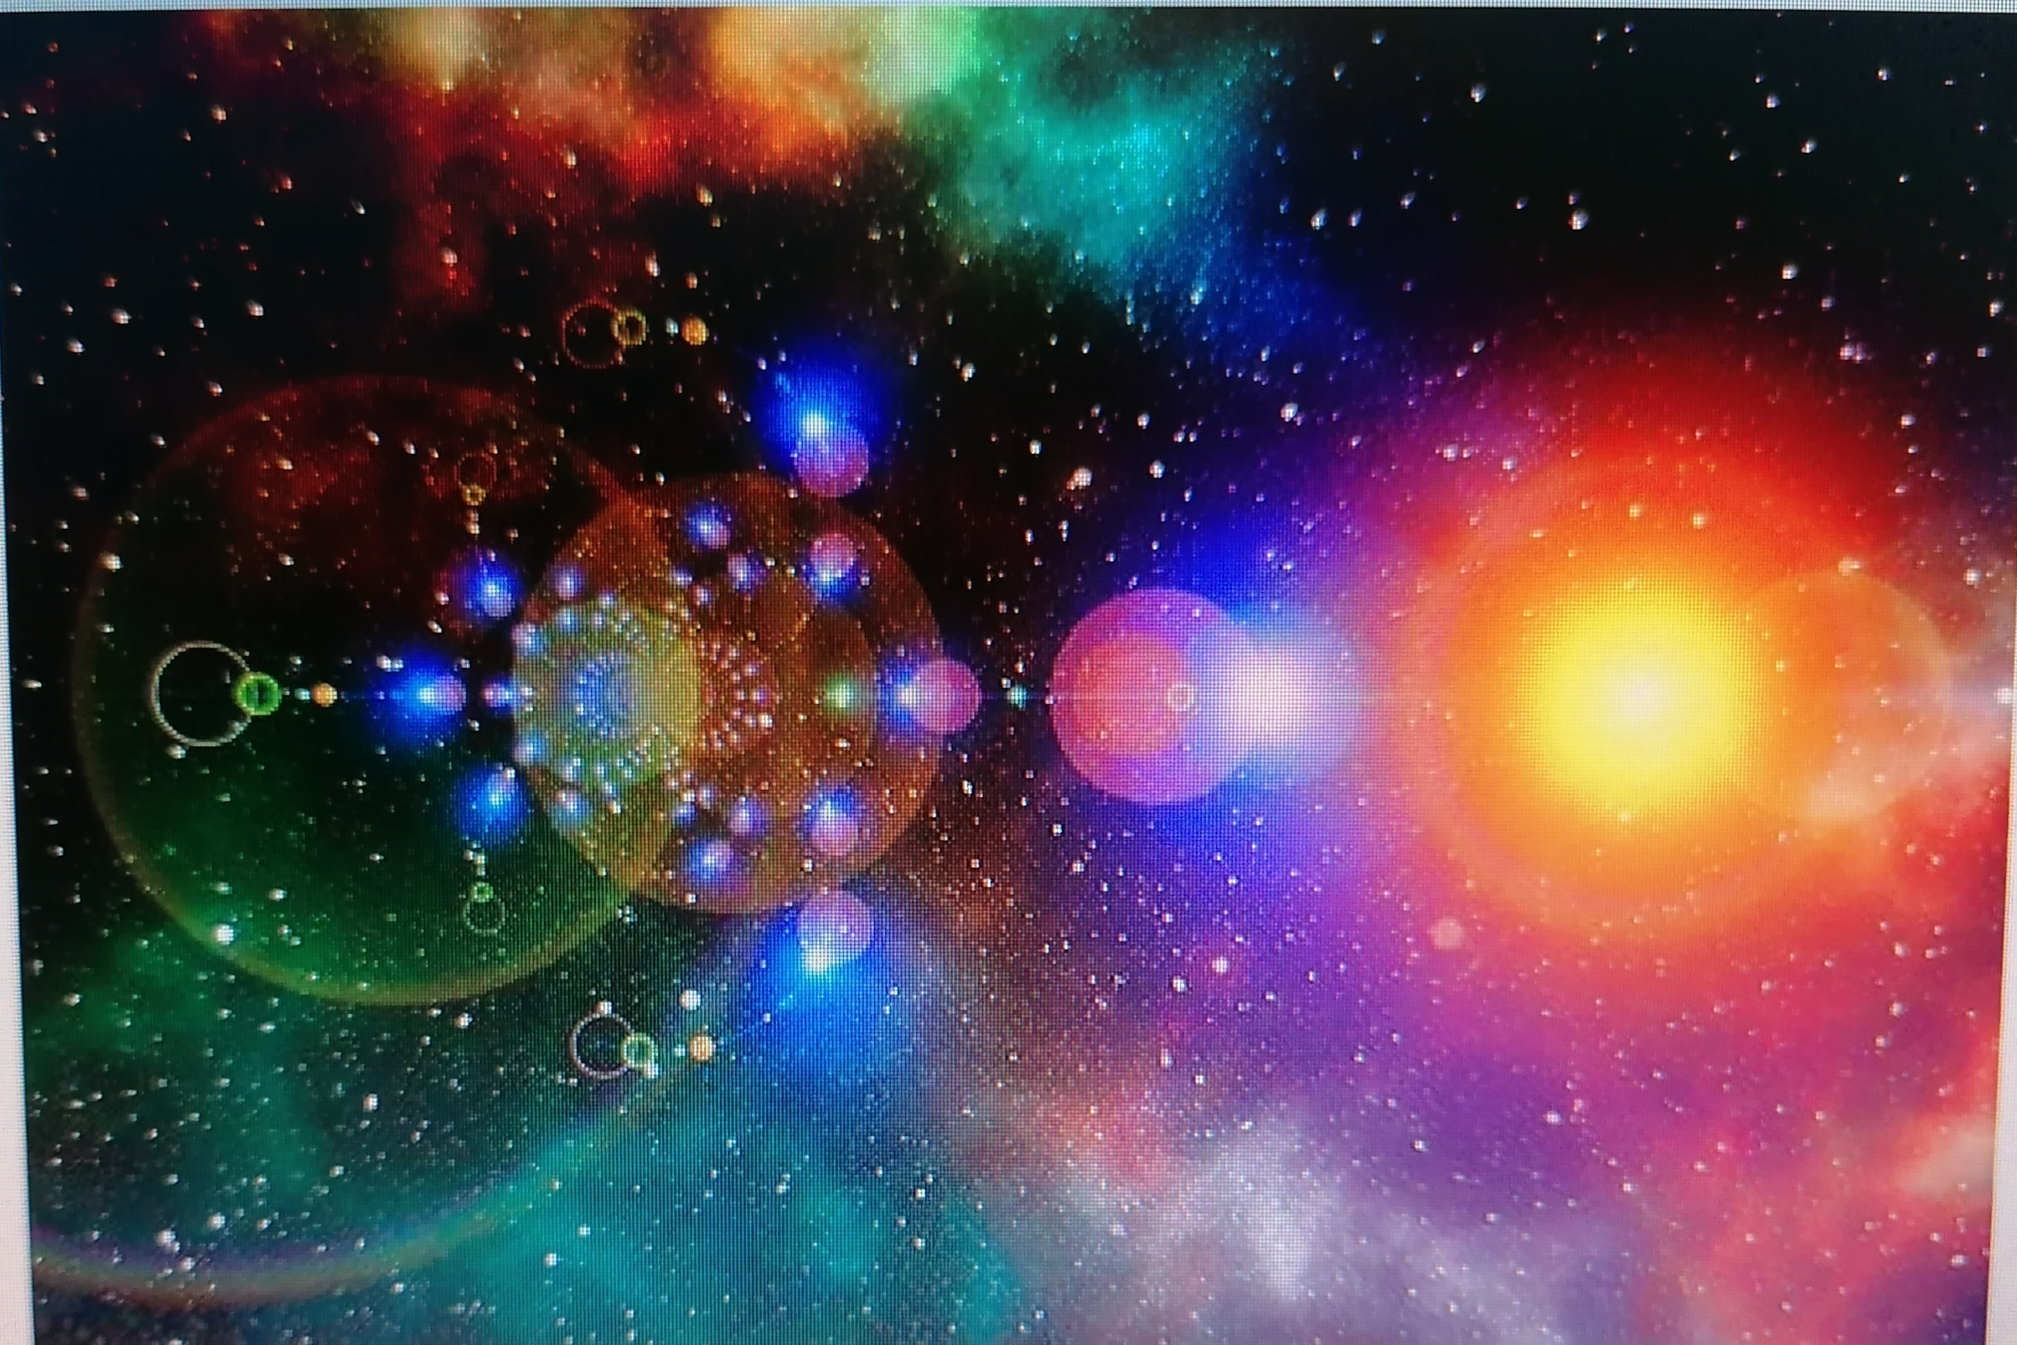
TRY DRAWING YOUR OWN UNIVERSE!

Slide 13
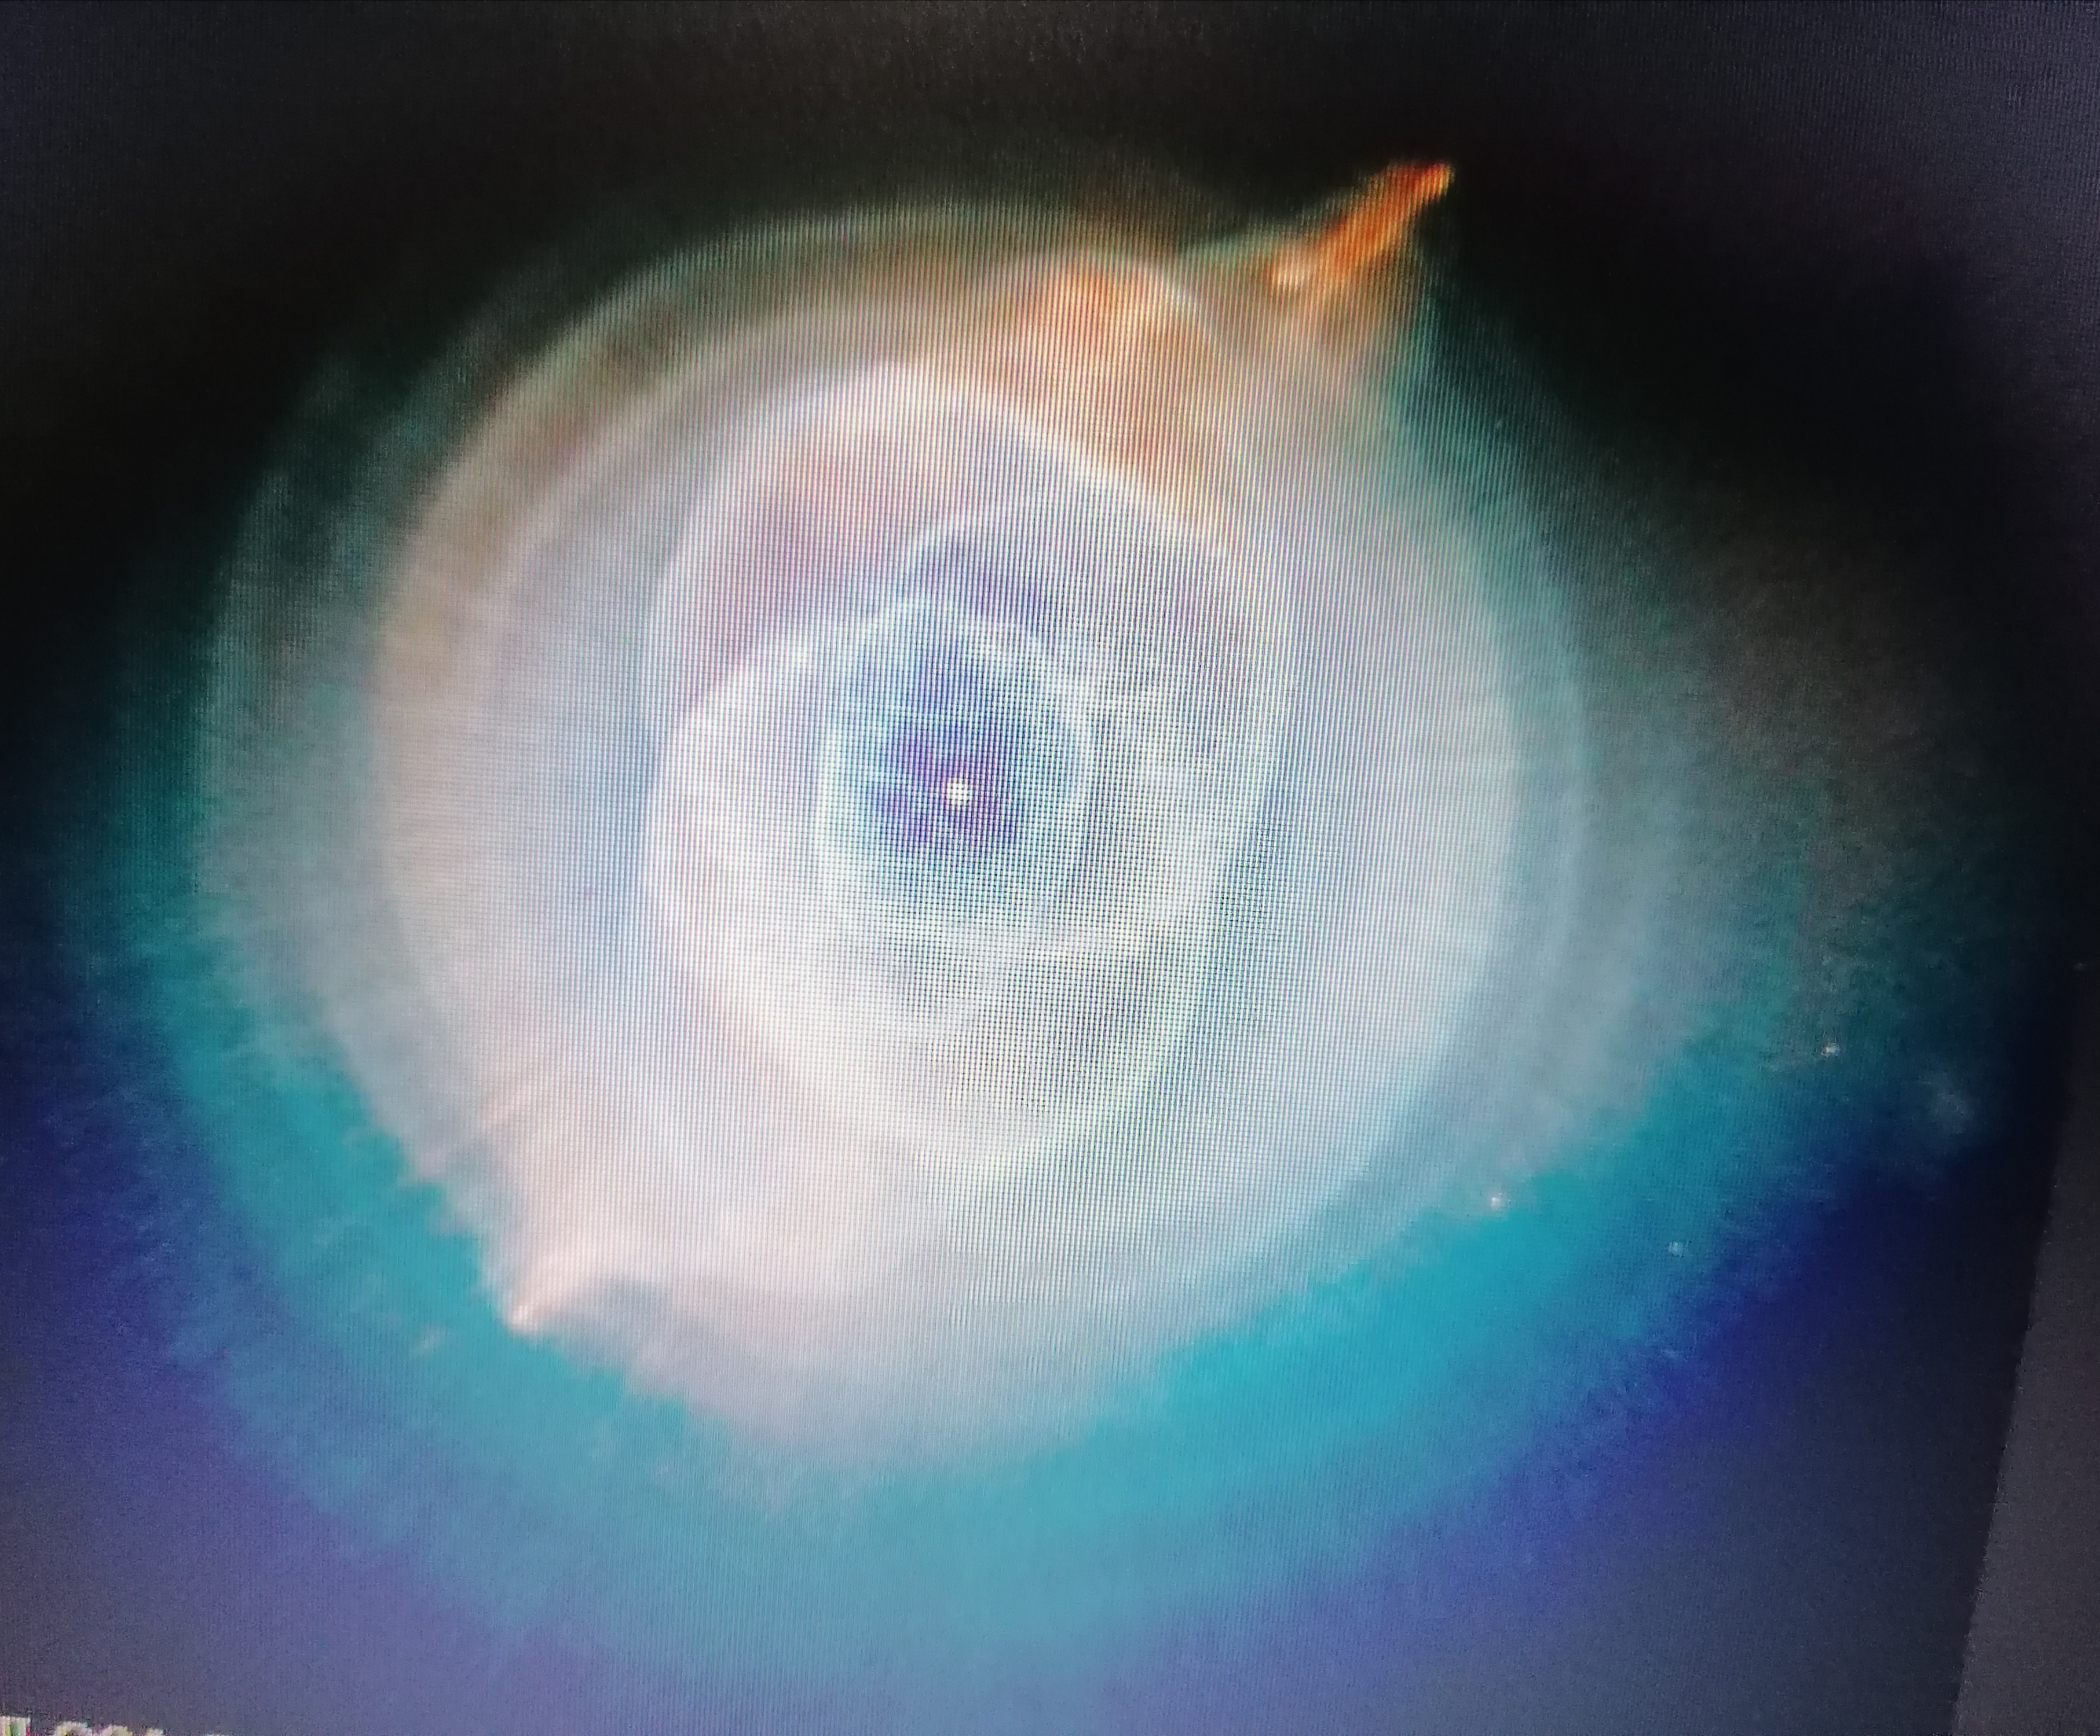
AND THE STARS ARE WATCHING !

