Slide 1
Ancora inglese
«The numbers»
Classe 3^ B Plesso Capoluogo
Ins. Pirozzi

Slide 2
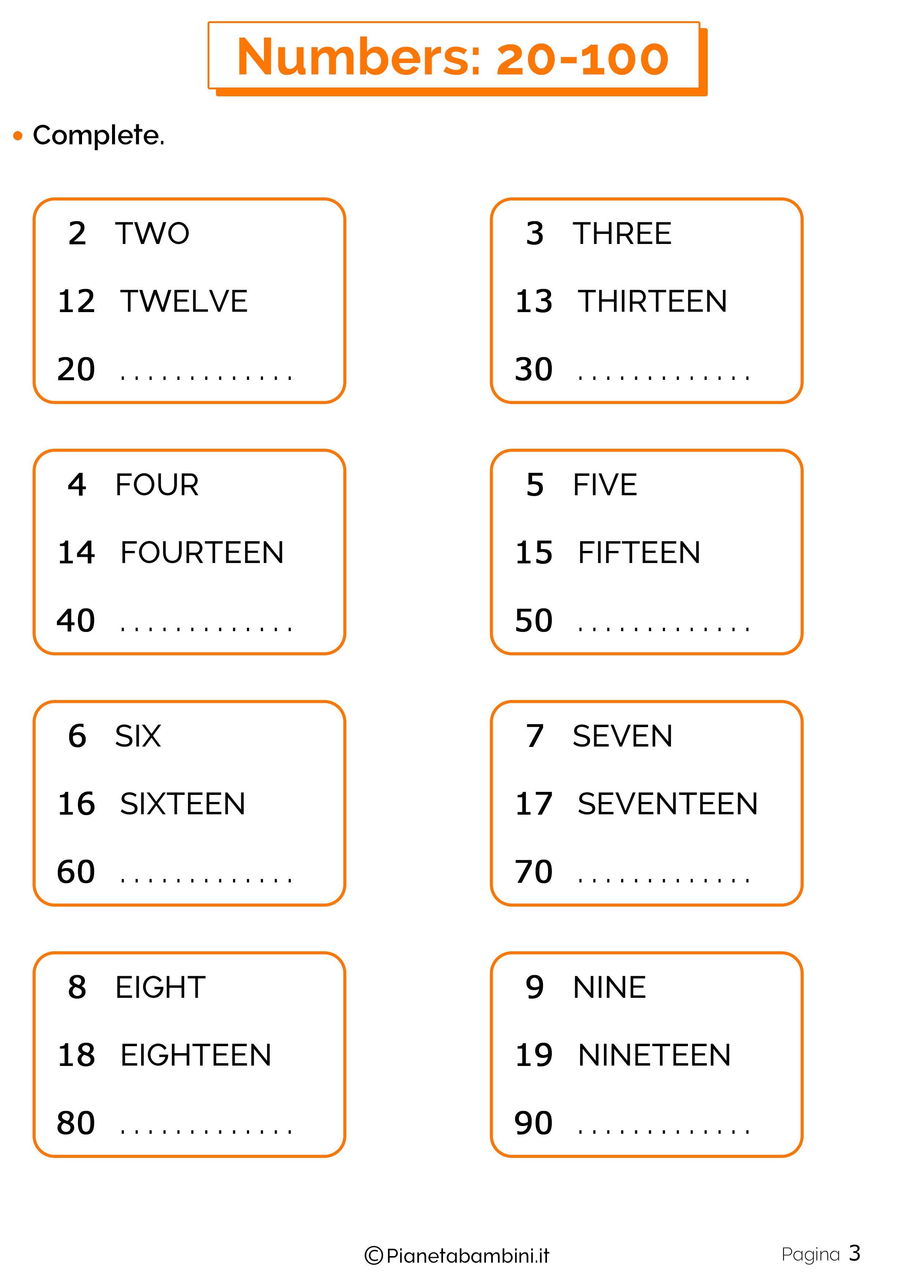

THE BIG NUMBERS 20-100
20 twenty
21twenty-one 40forty
22twenty-two 50fifty
23twenty-three 60sixty
24twenty- four 70seventy
25twenty-five 80eighty
26twenty-six 90ninety
27twenty-seven 100one-hundred
28twenty-eight
29twenty-nine
30thirty
Ascolta questa simpatica canzoncina e prova a memorizzare i numeri

Slide 3
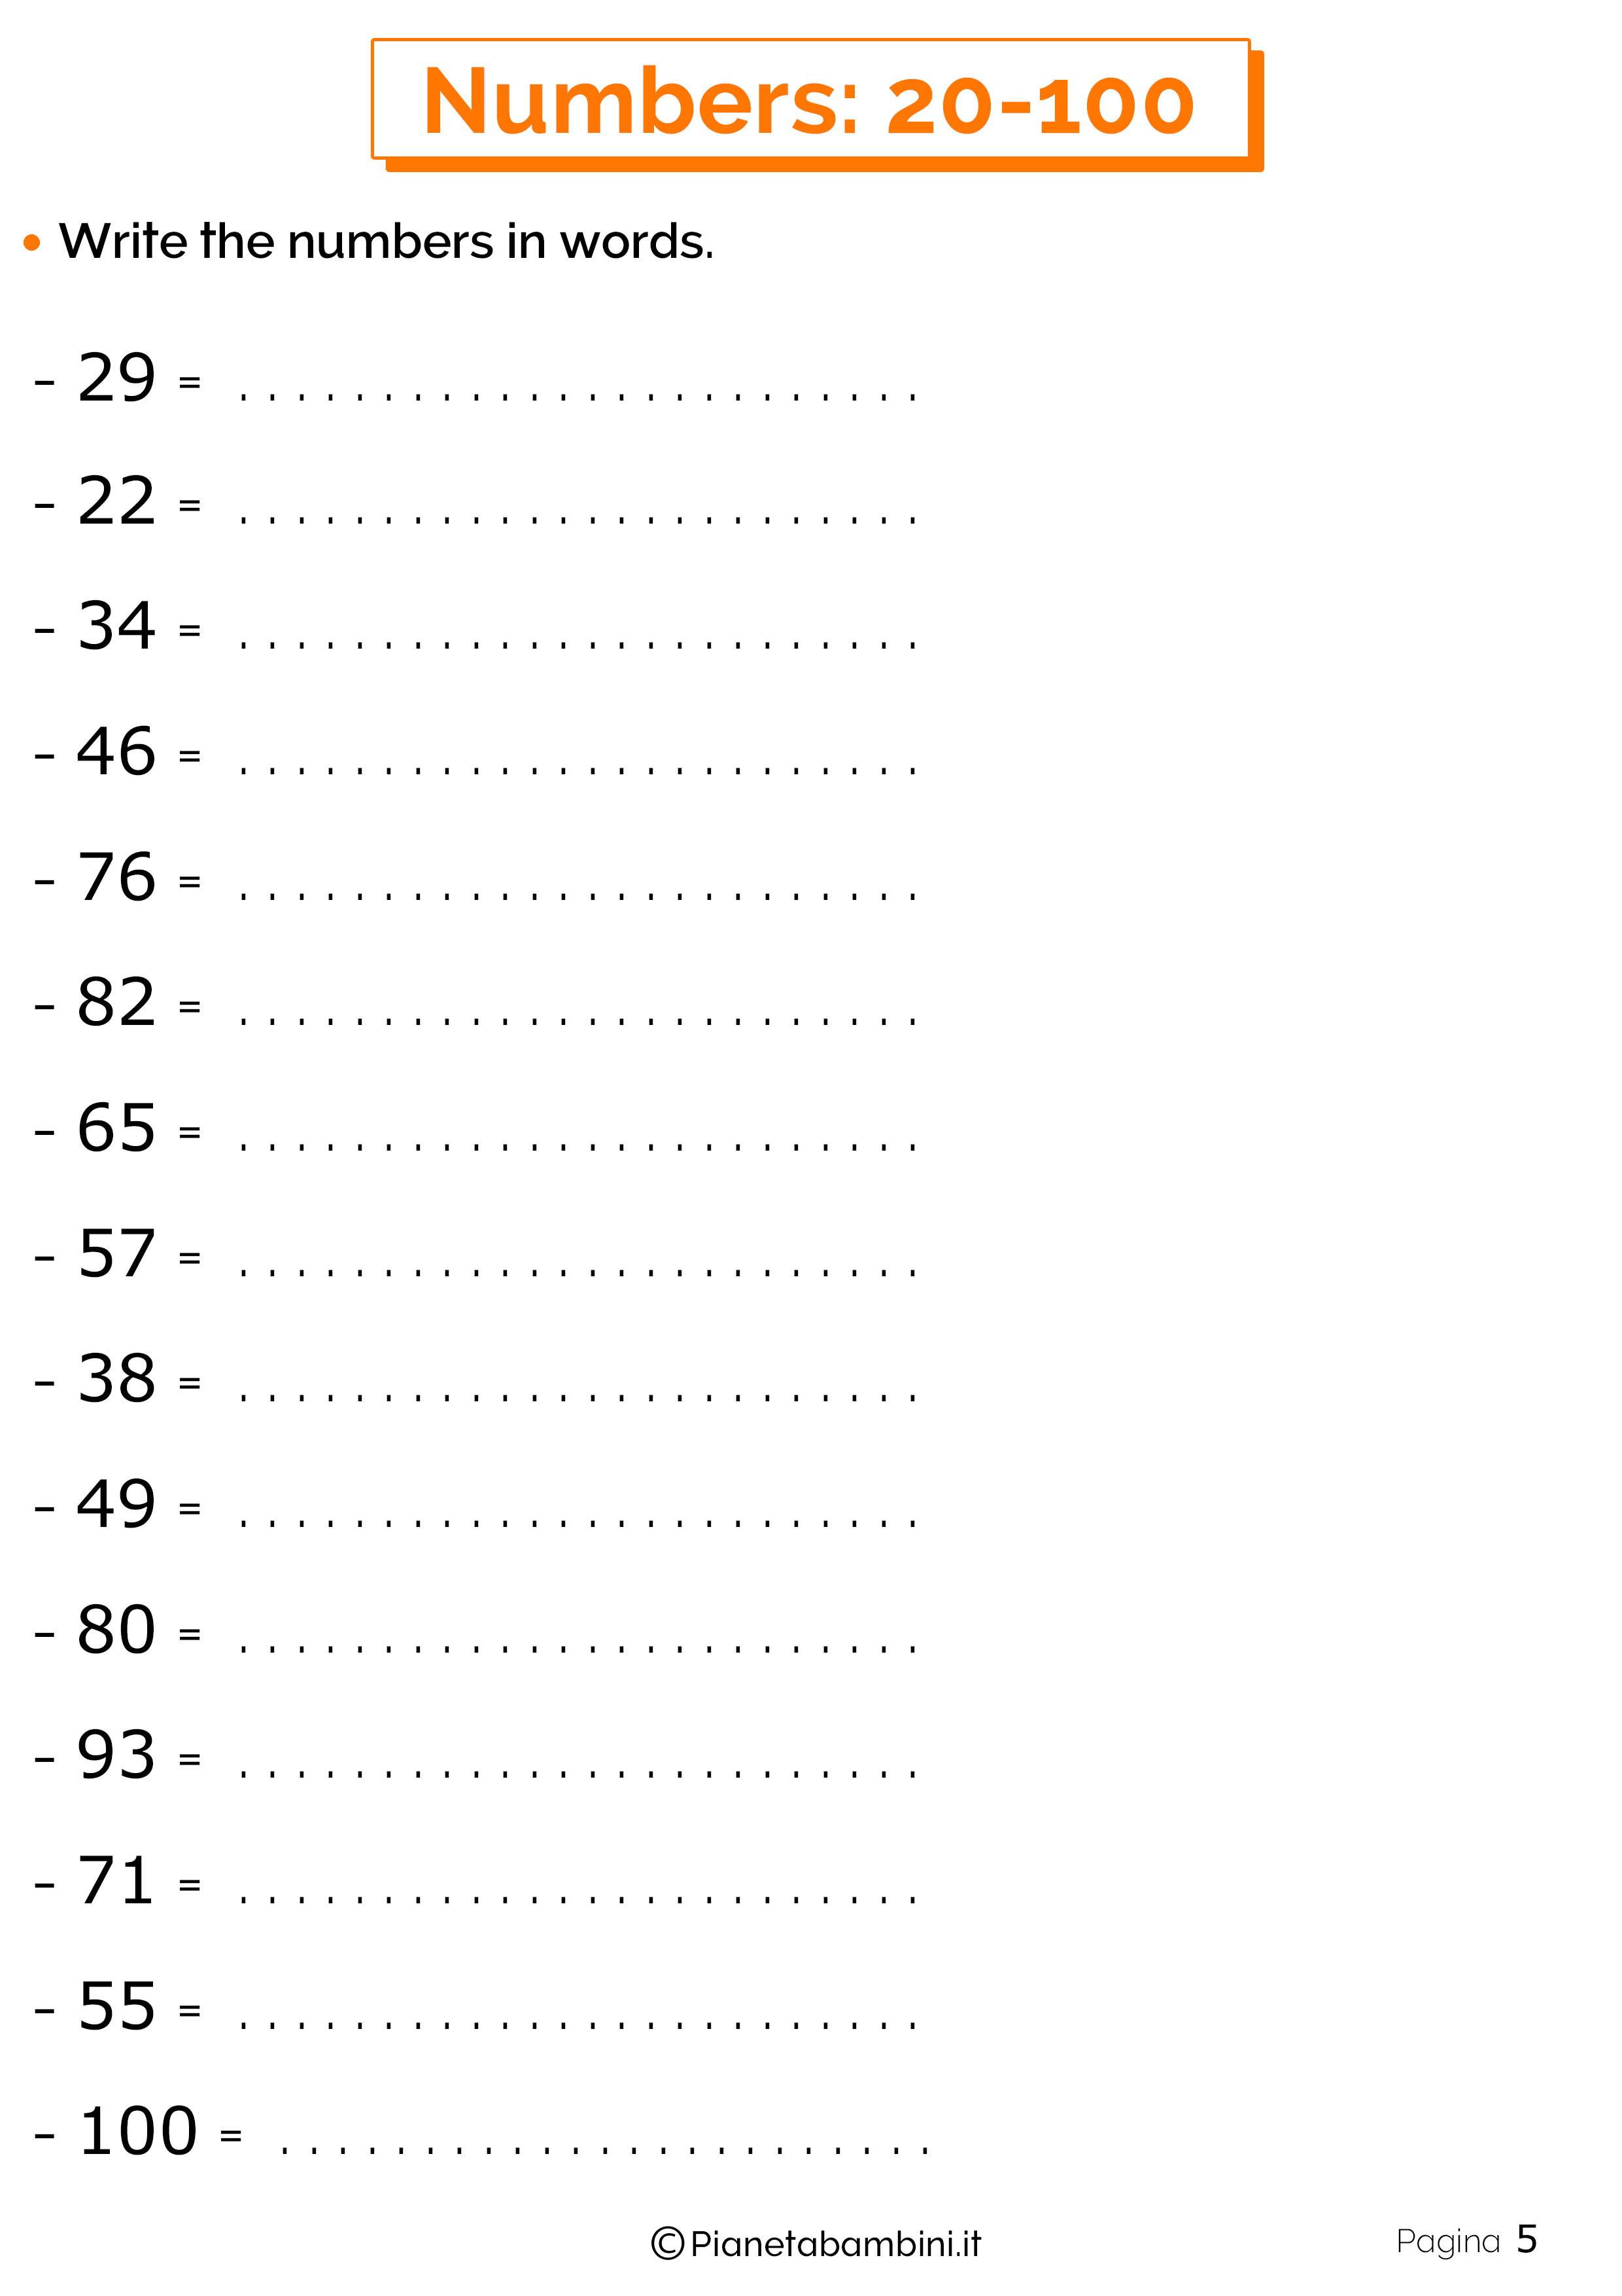
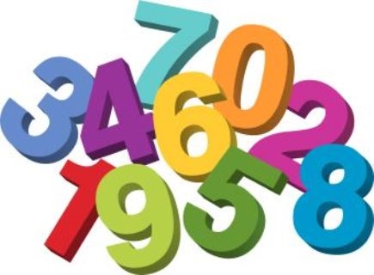

Slide 4
