Slide 1
INS. MARIA TERESA D’AMORE

Slide 2
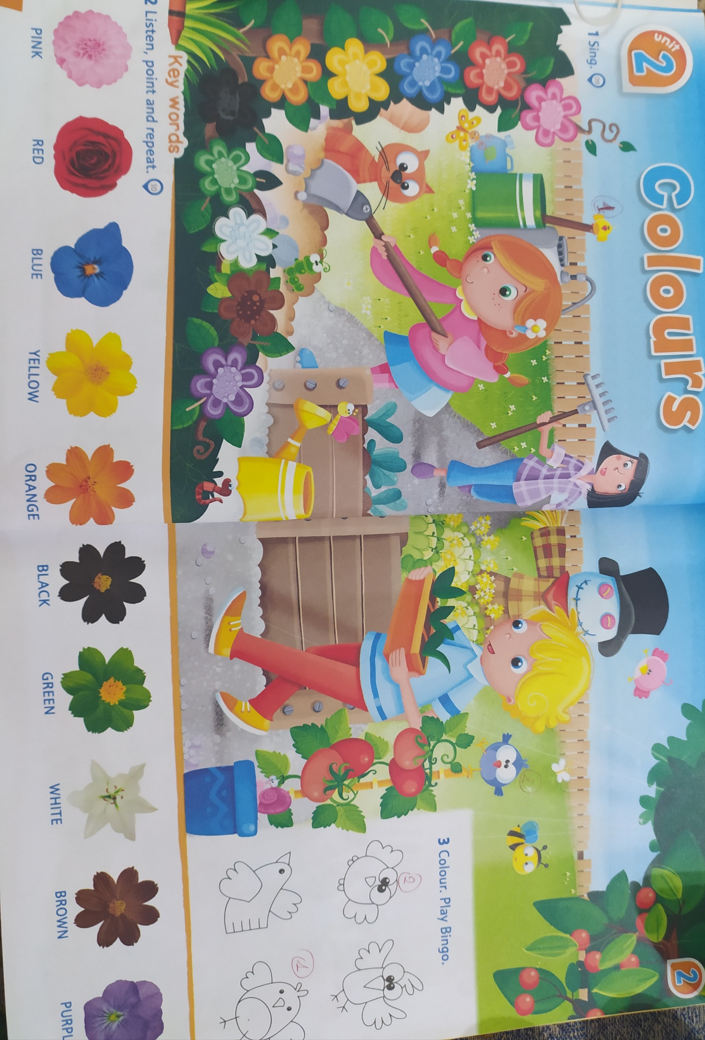
ENGLISH COLOURS BY STORY LANE

Slide 3
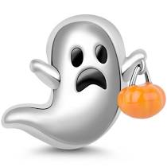
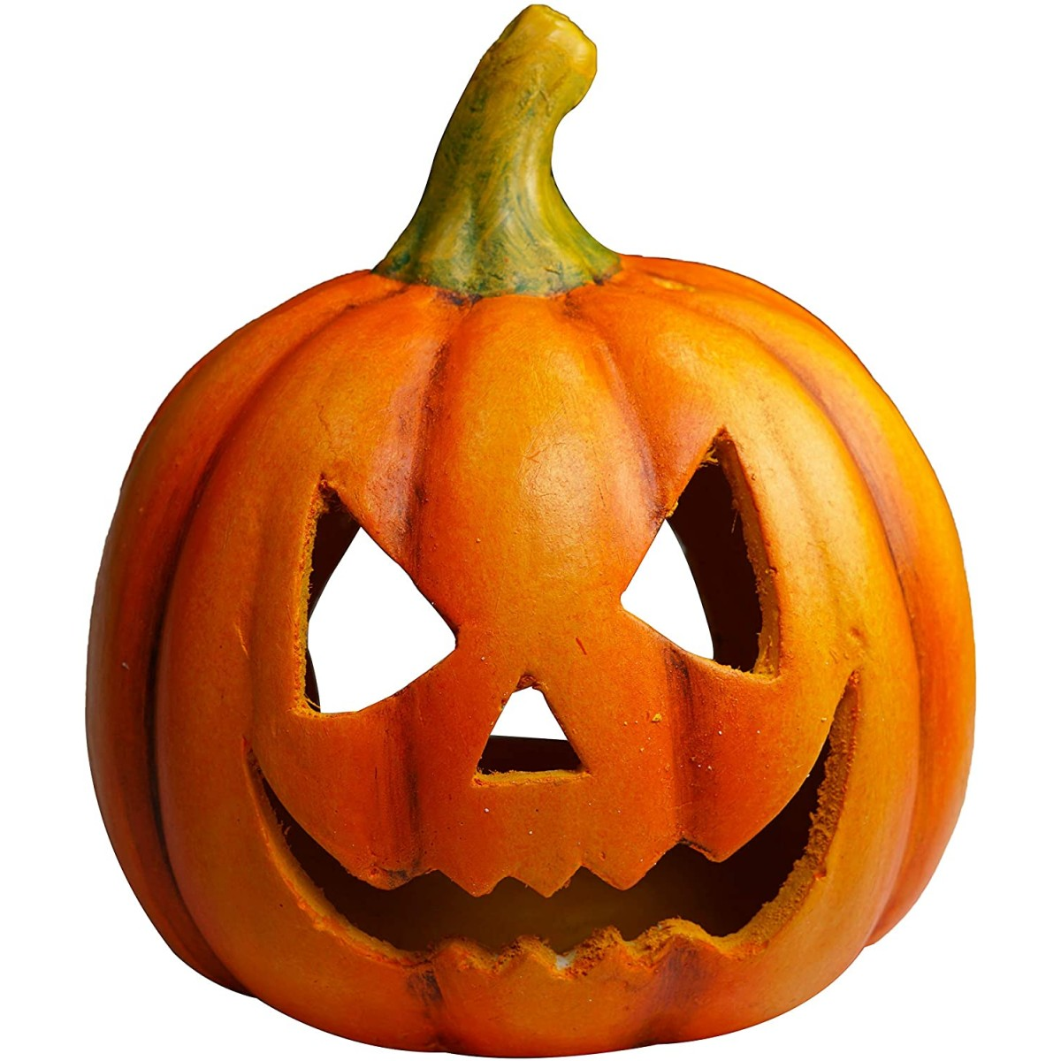
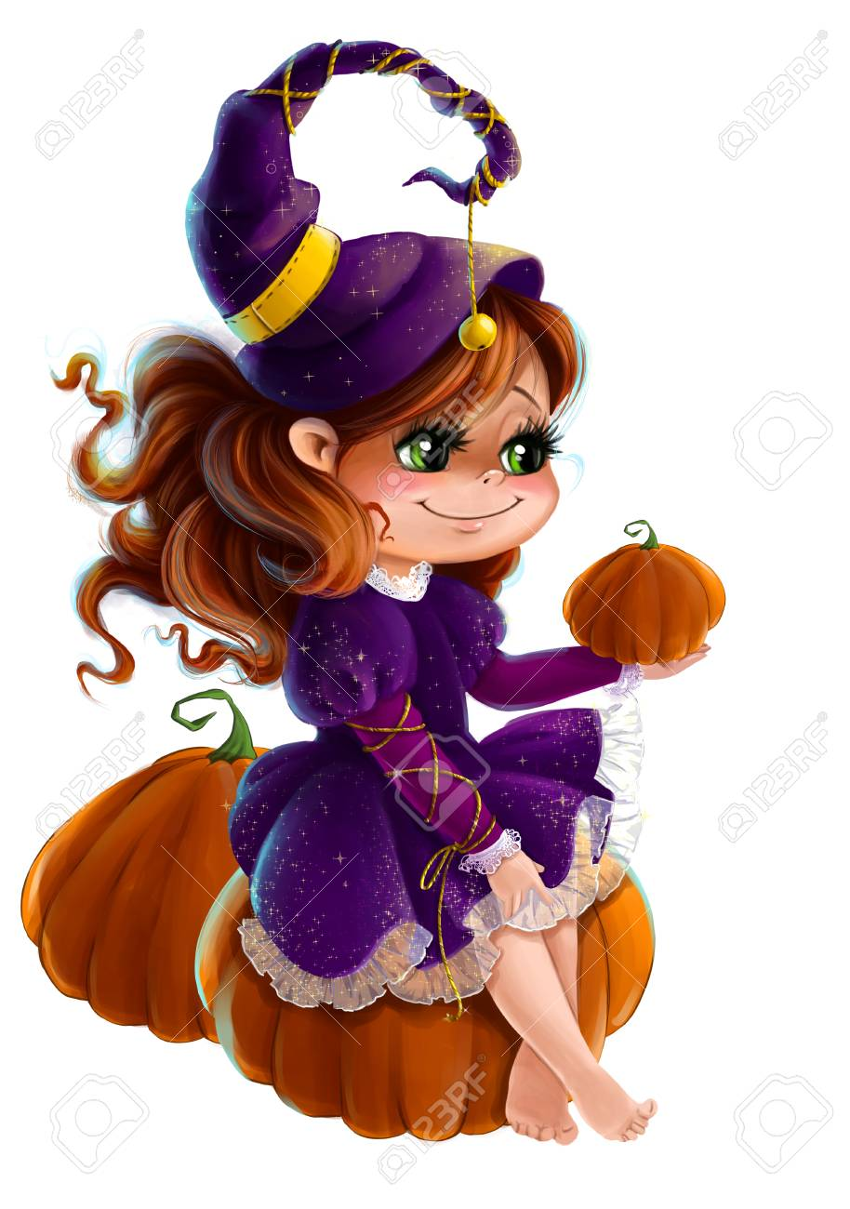
BLACK WHITE ORANGE HALLOWEEN COLOURS
GREEN
PURPLE

Slide 4
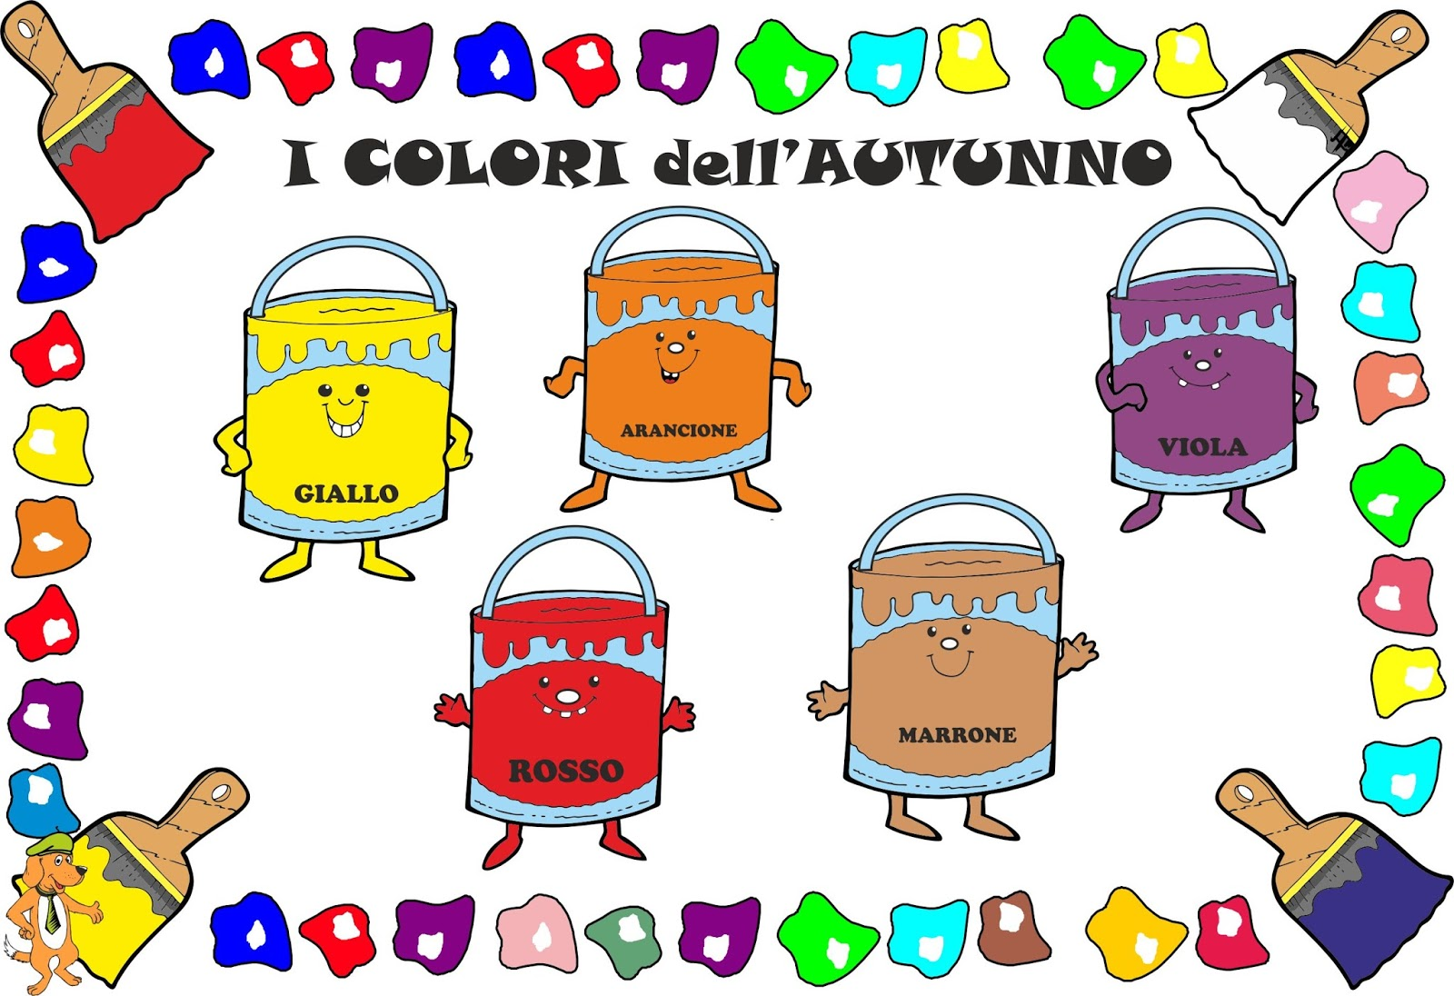
AUTUMN COLOURS
ORANGE
PURPLE
YELLOW
BROWN
RED

