Slide 1
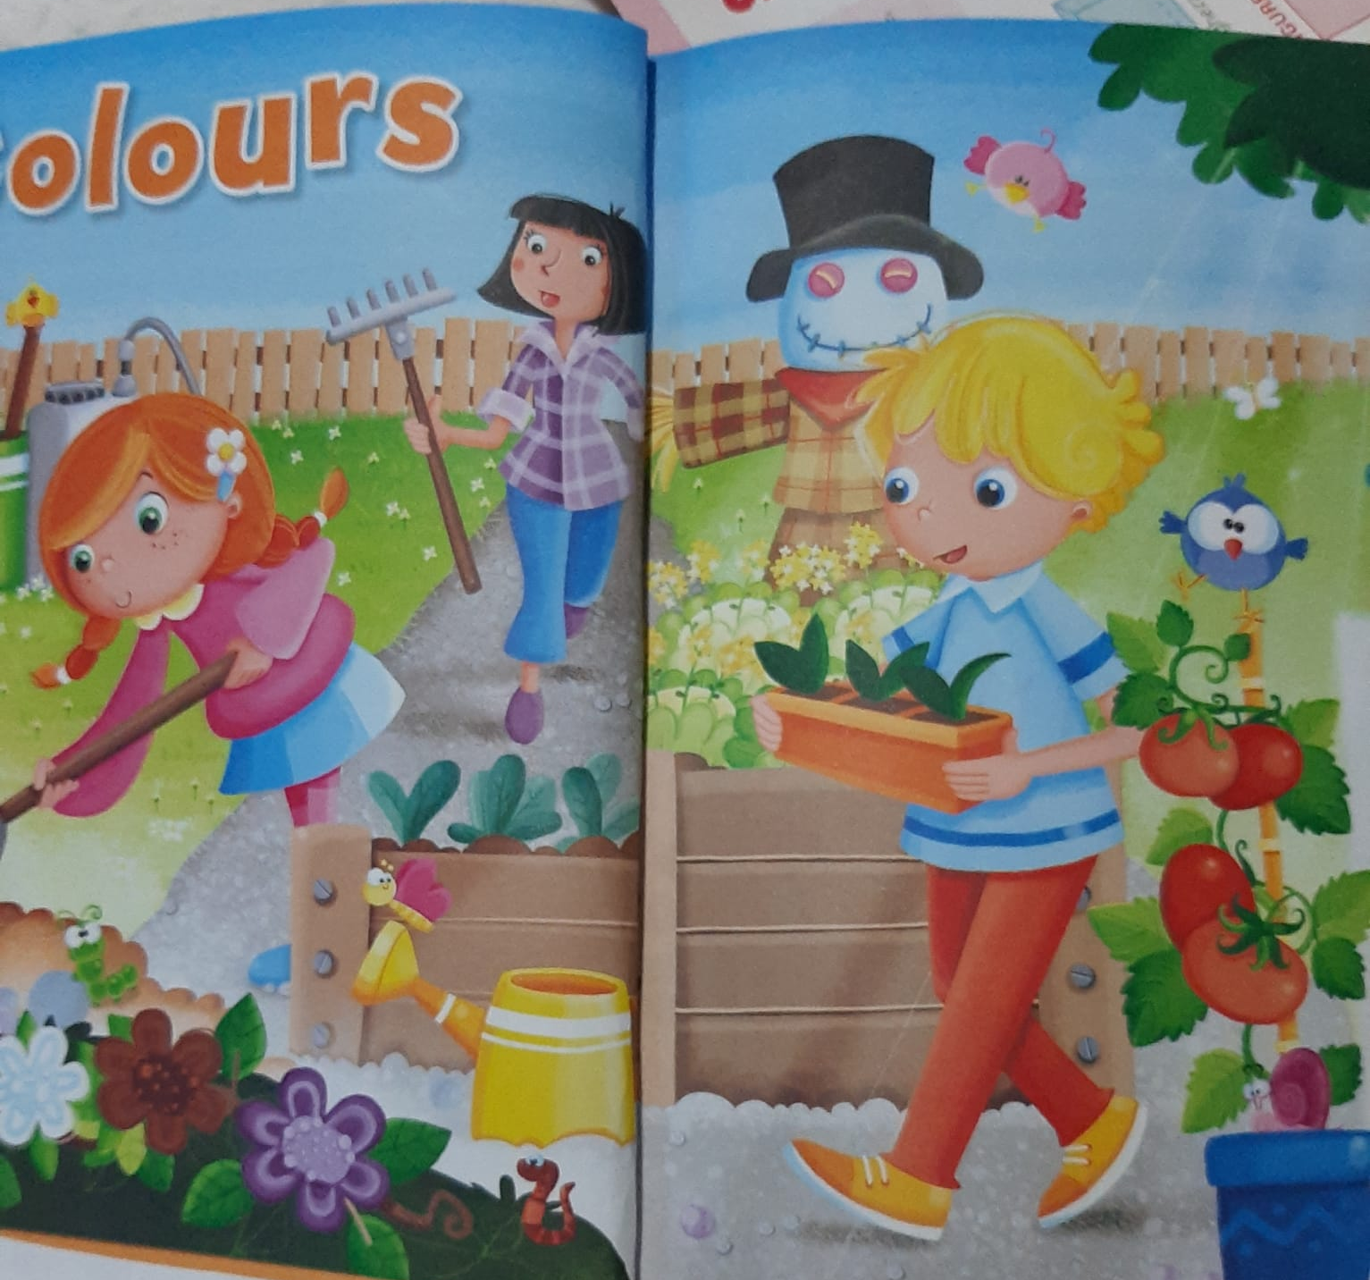
A LOT OF COLOURS !

Slide 2
COLORFUL FLOWERS

Slide 3
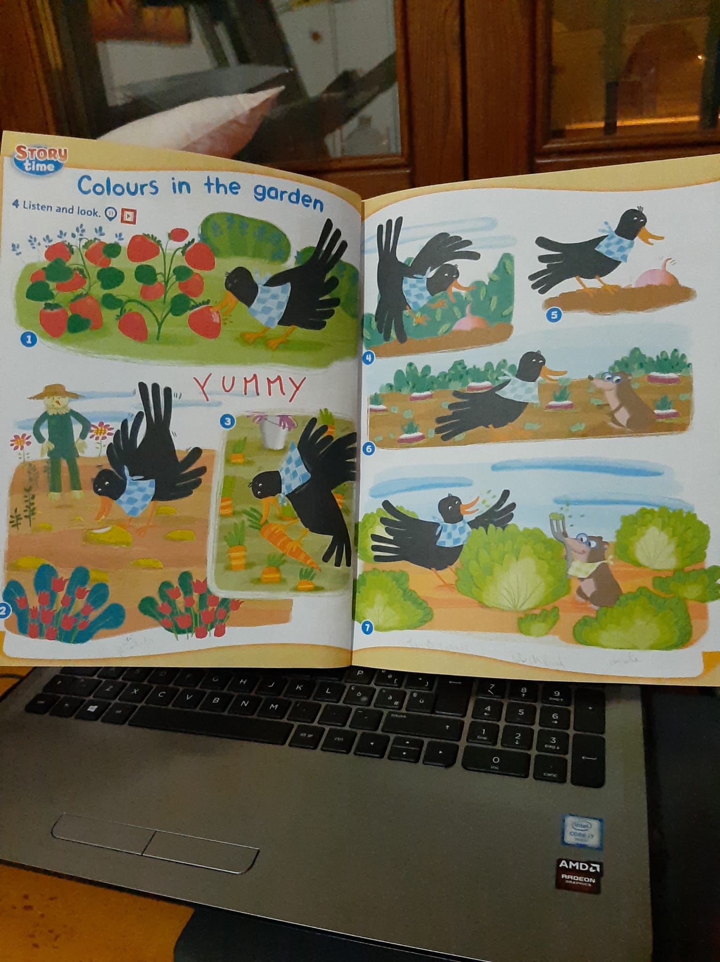

Slide 4
