Slide 1
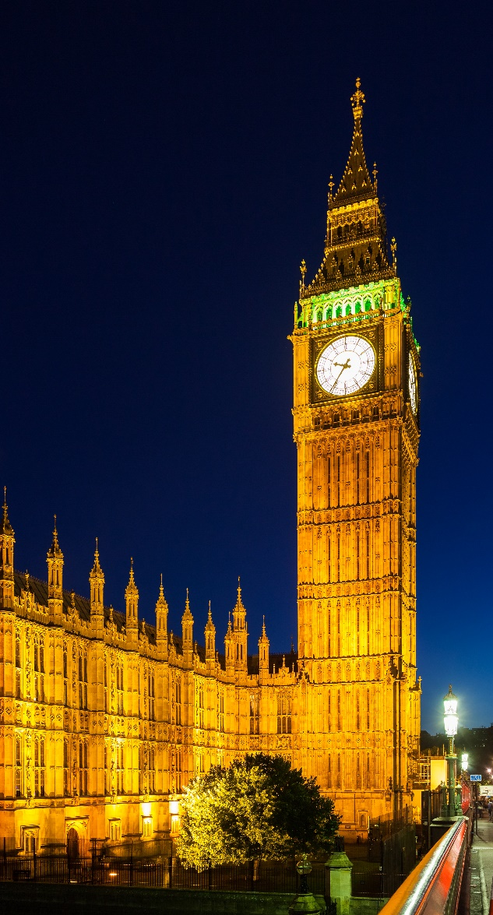
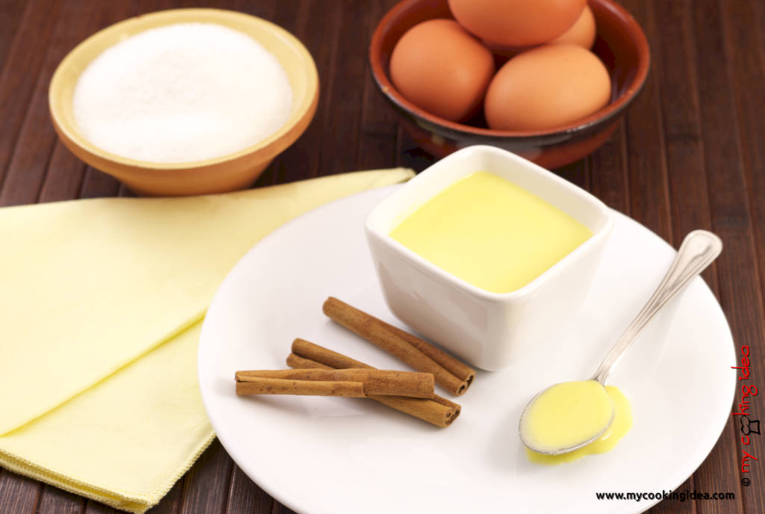
ENGLISH

Slide 2
THE DAYS OF THE WEEK
SUNDAY
MONDAY
TUESDAY
WEDNESDAY
THURSDAY
FRIDAY
SATURDAY
In inglese i giorni della settimana si scrivono con la lettera maiuscola e si elencano a partire dalla domenica

Slide 3
Timetable 4 F
Day | Subject | Hour
Monday |  | 9,00-9,45
 |  | 10,00-10,45
 |  | 11,00-11,45
Tuesday
Timetable 4 F
Complete in your notebook

Slide 4
Complete
Example: The first day of the week is Sunday.
Saturday is the……………….day of the week.
Wednesday is the………………. day of the week.
………….. Is the second day of the week.
….………. Is the sixty day of the week.
Tuesday is the ………. day of the week.
……………. Is the fifth day of the week.

Slide 5
