Slide 1
Il verbo have got
Simple present
Forma affermativa
Forma negativa

Slide 4
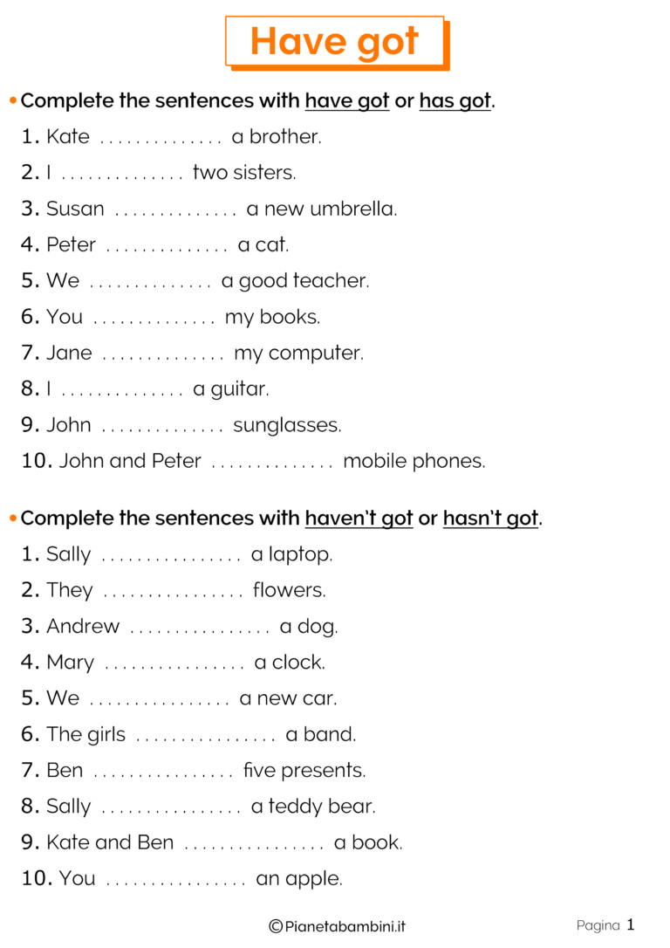
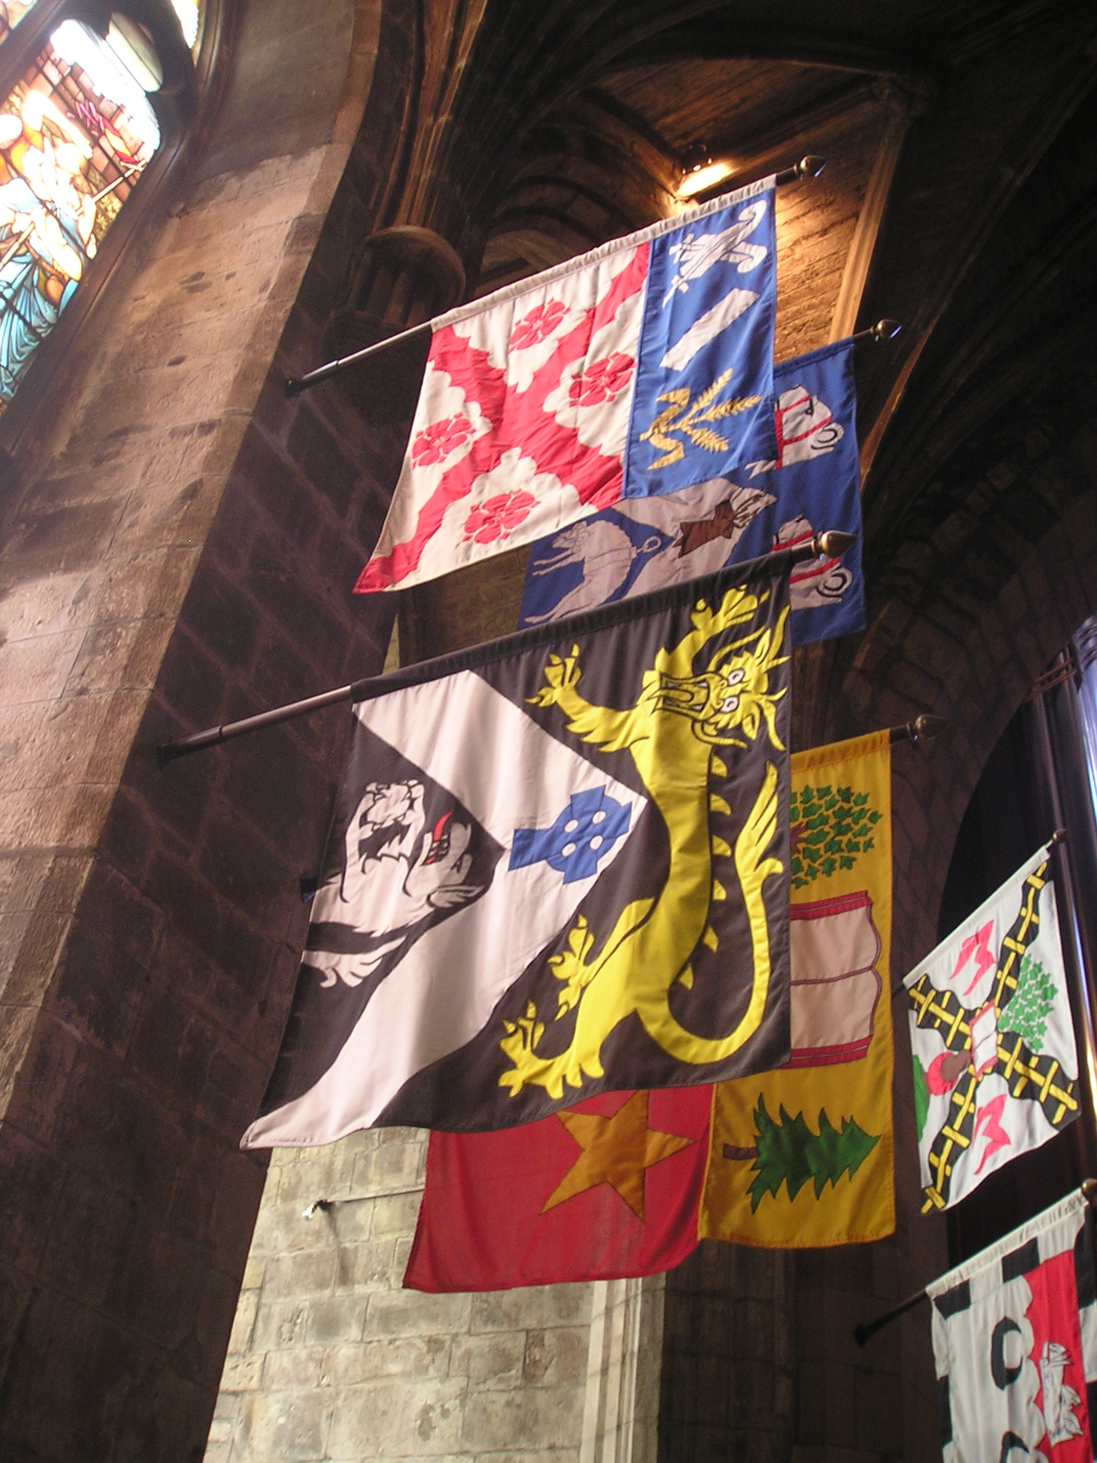

Slide 5
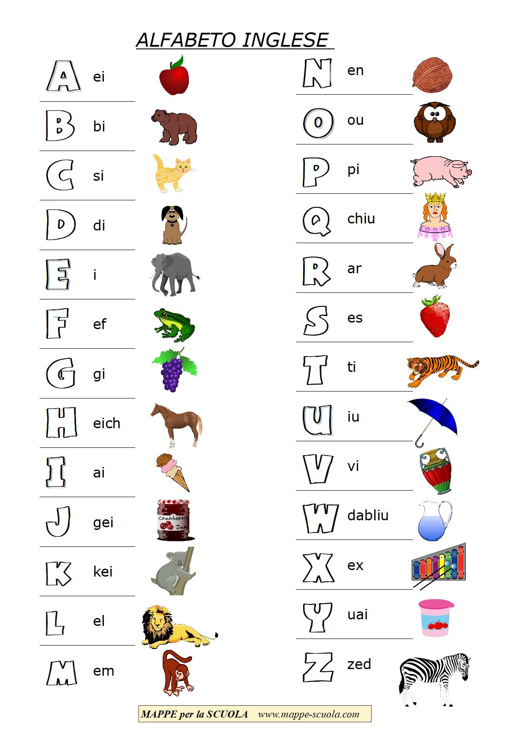
a
apple
B
bear
You continue on your notebook!

