Slide 1
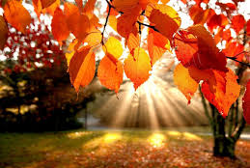
E’ AUTUNNO
CLASSE 4 A RODARI

Slide 2
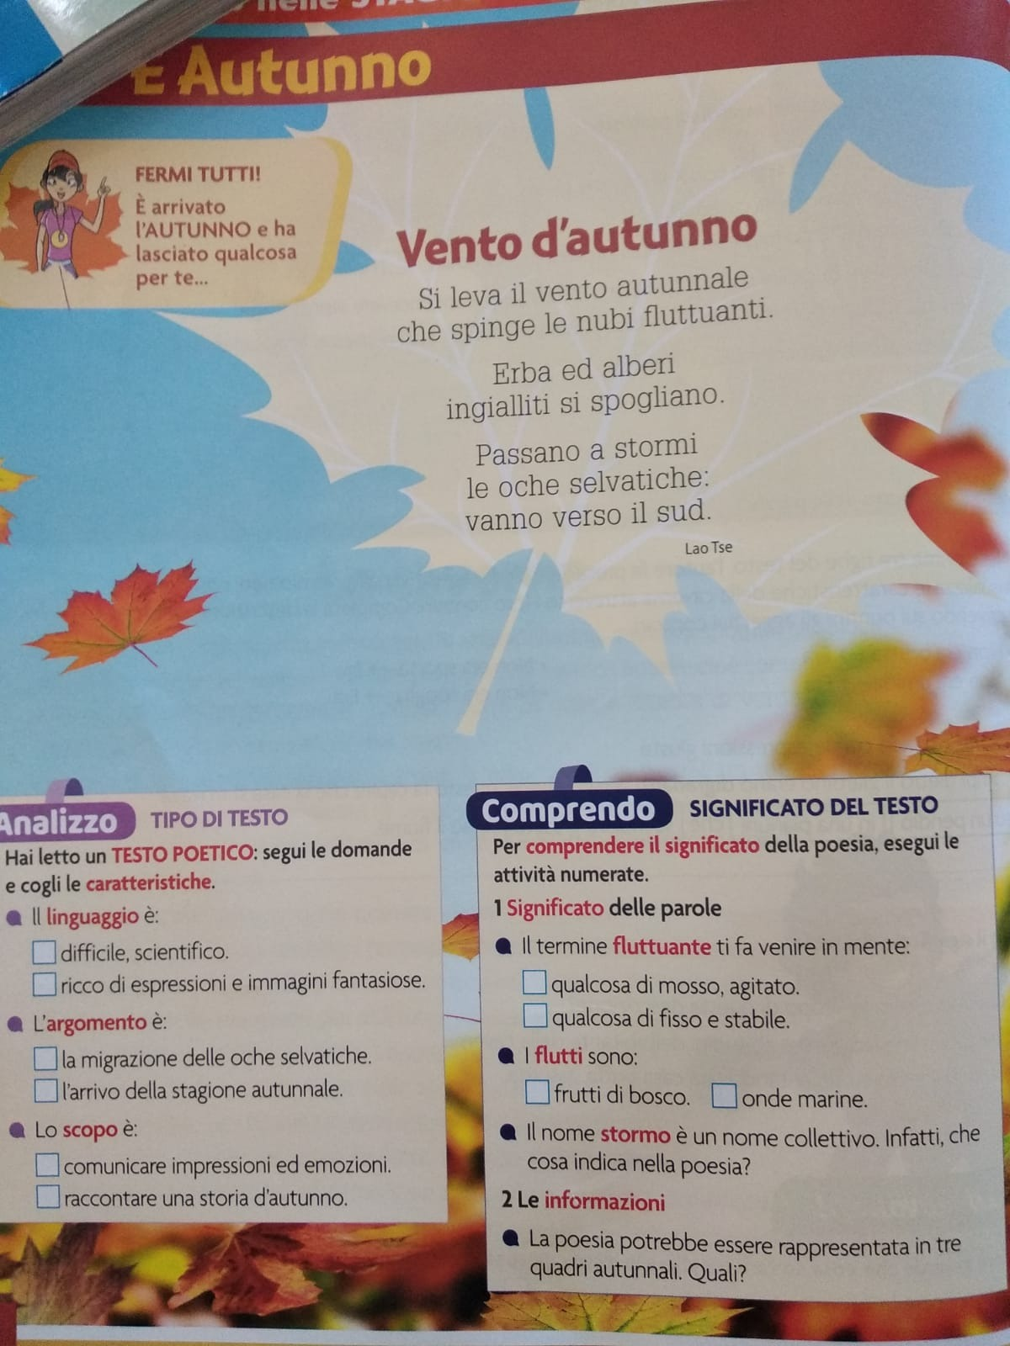
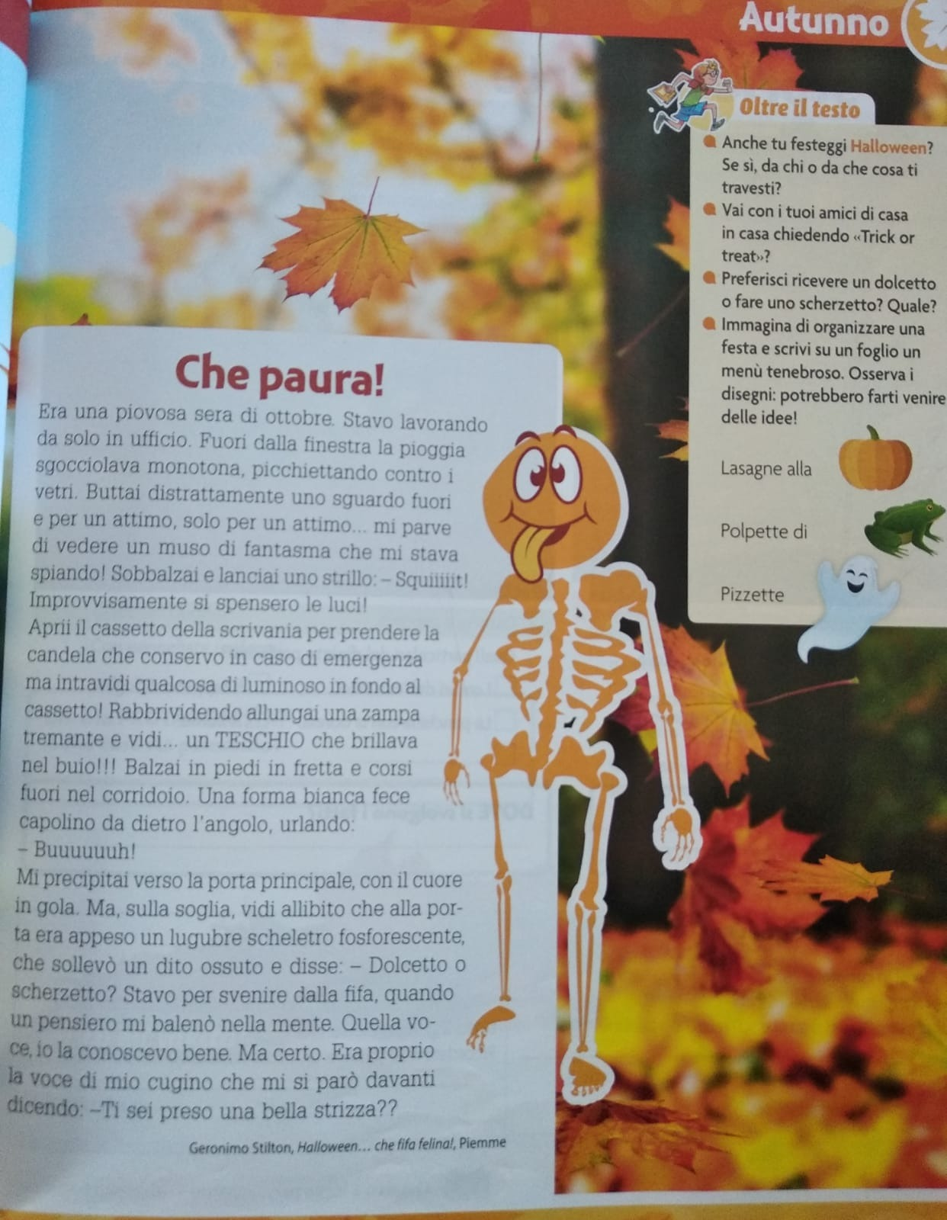


Slide 3
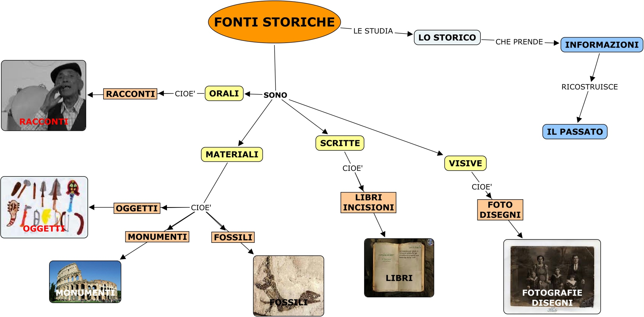
LE FONTI DELLA STORIA

Slide 4
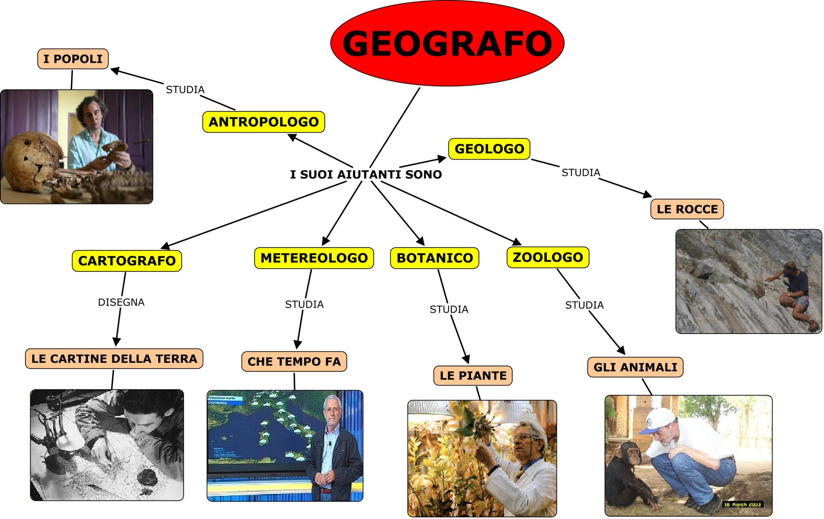
GEOGRAFIA
IL LAVORO DEL GEOGRAFO

Slide 5

Hello everybody?
How are you? I’m very well.
In this lesson we talk about Autumn season.

Slide 6

Listen, read and copy on the workbook.
Autumn
Autumn is one of the four season.
It is season between summer and winter. In this season the leaves are red, yellow, orange, brown. They fall from trees on the ground. In Autumn, it is windy and rainy. It is cool. In some countries like America Autumn is known as Fall.

Slide 7
Copy and read the exercise on the copybook . Then choose the right answer
What colour are the leaves?
A. They are red, yellow,orange, brown
B. They are green.
What’s the weather like?
A- It’ s rainy
B- it’s sunny
Autumn is one of the four season.
A- Yes, it is
B- No, it isn’t

Slide 8
Answer on the copybook
What’s your favourite season?
My favourite season is ________
Draw and colour your favourite season.
See you soon. Good work

