Slide 1


NUMBERS PLESSO RODARI INFANZIA
Teacher Teresa Calabria sez.Q-R

Slide 2
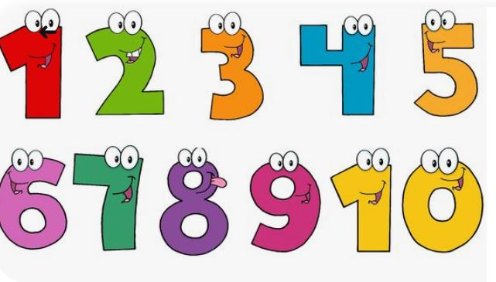
LISTEN AND REPEAT From one to ten

Slide 3
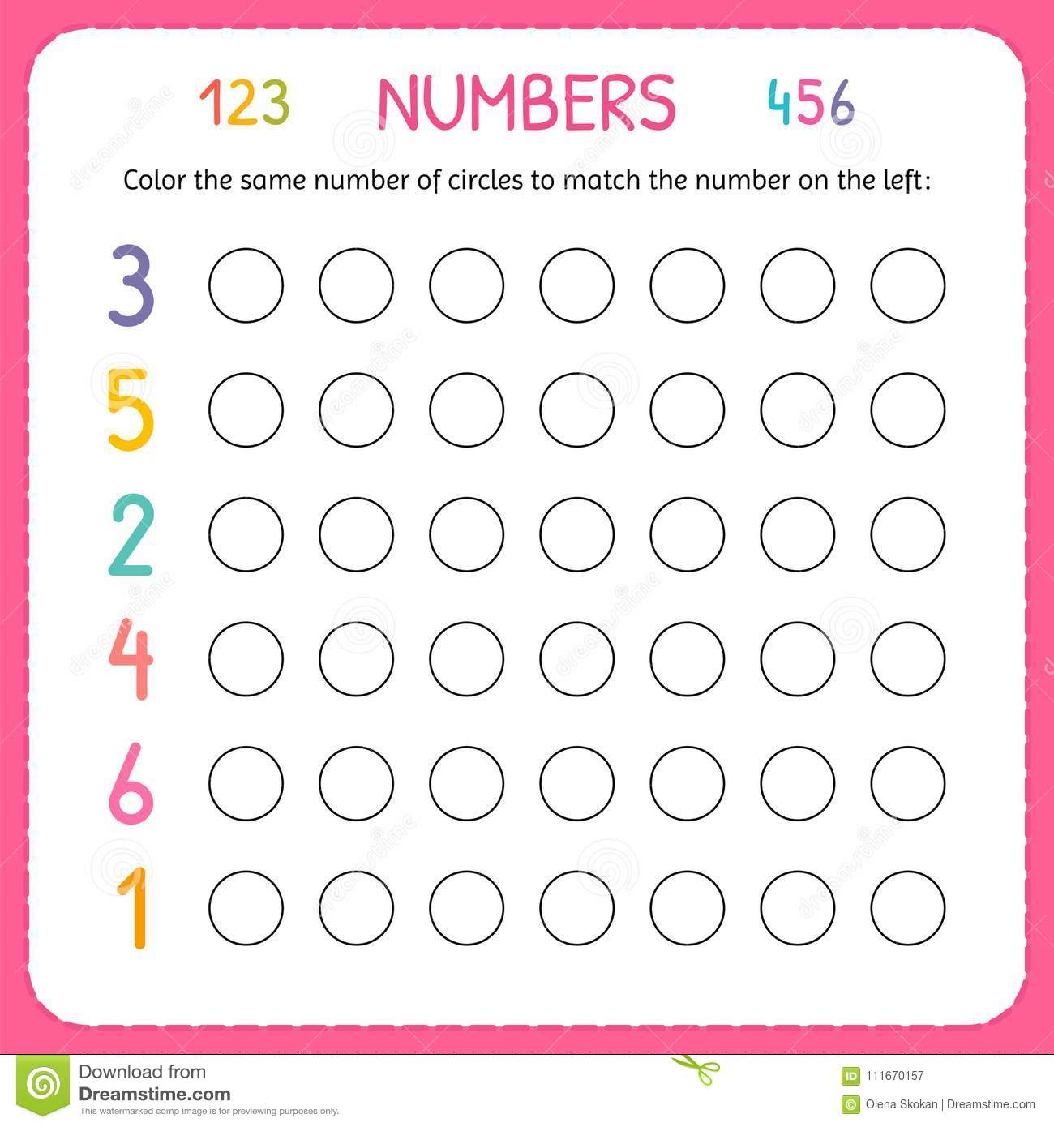
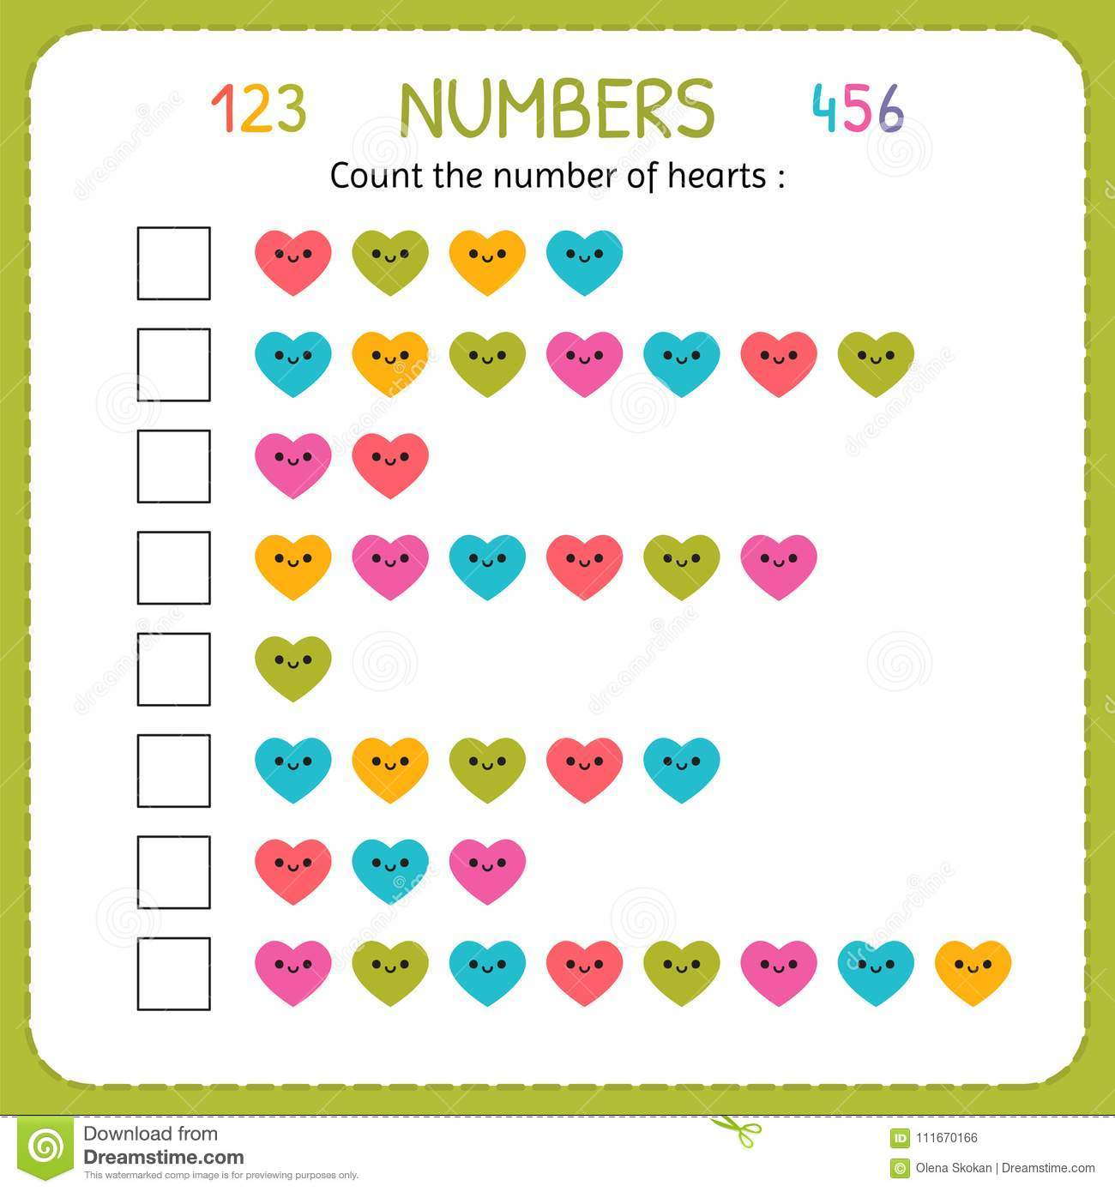

Slide 4
