Slide 1
WEATHER
II E CAPOLUOGO

Slide 2
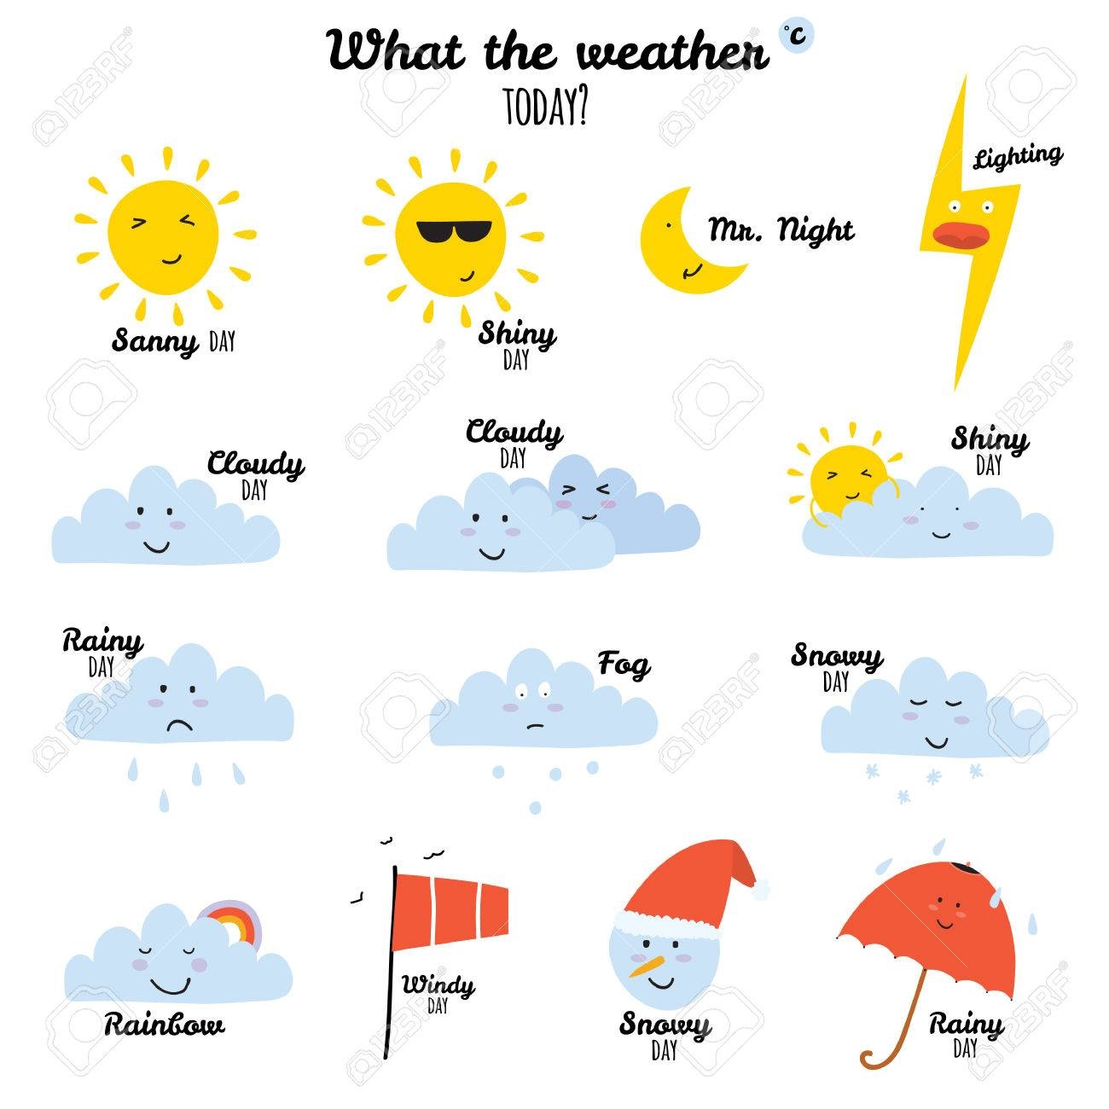
What’s the Weather like today?

Slide 3
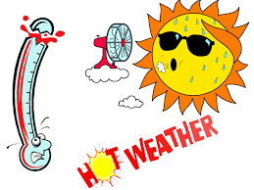
It’s sunny

Slide 4
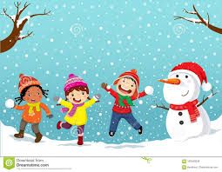
It’s snow

Slide 5
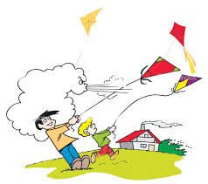
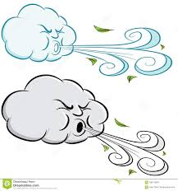
It’s windy

Slide 6
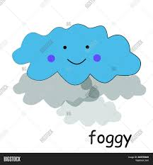
It’s foggy

Slide 7
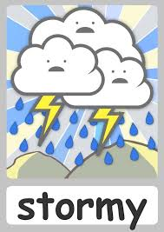
It’s stormy

Slide 8
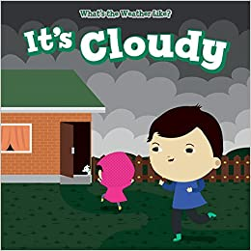

Slide 9
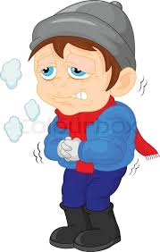
It’s cold

Slide 10
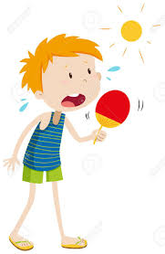
It’s hot

Slide 11
Listen and repeat https://www.youtube.com/watch?v=nA-jUj_9Uzw On your copybooks Draw and colour. Then copy the words

