Slide 1
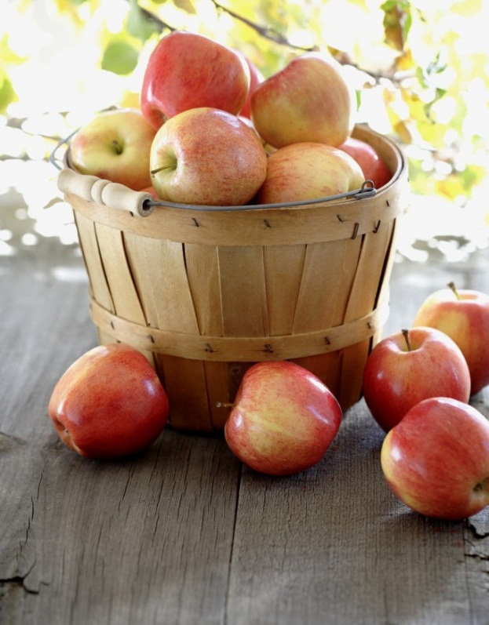
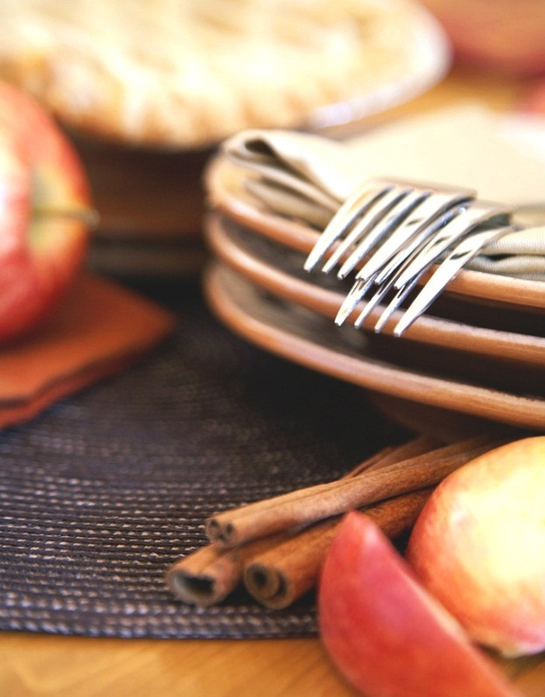
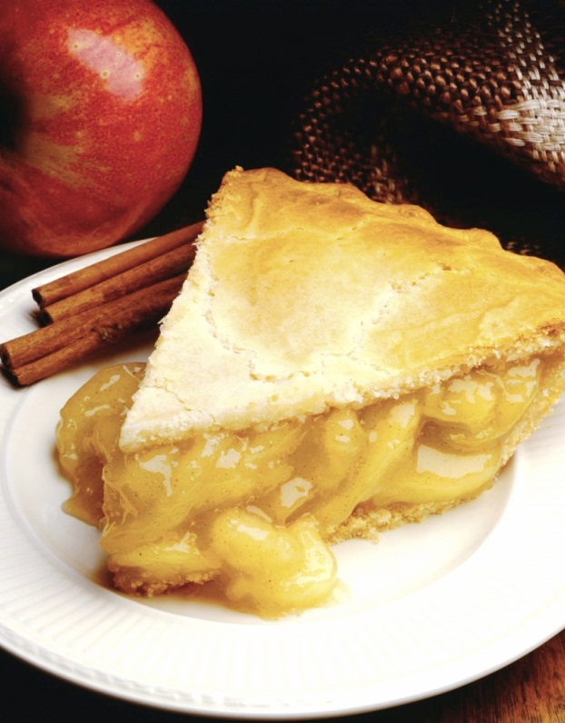
DO YOU LIKE…?
FOOD
Notes:
NOTA: per sostituire un'immagine selezionarla ed eliminarla, quindi usare l'icona Inserisci immagine per sostituirla con l'immagine desiderata.

Slide 2

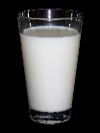
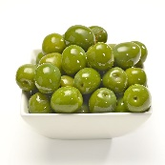
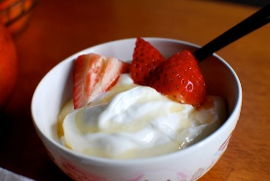
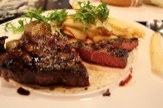

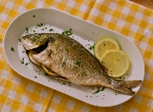
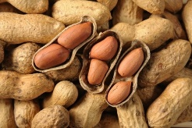


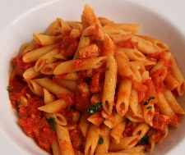

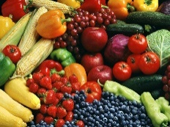
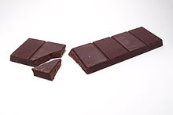
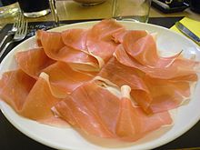
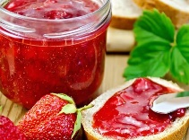
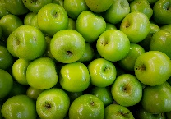
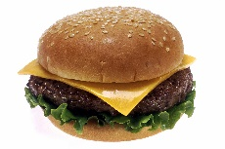
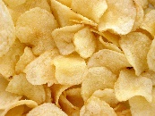
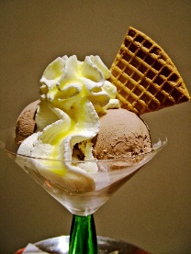

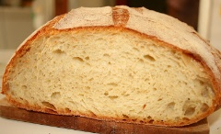
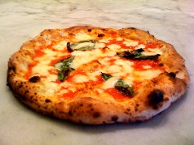
FOOD
BREAKFAST Milk Tea Coffee Chocolate Jam Honey | LUNCH Olives Pasta Ham Bread | AFTERNOON Yoghurt Peanuts Lemon Green apples Ice cream | DINNER Meat Fish Chicken Vegetables Hamburger Chips Pizza

Slide 3
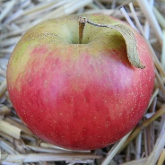
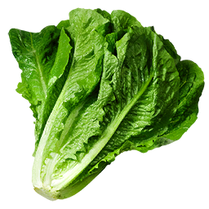
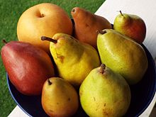
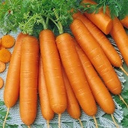

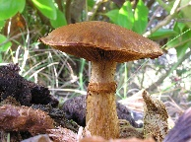
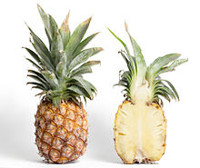
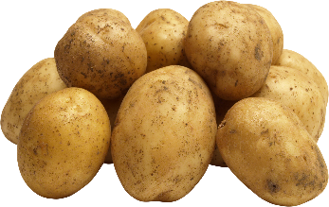

Fruits and vegetables
FRUITS APPLE PEAR GRAPES PINEAPPLE CHERRIES | VEGETABLES LETTUCES CARROTS MUSHROOMS PATATOES

Slide 4
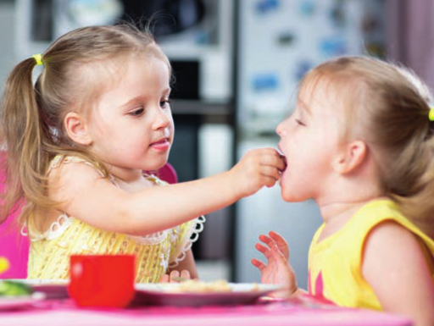
AT BREAKFAST…
YES I DO !!!!
IT’S MY FAVOURITE FOOD
DO YOU LIKE MILK AND CHOCOLATE?

Slide 5
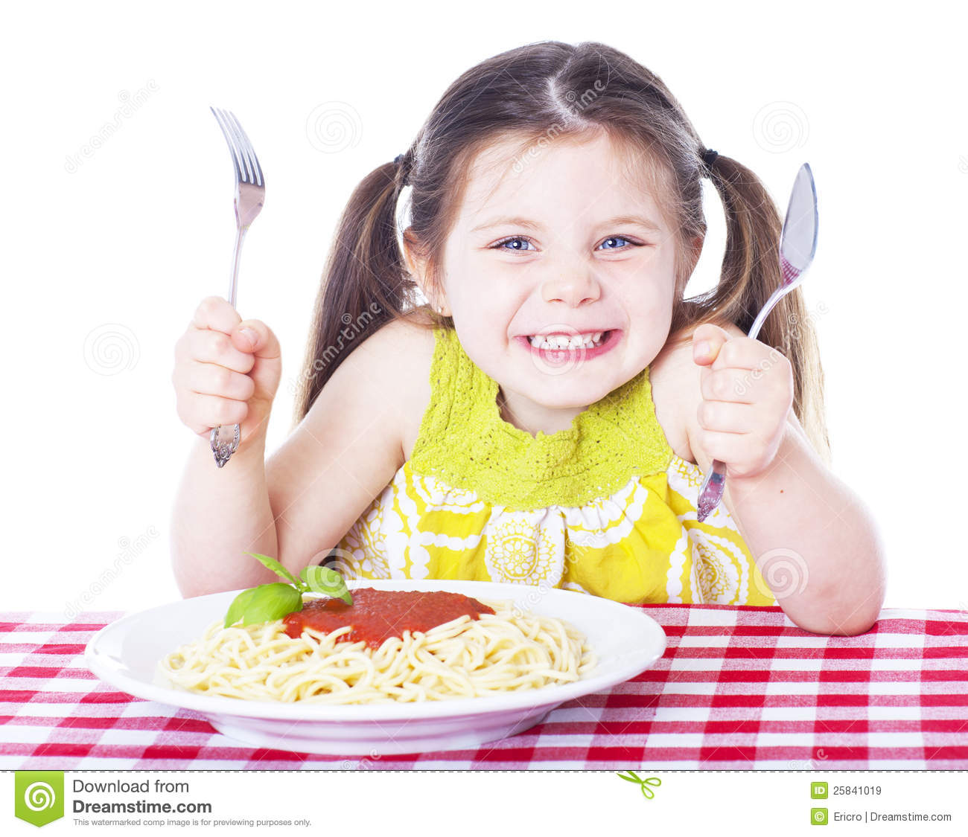
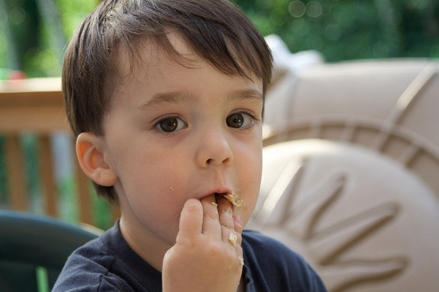
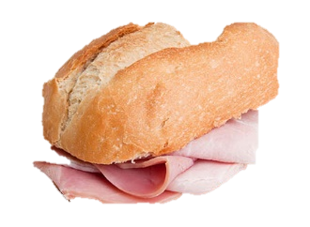
AT LUNCH…
I LIKE HAM AND BREAD!
I LIKE PASTA !

Slide 6
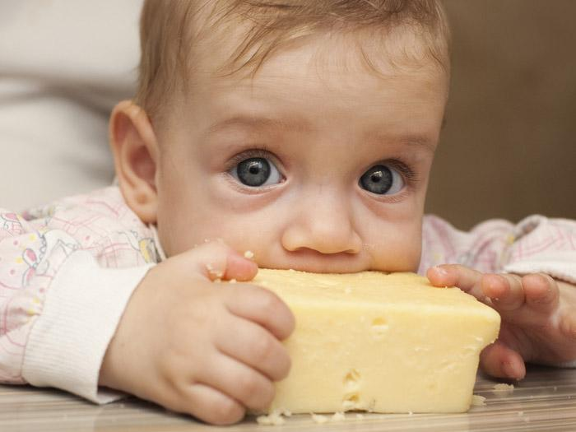
I LIKE CHEESE !

Slide 7

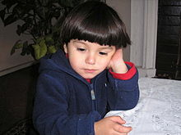
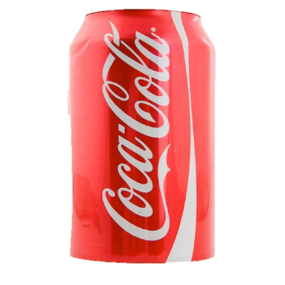

I LIKE COKE!
I DON’T LIKE WATER…..

Slide 8

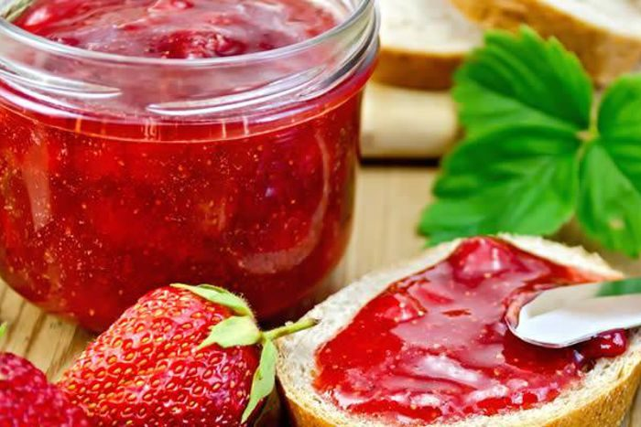
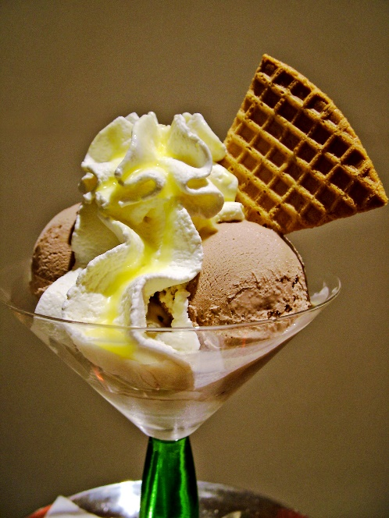
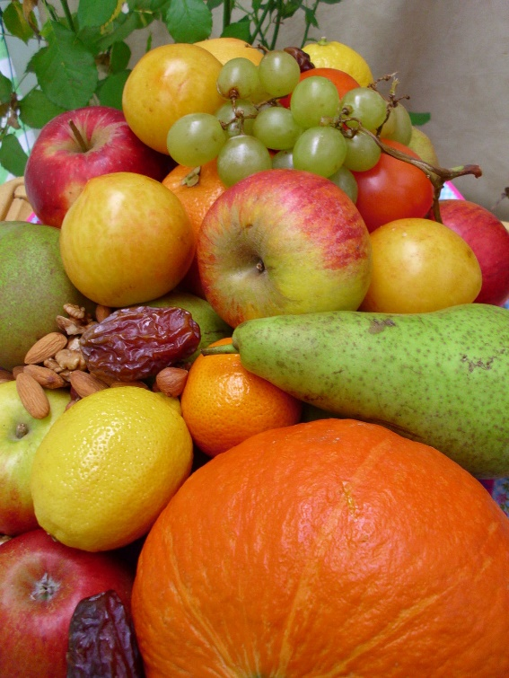
JAM
IN THE AFTERNOON
I LIKE…
ICE CREAM
FRUITS

Slide 9

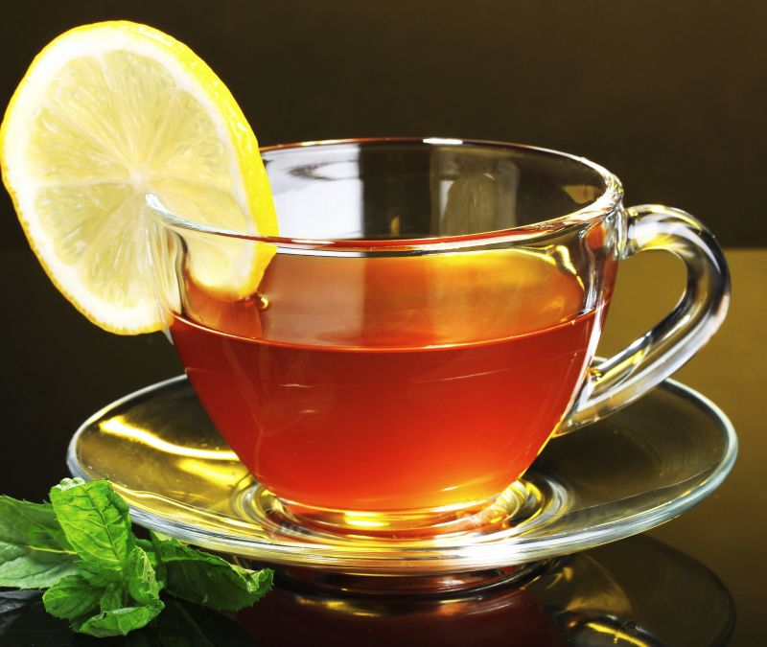

coffee
IN THE AFTERNOON
I DON’T LIKE…
tea

Slide 10
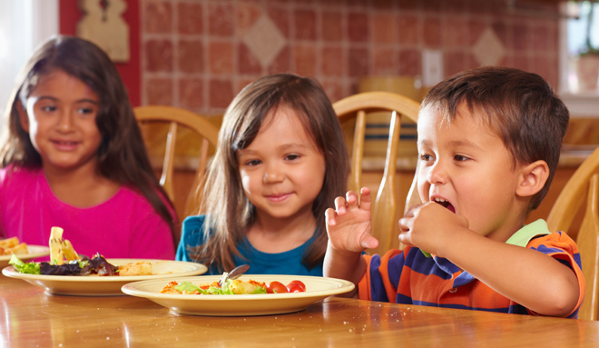
What do you like?
At dinner…
We like pizza !

Slide 11
Testo regolativo
LET’S MAKE A CHOCOLATE MILK SHAKE
Ingredients
Milk
Chocolate
Sugar
whipped cream

Slide 12
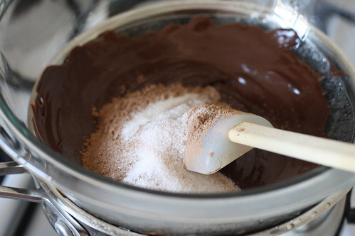
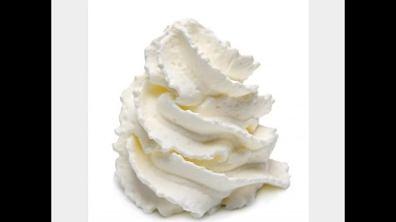
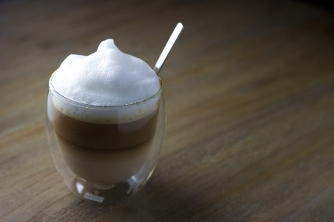
Instructions
Mix the sugar and chocolate in a mixer
Add milk and mix
Add whipped cream
Put it in a glass
Decorate milk shake with whipped cream

