Slide 1
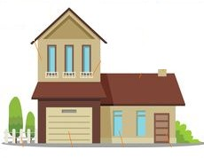

THIS IS MY HOUSE
CLICCA SULL’ ICONA PER ASCOLTARE L’AUDIO

Slide 2
IN MY HOUSE:
THERE IS A KITCHEN,
THERE IS A LIVING ROOM,
THERE IS A DINING ROOM,
THERE ARE THREE BEDROOMS,
THERE ARE TWO BATHROOMS.

Slide 3
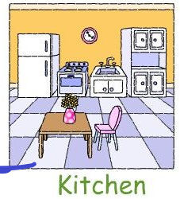
THIS IS MY KITCHEN
CUPBOARD
IN MY KITCHEN THERE IS :
(Nella mia cucina c’è)
A FRIDGE,
( un frigorifero)
A COOKER WITH AN OVEN,
( un fornello con un forno )
A SINK ,A CUPBOARD, A TABLE AND
( un lavello, una credenza , un tavolo e )
A CHAIR( una sedia)
FRIDGE
SINK
OVEN
TABLE
CHAIR

Slide 4
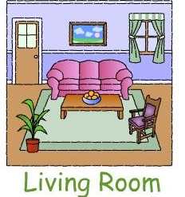
THIS IS MY LIVING ROOM
IN MY LIVING ROOM THERE IS :
( Nel mio soggiorno c’è)
A SOFA, AN ARMCHAIR, A COFFEE TABLE
( un divano, una poltrona , un tavolino da caffè)
A CARPET ON THE FLOOR,
( un tappeto sul pavimento)
A PAINTING ON THE WALL.
( un quadro sul muro)
THERE ISN’T A TV
( Non c’è un televisore)
PAINTING
COFFEE TABLE
SOFA
CARPET
ARMCHAIR

Slide 5
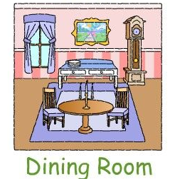
THIS IS MY DINING ROOM
PENDULUM CLOCK
IN MY DINING ROOM THERE IS :
(Nella mia sala da pranzo c’è)
A OLD PENDULUM CLOCK NEXT TO THE BUFFET,
( un vecchio orologio a pendolo accanto al buffet)
A TABLE.
( un tavolo)
THERE ARE TWO CHAIRS NEAR THE TABLE.
(Ci sono due sedie vicino al tavolo)
BUFFET

Slide 6
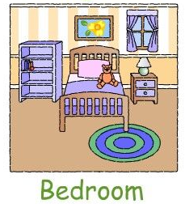
THIS IS MY BEDROOM
IN MY BEDROOM THERE IS :
( NELLA MIA CAMERA DA LETTO C’è)
A BED,
(UN LETTO)
A PILLOW ON THE BED,
(un cuscino sul letto)
A BEDSIDE TABLE NEXT TO THE BED,
( un comodino accanto al letto)
A LAMP ON THE BEDSIDE TABLE,
( una lampada sul comodino)
A RUG UNDER THE BED,
( un tappeto sotto il letto)
A BOOKSHELF NEAR THE BED,
( una libreria vicino al letto)
THERE ISN’T A WARDROBE.
( non c’è un armadio)
THERE AREN’T BOOKS
BOOKSHELF
WINDOW
PILLOW
LAMP
Bedside table
RUG
BED

Slide 7
THIS IS MY BATHROOM
IN MY BATHROOM THERE IS :
(Nel mio bagno c’è)
A WASHBASIN, A MIRROR , A BATHTUB,
( un lava, uno specchio, una vasca,)
A TOILET,
( un gabinetto)
BUT THERE ISN’T A SHOWER
( ma non c’è una doccia)
WASHBASIN
MIRROR
BATHTUB
TOILET

Slide 8
GRAMMAR
Nella UNIT «WHAT BEAUTIFUL CASTLE» ed in questo Power Point
«MY HOUSE» abbiamo incontrato alcune regole grammaticali come:
IN MY BEDROOM
THERE IS ( C’è) THERE ISN’T ( NON C’è)
THERE IS A BED THERE ISN’T A WARDROBE
THERE ARE ( CI SONO) THERE AREN’T ( NON CI SONO)
THERE ARE THREE BOOKS THERE AREN’T TWO CHAIRS

Slide 9
PREPOSITION OF PLACE
ON
(sopra/ su)
THE CAT IS ON THE CHAIR
NEXT TO
(accanto)
THE CAT IS NEXT TO THE BOWL
IN
(in/ dentro)
THE CAT IS IN THE BOWL
UNDER
(sotto)
THE DOG IS UNDER THE TABLE

Slide 10
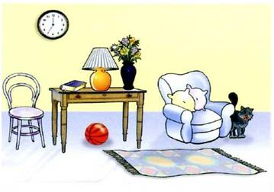
WHERE IS……………….? (DOV’è)
WHERE ARE……? (DOVE SONO)
WHERE IS THE CAT?
THE CAT IS NEXT TO THE ARMCHAIR
WHERE IS THE LAMP?
THE LAMP IS ON THE TABLE.
WHERE IS THE BALL?
THE BALL IS UNDER THE TABLE
WHERE IS THE CHAIR?
THE CHAIR IS NEAR THE TABLE
WHERE ARE THE FLOWERS?
THE FLOWERS ARE IN THE VASE

